Slide 1


LO#1 – Choose the appropriate infographic and chart based on data type.
LO#2 – Design appropriate visualizations for key performance indicators (KPIs).
LO#3 Apply appropriate visualizations that meet academic standards and follow APA 7th edition.
CHAPTER 6
Visualize Data With Purpose
Leveraging Data Visualization to Communicate Effectively
By Jennie Mitchell, Ph.D. Saint Mary-of-the-Woods College
and Trent Deckard, Indiana University

Slide 2

Content
01
Best Graphical Visualizations: Data
Type and Purpose.
02
Visualize Key Performance
Indicators
03
Academic Reporting Standards to
Accompany Visualizations

Slide 3


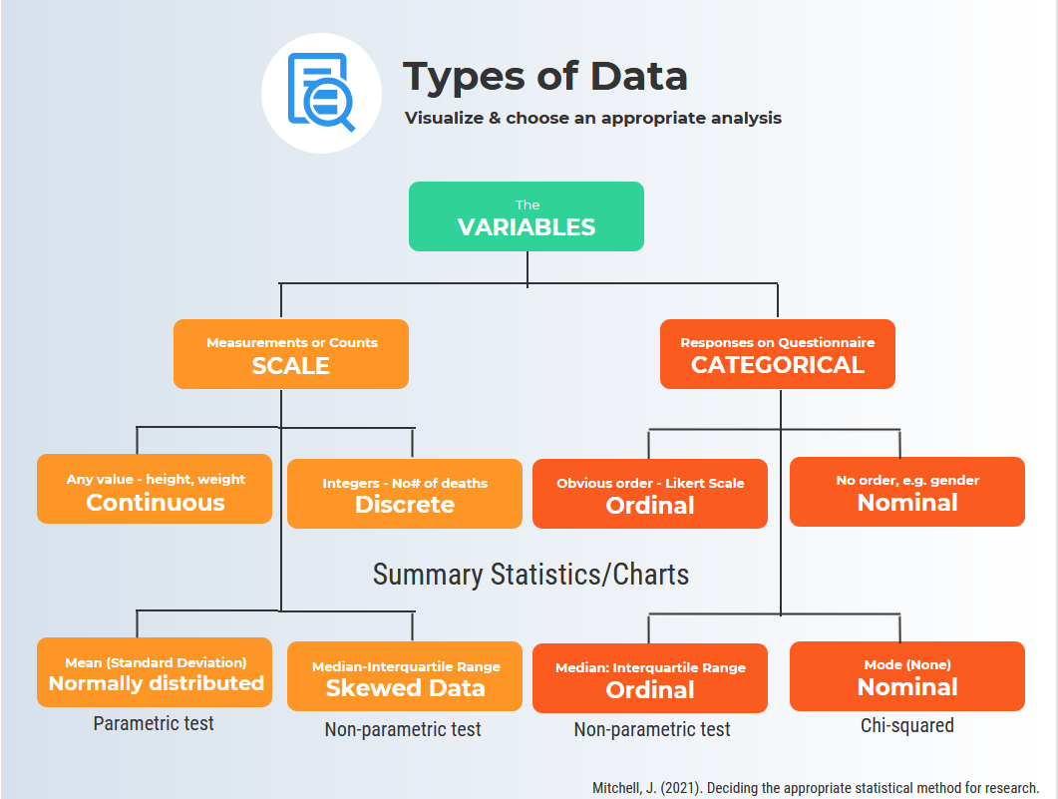
1. Types of Data:
Univariate, Bivariate, & Multivariate
Types of Variables
Univariate dataset: consists of observations on a single variable made on individuals in a sample. (for example - height)
Bivariate dataset: Where two different characteristics are measured simultaneously (for example, swimming pool attendance and temperature). Usually, the researcher is trying to find out the relationship, causes and explanations. These variables are often plotted on X and Y axis on various graphs. One variable is dependent, and one is independent.
Multivariate dataset: When the data involves three or more variables. (For example, a marketing researcher wants to compare three different social media ads using the click-through rate for both men and women.

Slide 4
1. Types of Data: Nominal
Nominal Scale
Nominal scale describes the variable with categories. “If you were to assign a numerical value to a category, a higher score would not necessarily mean that there was more of some quality” (Adams and McGuire. 2022, p. 66)
Example of nominal variables: zip code, eye color, political party, gender
Calculations: Frequency distribution, percentages, mode, describing ranking
Visualizations: Bar charts, pie charts. Nominal data represents categories with no inherent order, so visual representations focus on the distribution of categories.

Slide 5
1. Types of Data: Ordinal
Ordinal Scale
“Ordinal scales represent rankings that have magnitude, but we do not assume that the intervals between the rankings are equal. Because we do not assume equal intervals with ordinal data, we do not calculate the mean and standard deviation” (Adams & McGuire, 2022, p. 154).
Example of ordinal variable: social economic status – low income, middle-income, high-income Survey responses like a satisfaction rating (extremely dislike, dislike, neutral, like, extremely like)
Calculations: Frequencies, percentages, median
Visualizations: Bar charts, stacked bar charts, line charts. Since ordinal data has a meaningful order, display the rank order of categories.

Slide 6
1. Types of Data: Interval
Interval Scale
“Interval scales are ratings in which we assume there are equal intervals between scores…, do not have a true zero” (Adams & McGuire, 2022, p. 154).
Example of interval variable: SAT Score (200-800), Credit score (300-850)
Calculations: Frequencies, percentages, (*mean if normally distributed, median if not), standard deviation
Visualizations: Histograms, line charts, box plots. Interval data allows for meaningful differences between values, so you can use more advanced statistics like mean and standard deviation.

Slide 7
1. Types of Data: Ratio
Ratio Scale
“Ratio scales measure quantity and have both equal intervals and a true zero” (Adams & McGuire, p. 154).
Example of a ratio variable: pulse, weight, dose amount, income, age
Calculations: Frequencies, percentages, mean if normally distributed, or median if not normally distributed), standard deviation, range
Visualizations: Histograms, line charts, box plots, scatter plots. Ratio data, like interval data, allows for more advanced calculations. In addition to the mean and standard deviation, you can also calculate the range. Scatter plots are useful for exploring relationships between two ratio variables.

Slide 8



Graphical Display | Analysis Level | Data Type | Purpose | Summary Statistic
Bar chart | Univariate for 2 or more groups | Categorical: Nominal or Ordinal | Compare frequencies or proportions | Frequency, Percentage
Comparative Bar Chart | Univariate for 2 or more groups | Categorical: Nominal or Ordinal | Compare frequencies or values across categories | Frequency, Percentage, mean
Pie Chart | Univariate | Categorical: Nominal | Show proportions of a whole | Percentage
Box plot | Univariate for 2 or more groups | Scale: Interval, or Ratio | Show distribution and identify outliers | Median, Quartiles, and IQR, and outliers
Dot plot | Univariate | Both: Categorical or Scale | Display individual data points | Depends on the type of data
Comparative dot plot | Univariate for 2 or more groups | Categorical: Nominal or Ordinal | Compare individual data points across categories | Depends on the type of data
Stem-and-leaf display | Univariate | Interval, or Ratio | Show distribution and individual data points | Display counts
Comparative stem-and-leaf display | Univariate for 2 groups | Interval, or Ratio | Compare 2 or more groups of individual data points | Display counts to compare
Histogram | Univariate | Scale: Interval, or Ratio | Display distribution of continuous data | Mean, Median, Standard deviation
Scatterplot | Bivariate | Scale: Interval, or Ratio | Explore relationships between two variables | Correlation coefficient
Time series plot | Univariate, collected over time | Scale: Interval or Ratio | Investigate trends over time | Means by time point (if appropriate), Median, Time-related statistics
Bubble Chart | Bivariate | Both: Categorical and Scale | Display three dimensions of data with markers | Depends on the type of data
Heatmap | Univariate or Bivariate | Both: Categorical or Scale | Visualize the magnitude of a phenomenon | Mean, Median (if applicable)
1. Chart Types
Triangle or Pacman?
All interns worked approximately the same number of hours per week, but on different days with some overlap with other interns – 4-hour shifts.
Gestalt Principle of Closure
Gestalt Principle of Figure Ground
Gestalt Principle of Figure Ground
Always consider the context and purpose. And always see if your data is normally distributed. It will impact what statistic you report (mean or median) and will impact the type of statistical test (parametric or non-parametric).
Which graphical display fits the purpose?
Notes:
Charts matter – What message do you wish to convey?

Slide 9
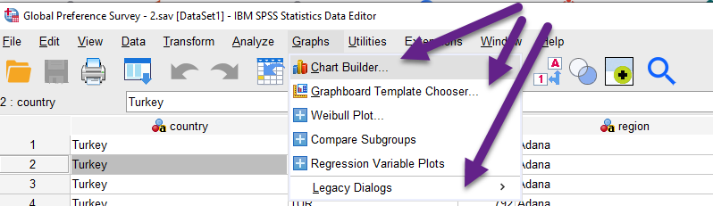
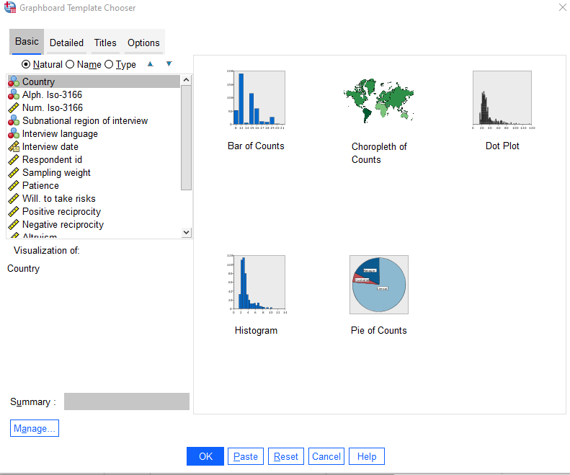
1. Charts
& Graphs
In SPSS
Gestalt Principle –
Proximity
Gestalt Principle –
Similarity and Dissimilarity
Graphboard
Template Chooser
in SPSS

Slide 10
1. Consider Purpose: Labels, Font Size, and Type
Label Data Points OR use the Axis
Font Size and Type – study
Consider your purpose when deciding to use either an axis label or labeling the data points directly. For big picture trends, use the axis. If specific values are important, label the data point. So, if you label the data point, eliminate the axis.
Another important aspect is font type and font size. Keep it simple and choose fonts that are easy to read. A study conducted by Song and Schwarz (2008) gave students instructions on exercising. Half the students were given written instructions in an easy-to-read Arial font. The other half were given instructions using a brushstroke font. The results? Students with the script font (brushstroke) expected the exercise routine to be difficult and indicated they were less likely to try it. So, if your chart looks complicated, the message may get lost.
Your brain loves simplicity and will process simple patterns, so consider supporting the patterns by sorting the data.
Western Cultures read from the left to right
and from top to bottom.

Slide 11
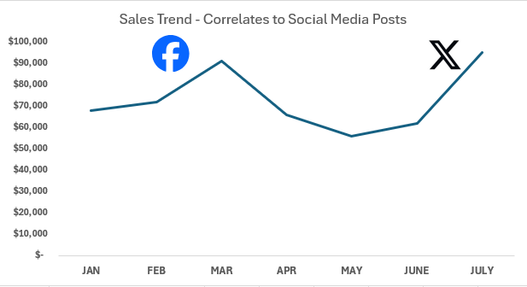
1. Consider Purpose: Default & Emphasize
Visual Noise
Emphasize Purpose
Excel’s default settings for graphs will include gridlines, two decimal places, tick marks, and its own interpretation for colors. Excel will also include a legend that you might not need, as well as a poor title name and field buttons. Some experts refer to these as “visual noise.”
If you have a specific chart style preference, the ideal step is to create a chart template, rather than customizing each chart.
Many data storytellers use arrows to draw the audience’s attention. However, you can also use images with annotations.
Create a custom chart that uses your organization’s branding colors..
Example: You notice your online user visits increases every time you post a sale on Facebook or X. You can add Facebook’s logo or “X’s logo above
the higher trendline.

Slide 12
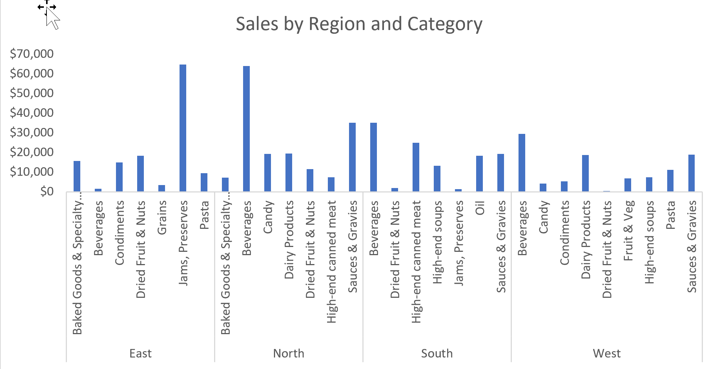
1. Consider Purpose:
Pre-chunk
Pre-chunk four to seven pieces
Too many chunks of data
Most people can only process four to seven pieces of information, so it makes sense to evaluate the data and think of how best to show it.
Suppose your main point is to show the largest sale category for each region with a sense of the variety of products sold. The graph on the right gives you that information, but it exceeds the information.
Ideal number of pre-chunked data is
4 for long-term memory.
You have the main products from the East, North, South, and West regions, but it exceeds the ideal pre-chunk of data..

Slide 13
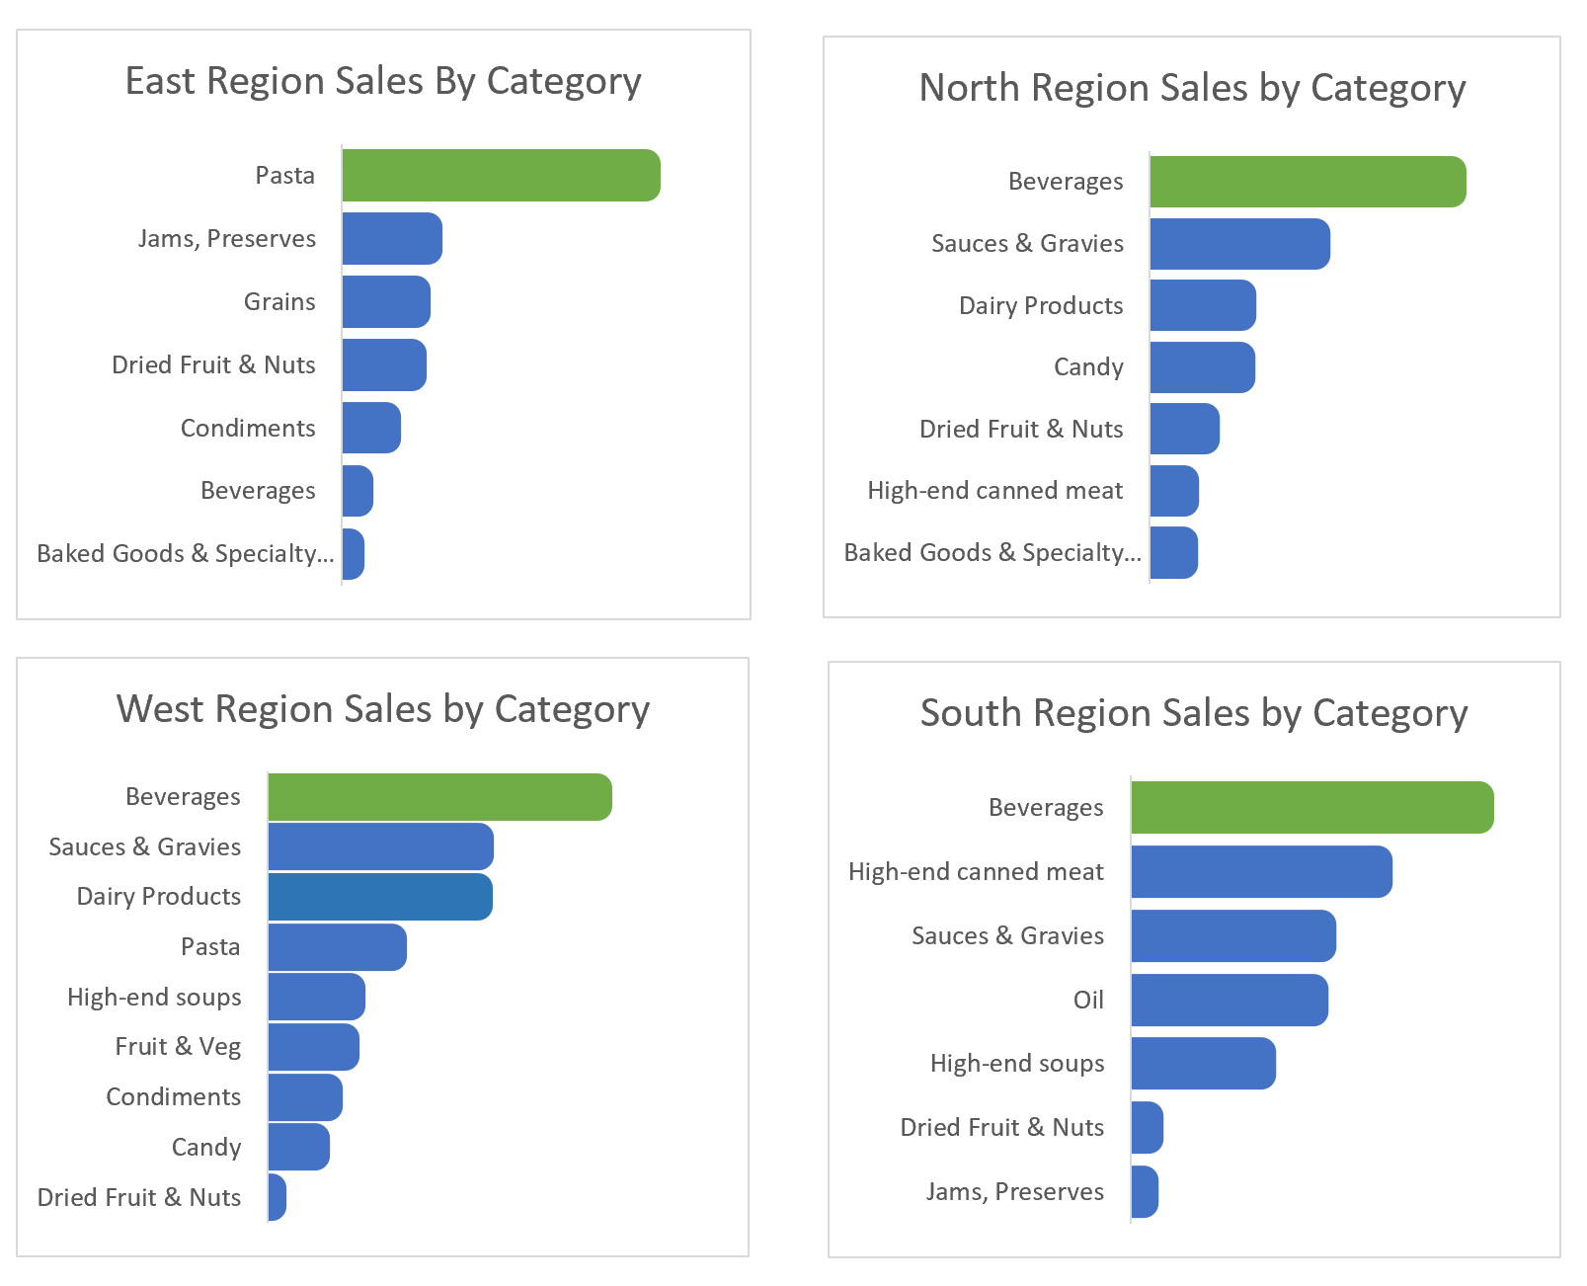
Consider Purpose:
Pre-chunk
Pre-chunk four to seven pieces
Split the one chart into four
Insight #1: In the multiple charts, it is obvious that three out of four regions have beverages as the largest sales category.
Insight #2: In the multiple charts, the West region, has the largest variety of products.
Insight #3: Pasta is the highest sales in the East, but pasta is barely represented in the other regions. What insight could a presenter bring for this finding?
Ideal number of pre-chunked data is
4 for long-term memory.
You have the main products from the East, North, South, and West regions, sorted by highest to lowest product.

Slide 14
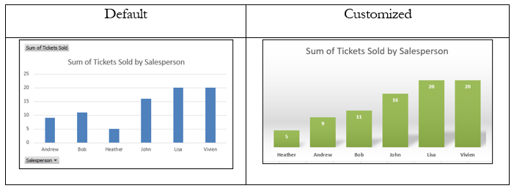

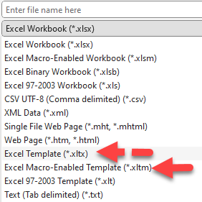
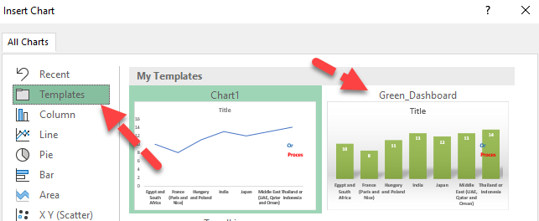
Report, Inform, Explain, Announce
1. Custom Templates in Excel
The default template design may not match your branding. Customize the chart using ‘Save as Template.’
Once the template is saved, you can find it in the Template folder.

Slide 15
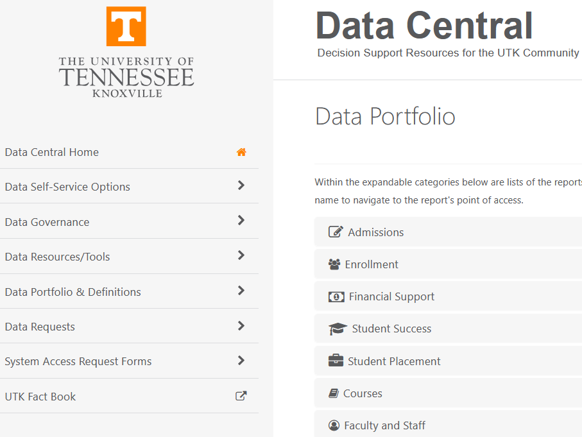
2. Data Central & KPI
- How do we define KPI?
The University of Tennessee, shares Data Central
Think about what we mean when using the workds “key, performance, and indicator.”
Key = major contribution to success or failure
Performance = Provides measurable, quantifiable, and controllable elements
Indicator = Valid representation of present performance
Attentive Processing – How many 5’s?
Visit https://data.utk.edu/executivedashboard/ to see the dashboards in the data portfolio of The University of Tennessee

Slide 16
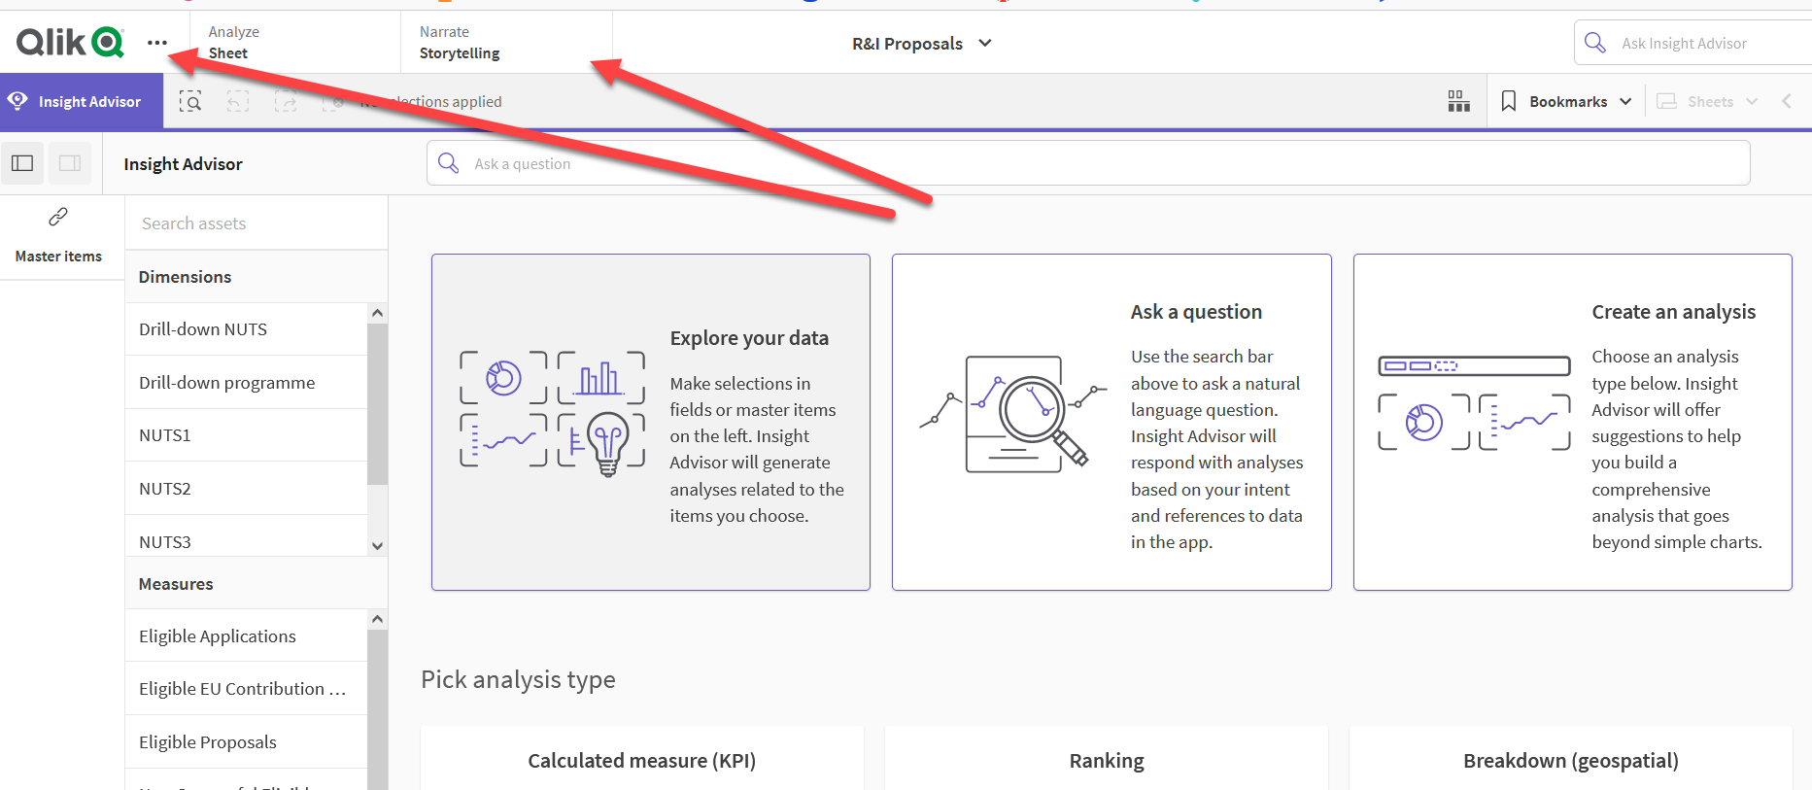
2.Visualize KPI’s with Qlik
European Commission uses
Qlik and Narrative Storytelling
Qlik -
The European Union uses Qlik to add a “Narrative Storytelling” feature so a user can take snapshots of current graphics and create their own story.
Look at this ‘before’ chart. What do you find distracting?
Qlik Help. (2022, Apr 29). Building Your Story. [Video]. YouTube. https://www.youtube.com/watch?v=vRlBeOOFECA

Slide 17

2.Visualize KPI’s With Infographics
United Nations Sustainable Development Goals (SDGs)
SDG KPIs Video
The United Nations Sustainable Development Goals (SDGs) represent an ambitious agenda aimed at addressing global challenges, ranging from climate action to social equality. KPIs play a pivotal role in tracking the progress of each goal, providing a quantifiable framework for assessing impact. The point to make here is the use of icons that drive every report.
Look at this ‘before’ chart. What do you find distracting?
United Nations. (2018, Apr 20). Do you know all 17 SDGs? [Video]. Youtube. https://youtu.be/0XTBYMfZyrM?si=XqUZ9hz0Eb24nsWm
Notes:
Look at how thoroughly the United Nations carries out the icon and even the icon color. For example, Goal 1 is “No Poverty” and bright red background. If you click on goal 1 at https://sdgs.un.org/goals, and scroll down, the infographic is a white background with red lettering with the title “End poverty in all forms everywhere.” Try visiting the website to notice how well the United Nations uses color and icons to keep a wealth of data organized. Visualization of KPIs often take the form of interactive dashboards, heatmaps and thematic charts.

Slide 18
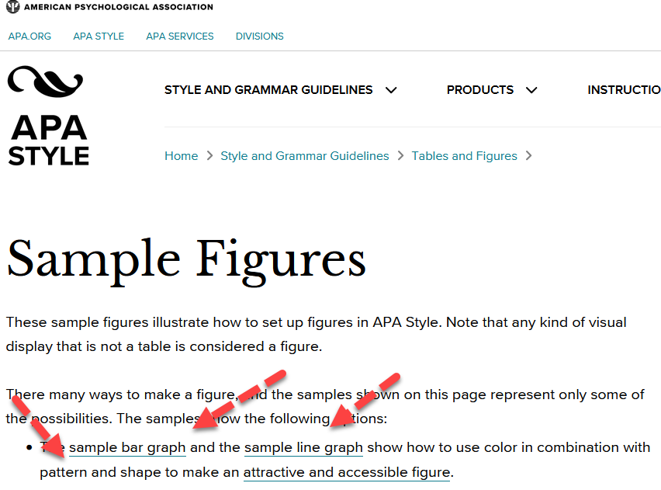
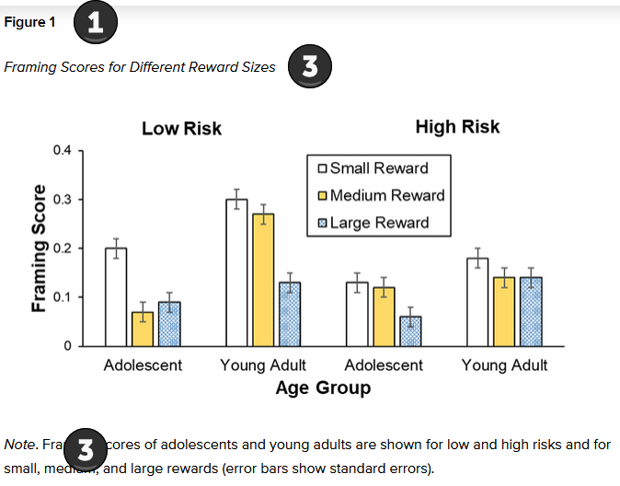
3. Academic Reporting
Using APA 7th Edition Standards
Sample Figure
APA shows a heading Figure (1), then a Title (2), the actual figure, and note or source (3)
Visit the APA Style Website: https://apastyle.apa.org/style-grammar-guidelines/tables-figures/sample-figures
Notes:
APA has very specific guidelines for reporting information. Make sure you review these before creating visuals for an academic writing assignment.

Slide 19
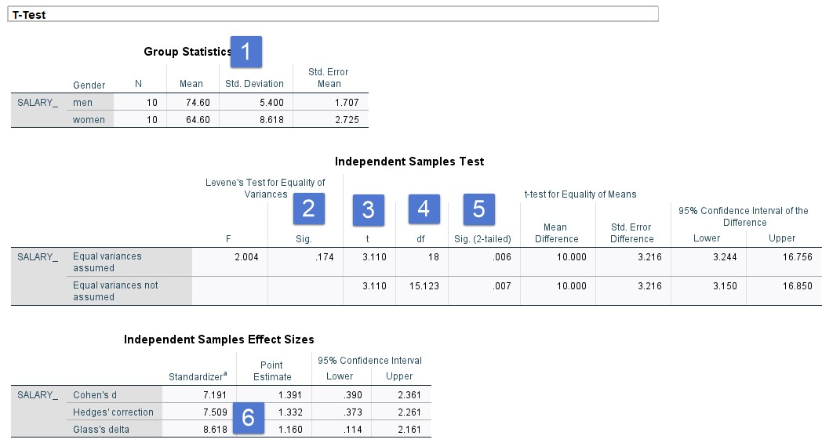
3. Reporting: t-test
Sample T-Test Information - Output from SPSS
Explanation
#1—Include the mean and standard deviation of both groups
#2—Include Levene’s test result
#3—Include the calculated t-value
#4—Include the degrees of freedom
#5—Include the significance (report p values less than .001 as p < .001)
#6—Include the effect size

Slide 20
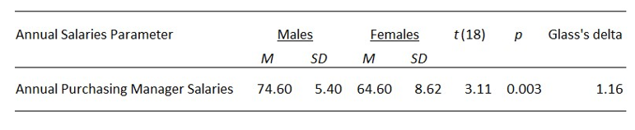
3. Reporting: t-test
Sample T-Test Information – APA table
T-test Write-up
Table 2
Results of t-Tests comparing salaries by males and females for Purchasing Managers
An independent t-test sample was conducted to compare annual salaries for male purchasing managers and female purchasing managers. Levene’s Test for equality of variance (showed no violations, p = .174). Results indicate that males (M = 74.60, SD = 5.40) earned significantly more than females (M = 64.40 and SD = 8.618). (t (18) = 3.11, p < .001, Glass’s delta = 1.160. The effect size is high; the difference between the two means is more than one standard deviation.
American Psychological Association. (2023). APA Style—Sample Tables. Sample tables (apa.org)
Visit: https://apastyle.apa.org/style-grammar-guidelines/tables-figures/sample-tables.

Slide 21
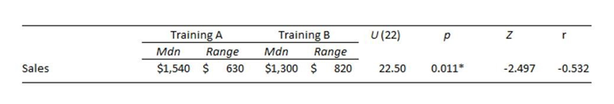
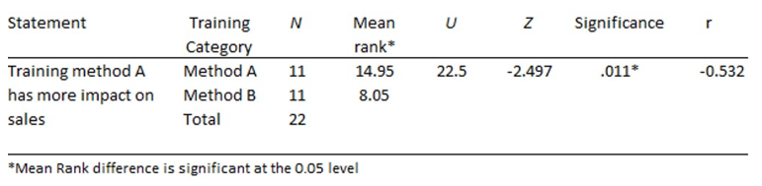
3. Reporting: Mann-Whitney U Test
Mann-Whitney U Test – APA table
Mann-Whitney U Test Write-up
Table 3
Results of Mann-Whitney U Test for Training Method A and B
Training method A had sales of (Mdn = $1540, n=11) and were higher than those in training method B (Mdn = $1300, n=11). A Mann-Whitney test indicated that this difference was statistically significant, U = 22.5, Z = -2.497, p =.011, with a larger effect size, r = -.5324, 95% CI [80, 510].
Table 4
Results of Mann-Whitney U Test Training method A Impact
Visit: https://apastyle.apa.org/style-grammar-guidelines/tables-figures/sample-tables.

Slide 22
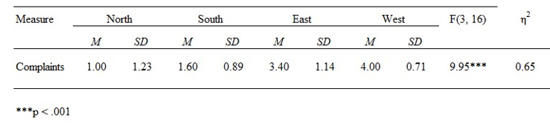
3. Reporting: ANOVA
ANOVA– APA table
ANOVA Test Write-up
Table 6
Title related to the study
There was significant difference among the four regions on COVID-19 mask complains, F(3, 16) = 9.951, p < .001, η²p = .65. Post hoc testing revealed significant differences between pairs of regions with North (M = 1.0, SD = 1.23) and South (M=1.60, SD = .89) having fewer complaints than East (M= 3.40, SD = 1.14) and West (M = 4.00, SD =0.71). These findings indicate that there are more complaints in the East and West regions.
See textbook for details on study.
Visit: https://apastyle.apa.org/style-grammar-guidelines/tables-figures/sample-tables.

Slide 23


Ch 6 Case
Create Infographics & Charts

Slide 24




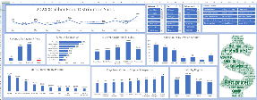

  Step 5
Post the PowerPoint and be ready to discuss insights.
  Step 4
Research and provide insight about the online retail sector
  Step 3
Comparison Report
Use animation (like Flourish or PowerPoint features for animation
  Step 2
Create graphs for both tables. Embed them in PowerPoint. Use sparklines for Online Retail Sector Revenue.
Step 1
Learning Objective :
#1: Choose the appropriate infographic and chart based on data type.
#2. Design appropriate visualizations for KPIs
Calculate the percent growth for Walmart

Slide 25




Chapter 6
THANK YOU
Jennie Mitchell, Ph.D.
jmitchell@smwc.edu
Saint Mary-of-the-Woods College
Trent Deckard
Trent.deckard@smwc.edu
Saint Mary-of-the-Woods College

