Slide 1


LO#1 – Evaluate data storytelling for effectiveness.
LO#2 – Differentiate between effective and ineffective data visualizations.
LO#3 – Apply design principles to evaluate infographics.
LO#4- Differentiate between static, interaction, and video infographics.
LO#5 – Design an effective infographic using a free application.
LO#6 – Recognize bias and unethical use of data.
CHAPTER 2
What is Data Visualization?
Leveraging Data Visualization to Communicate Effectively
By Jennie Mitchell, Ph.D. Saint Mary-of-the-Woods College
and Trent Deckard, Indiana University

Slide 2

Content
01
Storytelling and Complex Data
02
Evaluating Data Visualizations
03
Evaluation and Context
04
Infographic Basics

Slide 3



1. Storytelling and Complex Data
Design Thinking Approaches
Contextualization: Reflect the audience’s world using real-life examples, mini-stories, and supporting media like video or audio. A clear story arc can guide understanding and evoke emotional connection even without physical presence.
Engagement: Interactive elements such as dashboards, filters, or live queries invite exploration and build involvement. Techniques like foreshadowing create suspense and keep users curious.
Emotional Connection: Use metaphors, symbolism, and storytelling devices to give the data emotional resonance. Prototyping and ethical considerations ensure the visuals are meaningful and inclusive.
Simplification & Clarity: Design thinking fosters collaboration, ensuring visuals are accessible and meaningful to diverse audiences with varying expertise.
Guiding Attention: Anchor visual storytelling in familiar goals and components, like KPIs, to make key takeaways instantly recognizable.
Retention & Comprehension: Tailor content to individual users and test visualizations with pilot audiences. Use tools like eye-tracking and follow-up questions to evaluate what resonates and sticks.

Slide 4
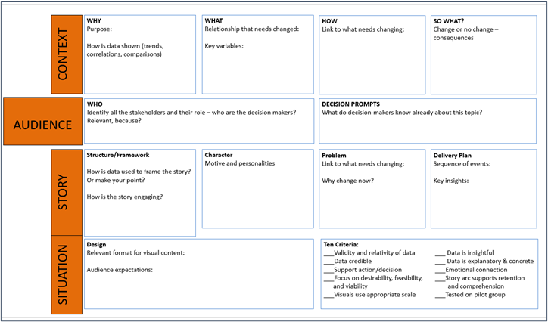
CASS Storytelling Framework

Slide 5

2. Evaluating Data Visualization
Good rules of Data Visualization
1. data tell the truth, and visuals use appropriate scale
2. data are valid, accurate, relatable, and credible
3. data are insightful, explanatory, and concrete
4. data are transparent and supports the action or decision
5. the consumer of the data is provided with relevant context that impacts the data (e.g., maps are representative of population density centers).

Slide 6
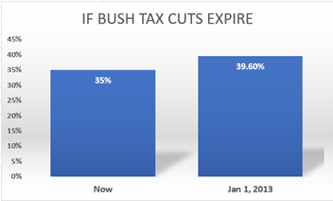
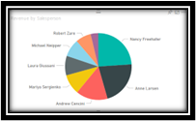
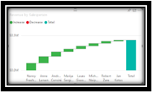
Evaluating Data Visualization
The Good
The Bad
The Ugly
Bar chart starts with a 0.00 scale. Doesn’t distort the data.
Pie chart has too many slices. Information incomplete. Will distract audience.
A waterfall chart, used here, is good for showing increases and decreases. This chart will be confusing.

Slide 7
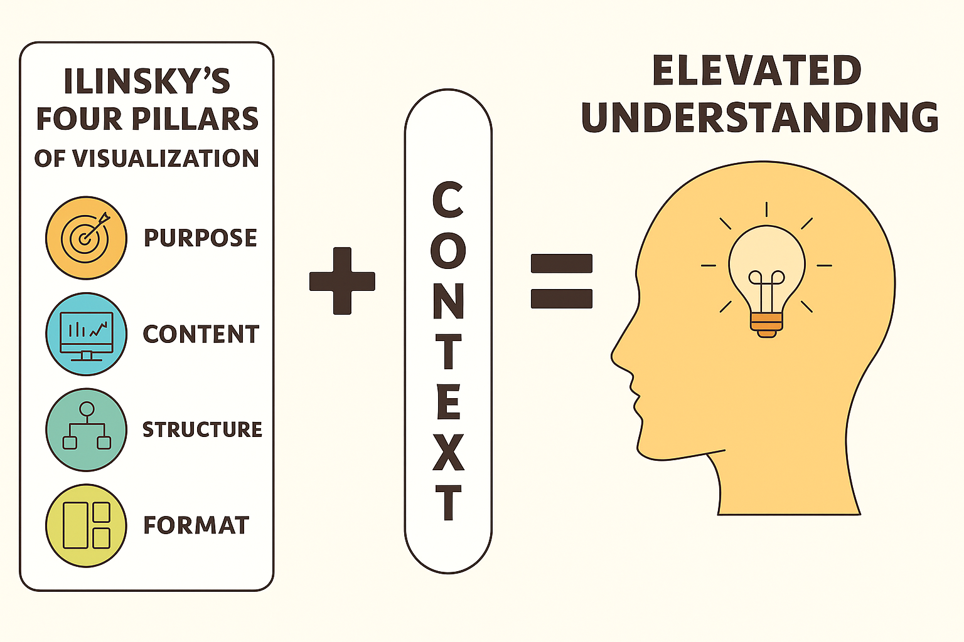
3. Evaluation and Context

Slide 8
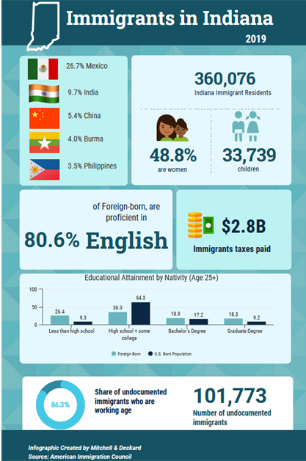
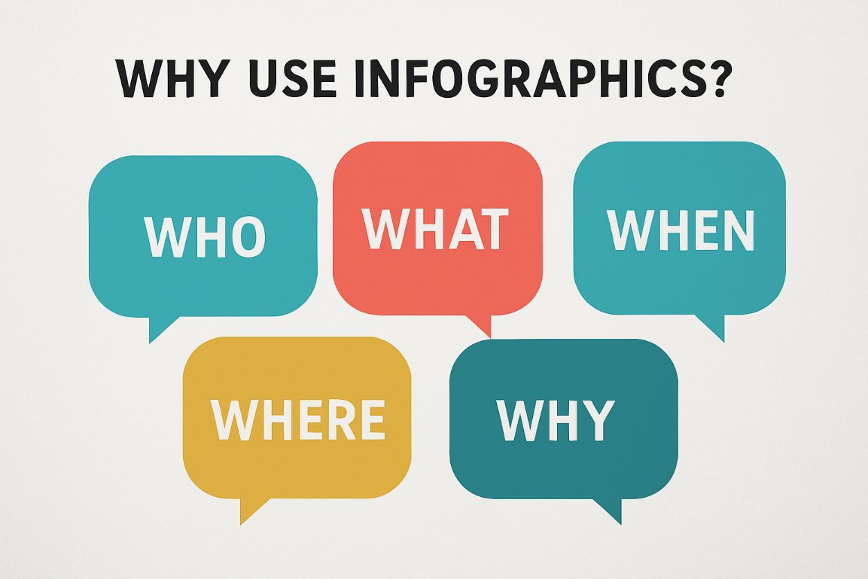

4. Infographic Basics
Good rules of Data Visualization
Infographics can address key questions for audiences

Slide 9
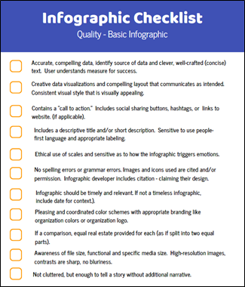

Infographic Checklist
This checklist by Beegle (2014) and Wallace (2015) provides a path for universal infographic adoption.
Good rules of Data Visualization

Slide 10






Types of Infographics
Good rules of Data Visualization
Statistical: uses charts, multiple types of graphs, and people icons representing numbers to present statistical data
Process: shows a step-by-step visual guide to explain a process or instruction
Timeline: have a chronological layout to represent historical events, and time-related information
Interactive: allows the user to interact and dive deeper into the information
Comparison: compares two or more concepts side-by-side using visuals to highlight similarities and differences
Geographical: use maps to visualize information

Slide 11


Ch 2 Case
Creating an Infographic

Slide 12





  Step 4
Present, reflect, and gather feedback on the design choice and presentation.
  Step 3
Making your own Creative Infographic
Create a compelling narrative to frame your presentation. Separately, identify a target audience.
  Step 2
Design a visual presentation using a digital tool (Canva, Snappa, Venngage). Use a framework (like CASS) to evaluate the infographic.
Step 1
Please visit the step-by-step instructions to use Flourish.
Choose from a topic of interest from within your organization. Conduct research and gather data to support the passing of this information.

Slide 13




Chapter 2
THANK YOU
Jennie Mitchell, Ph.D.
jmitchell@smwc.edu
Saint Mary-of-the-Woods College
Trent Deckard
Trent.deckard@smwc.edu
Saint Mary-of-the-Woods College

