Slide 1


LO#1 – Explain the differences between Power BI Desktop and Power BI Services Online..
LO#2 – Upload Excel files and/or sample files to Power BI Desktop to transform (clean) data.
LO#3- Create a multipage report in Power BI Desktop with storytelling techniques.
LO#4 - Publish a Power BI Desktop File (or a .pbix file) to Power BI Services Online.
LO#5 -Generate quick insights in Power BI Services Online to analyze trends, outliers, and correlations.
LO#6 - Download available datasets using Power BI skills.
LO#7 - Apply appropriate visualizations for (KPIs).
CHAPTER 7
The Power of Business Intelligence
Leveraging Data Visualization to Communicate Effectively
By Jennie Mitchell, Ph.D. Saint Mary-of-the-Woods College
and Trent Deckard, Indiana University

Slide 2

Content
01
Features of Power BI Suite
02
Transform: Clean Data in Power BI Desktop
03
Create a Report in Power BI Desktop+ Storytelling
04
Publish to Power BI Services Online
05
Dashboards Vs Reports in Power BI Services Online
06
Finding Datasets to Use in Power BI Desktop

Slide 3
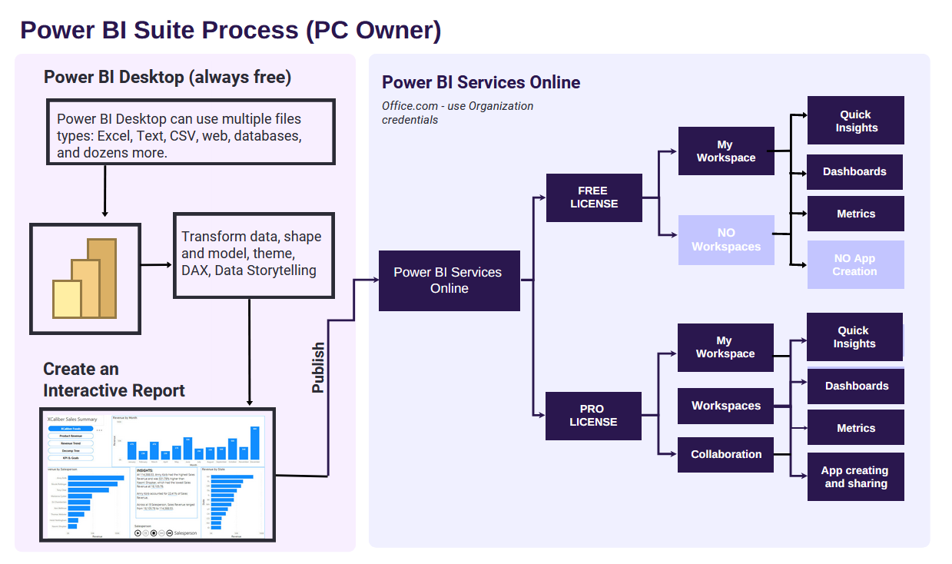



1. Power BI Suite
Triangle or Pacman?
All interns worked approximately the same number of hours per week, but on different days with some overlap with other interns – 4-hour shifts.
Gestalt Principle of Closure
Gestalt Principle of Figure Ground
Gestalt Principle of Figure Ground
Start with Power BI Desktop (always free) – but it does not work on a Mac.
Notes:
"Power BI is a collection of software services, apps, and connectors that work together to turn unrelated sources of data into coherent, visually immersive, and interactive insights" that can be shared (Microsoft- Power BI Introduction, 2023, para 1). You can upload an Excel file, a SalesForce file, a Mailchimp file, a web page, a database, and hundreds of other sources into Power BI Desktop. Multiple sources are possible. Just as a car is built of metal, fabric, glass, and rubber, a dataset potentially pulls from unrelated, even third-party sources.
The best Power BI experience is on a PC. You can only use Power BI Desktop on a PC unless the MAC is running software to simulate the Window’s experience. However, it is possible to do most of the same things in Power BI Services (Online). Let’s look at a comparison of Power BI Desktop and Power BI Services (Online). Make sure to notice the main points in the visual

Slide 4
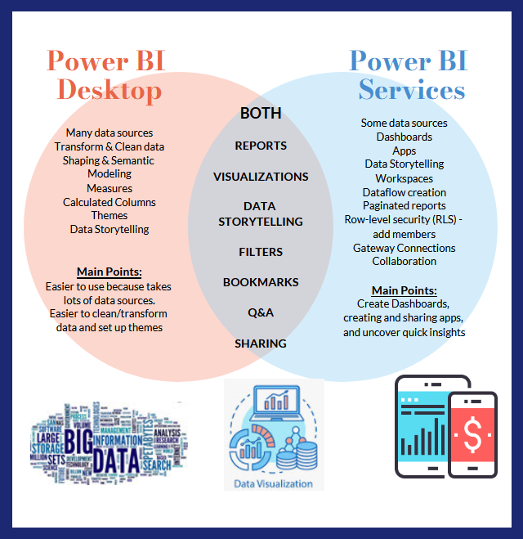
1. Compare Power BI Desktop to Power BI Services (online)
Gestalt Principle –
Similarity and Dissimilarity
Two different apps
Power BI Desktop does not work on a Mac.
Power BI Services (online) works with PC or Mac. Alternative instructions are provided in the textbook.
Notes:
“Power BI is a collection of software services, apps, and connectors that work together to turn unrelated sources of data into coherent, visually immersive, and interactive insights” that can be shared (Microsoft—Power BI Introduction, 2023, para 1). You can upload an Excel file, a SalesForce file, a Mailchimp file, a web page, a database, and hundreds of other sources into Power BI Desktop. Multiple sources are possible. Just as a car is built of metal, fabric, glass, and rubber, a dataset potentially pulls from unrelated, even third-party sources.
The best Power BI experience is on a PC. You can only use Power BI Desktop on a PC unless the MAC is running software to simulate the Window’s experience. However, it is possible to do most of the same things in Power BI Services (Online). Let’s look at a comparison of Power BI Desktop and Power BI Services (Online). Make sure to notice the main points in the visual

Slide 5


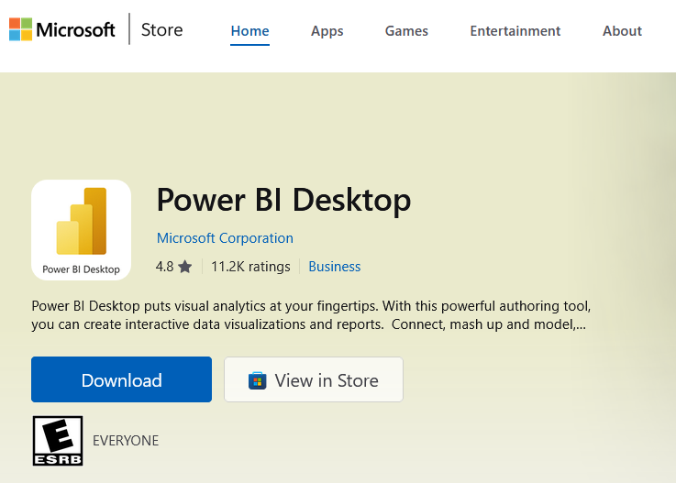
1. Get Power BI Desktop
Power BI Desktop Notes
Power BI Desktop
A Power BI Desktop license allows you to publish reports to My Workspace if you are using the free version of Power BI Online. If you have a Pro license in Power BI Services Online, you can also publish from the Power BI Desktop to Workspaces in Power BI Services Online.
Explore Publish to Web from Power BI or Power BI service per-user and capacity-based licenses from Microsoft Learn.
The biggest difference between Pro and the FREE license is collaboration within the Workspace and the ability to create a Power BI app for consumer consumption.
IF you download from store, it will automatically
be updated.

Slide 6

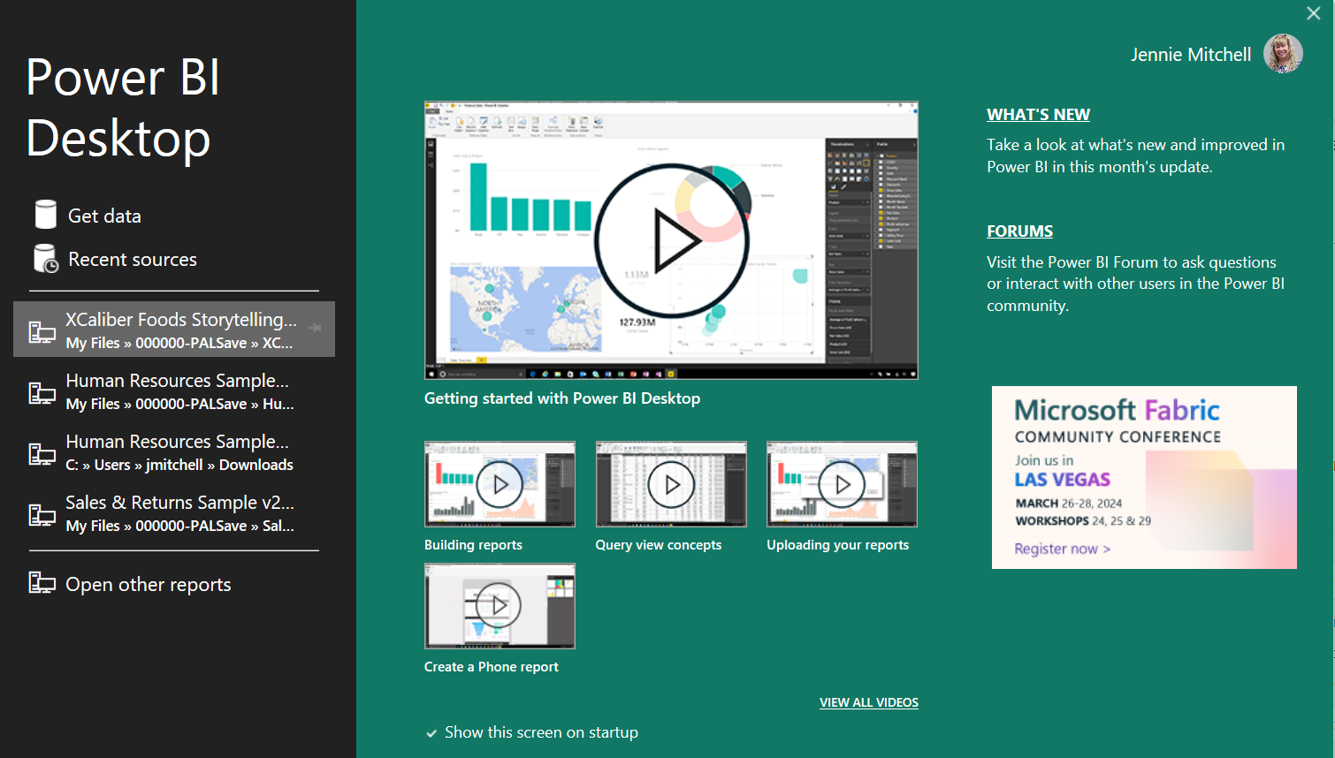
1. Opening Screen for Power BI Desktop
Report, Inform, Explain, Announce
If you are new to Power BI, spend time reviewing the videos. Remember, only PC users can take advantage of Power BI Desktop; Mac users will need to complete reports in Power BI Services (online). The biggest advantage to Power BI Desktop is the 100’s of file types in the ‘Get Data’ feature.

Slide 7
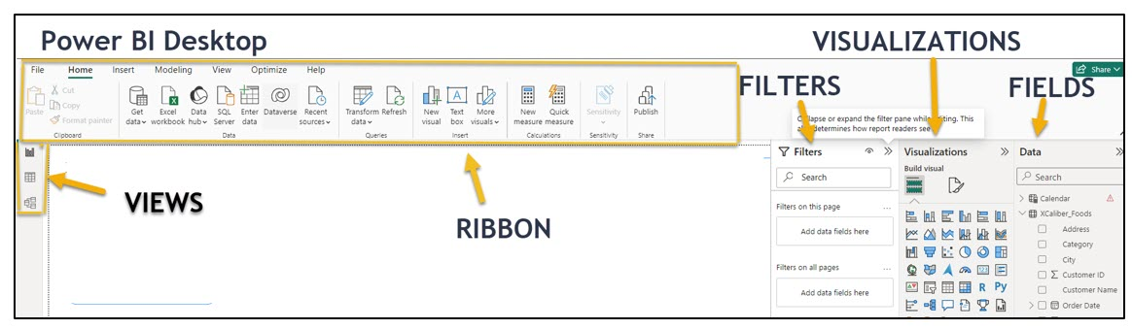
1. Navigating Power BI Desktop
Report, Inform, Explain, Announce
Ribbon – The ribbon has a similar look and feel to other Microsoft products
Views – These three icons provide views: Report view, data view, or model view. The data view shows your dataset (like opening Excel). The report view shows the canvas and any visualizations you have started. The model view is where you can create relationships, build hierarchies, or perform calculations through DAX (Data Analysis eXpression).
Filters – This is somewhat explanatory. You can add filters to “filter the data.”
Visualizations – Although you see a robust number of visuals, if you click on the three dots (ellipsis) you can get more visuals.
Data – Shows the tables and fields of the dataset
Canvas – This area is where you build the report with visualizations and context.
Notes:
One of the key differences of Power BI Desktop when compared to Power BI Services (Online) is the ability to ‘get data’ from multiple sources. Besides Excel, some of the file types accepted by Power BI Desktop include text/CSV, XML, PDF, as well as several databases like SQL Server database. There are hundreds of other files that can be used with Power BI Desktop. This is a significant difference since Power BI Services Online accepts very few file types and Power BI Desktop accepts over a hundred file types. Also on the ribbon is the ability to transform data (essentially clean it up).

Slide 8
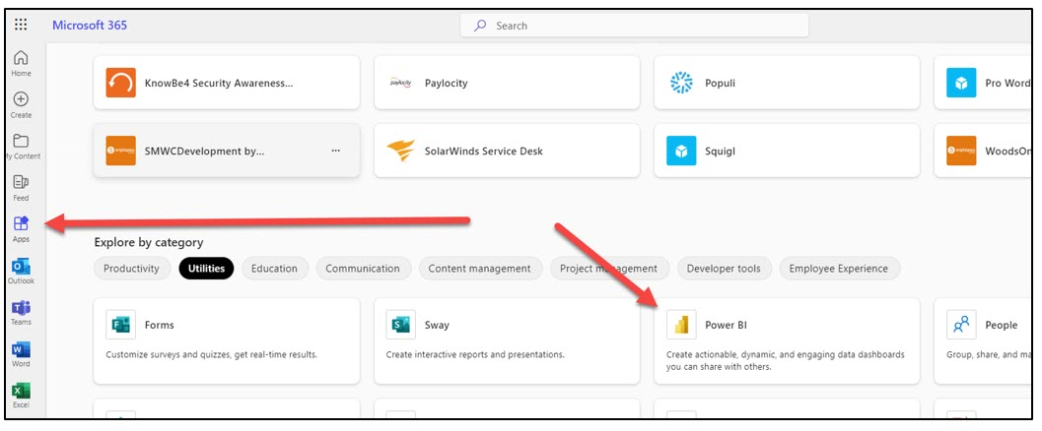
1. Find Power BI Services Online
Instructions for students
Look for the Power BI app
1. Login to your Microsoft Office account provided to you at your university. Make sure to use your college credentials.
2. In the menu (located vertically on the left side), choose Apps.
3. Look in the “Explore by category” section for Power BI (Power BI is listed under several categories).
The biggest difference between Pro and the FREE license is collaboration within the Workspace and the ability to create a Power BI app for consumer consumption.
Power BI Services Online work for PC or Mac.

Slide 9
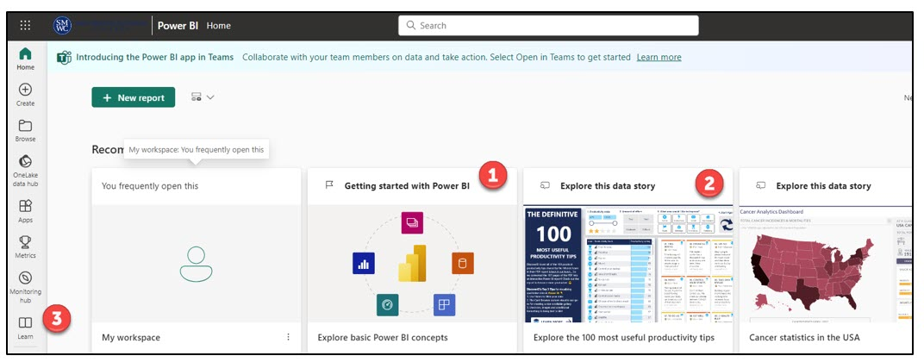
1. Opening Screen for Power BI Services online
Report, Inform, Explain, Announce
When you open Power BI Services (Online) the first time, you should see several tiles like,
* Getting Started with Power BI (see #1),
* Explore this data story (see #2).
* If this is your first time working with Power BI Services Online, make sure to explore these. Keep in mind, your experience will be slightly different since the examples change. Also, you will not see anything in the My Workspace tile since you have not added anything to your My Workspace yet. But the most important component is Learn (see #3).

Slide 10
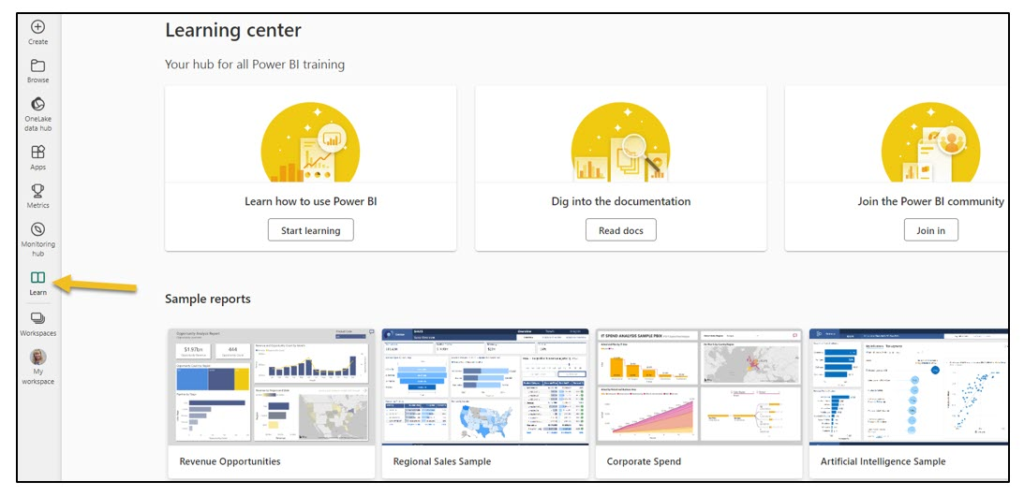
1. Select ‘Learn’ for Power BI Services online
Report, Inform, Explain, Announce
Note the sample reports, information on the newest features, lots of potential training opportunities, and testimonials.

Slide 11
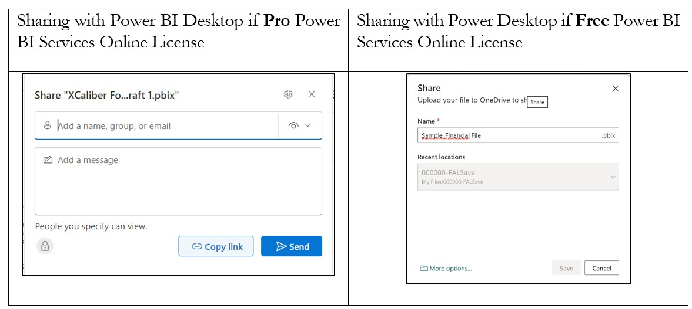
1. Sharing in Power BI Services online
Report, Inform, Explain, Announce
When you use the share button in Power BI Desktop, it is a unique experience depending on whether you use the Pro or Free version of Power BI Services Online.
Notes:
Sharing in a Pro environment gives you a way to directly connect with others. Sharing in the Free version means the sharing comes about because you are saving it to a shared folder.

Slide 12
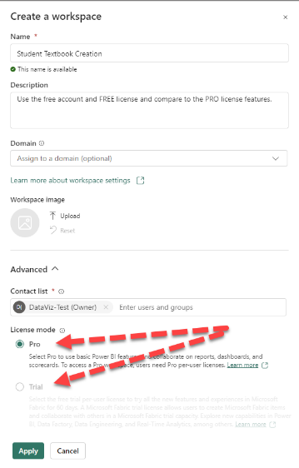
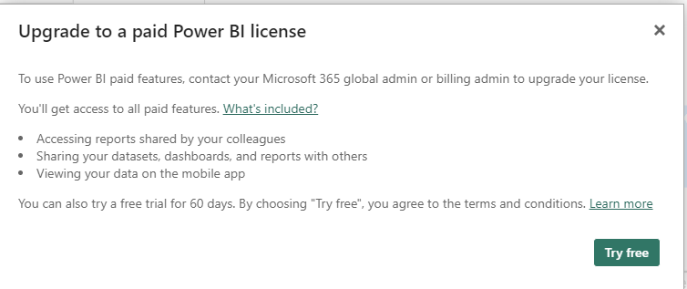
1. Limitation of Power BI Services (online)
FREE Account
Report, Inform, Explain, Announce
If you have a ‘free’ Power BI Services (Online) license, you will still see a button to create a workspace. However, once you start setting up the workspace, you won’t be able to move forward unless you update your account from ‘free’ to ‘pro’ or sign-up for a free trial. It is not necessary to purchase a Pro account, but feel free to try the trial.
Do not give your credit card information.
Notes:
You can only create a Power BI app with a Pro license and only one app per workspace. Creating an app is one of the more powerful aspects of Power BI Services Online.

Slide 13
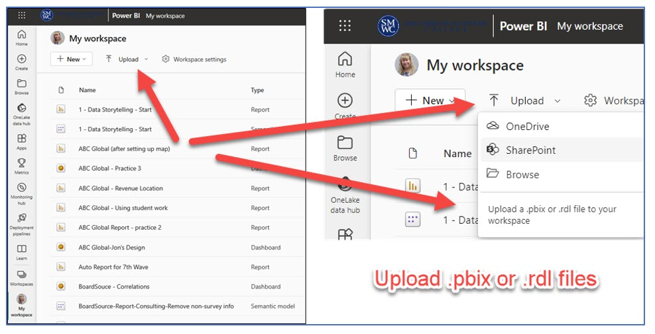
1. Power BI Services online
Report, Inform, Explain, Announce
Unlike Power BI Desktop, Power BI Services (online) can only upload a few file types: .pbix files or .rdl files. You may see Excel (preview) if you select ‘Create.’ If you see ‘preview’ it means the feature is still being developed or updated. (Remember, if you have Power BI Desktop, you can upload about any file type and can PUBLISH to Power BI Services (online). Mac users will need to work in Power BI Services online.

Slide 14
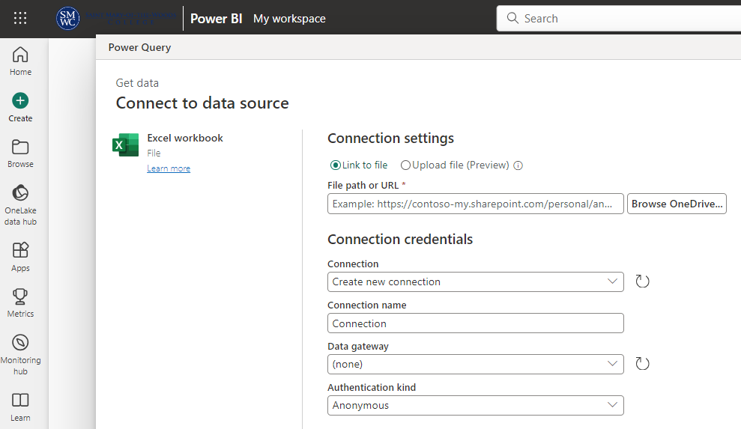
1. Power BI Services Online: MAC Users
MAC Users: Option #1
Option #1 – To Link an Excel File to Power BI Services Online
MAC users should be able to use Excel Preview to LINK their Excel file to Power BI Services Online. Two things are important.
First: The Excel file must live in a OneDrive space. According to Microsoft (as of Sept 29, 2023), “Upload of local workbooks to Power BI Workspaces will no longer be allowed” (Microsoft Learn, 2023, para 2.)
Second: Use the link to file and do not use the upload option. Start with ‘Create’, then Excel (Preview), and Link to the Excel file
A Word to MAC Users
Although you can’t use Power BI Desktop to ‘get data,’ you can still get your data into Power BI Services Online. Once you have the data in Power BI Services Online, you should be able to create dashboards and reports. See the next slide for more information.

Slide 15
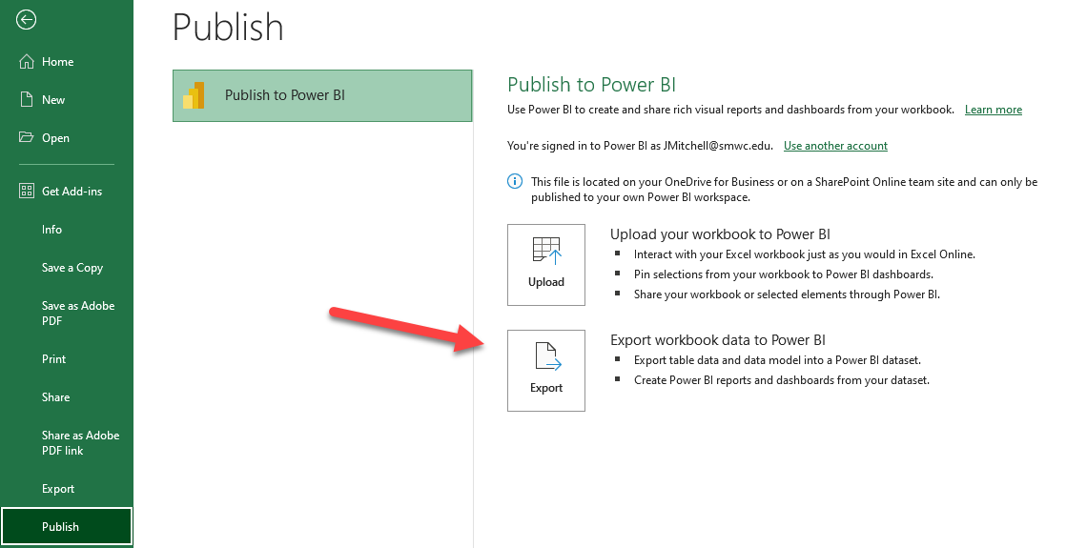
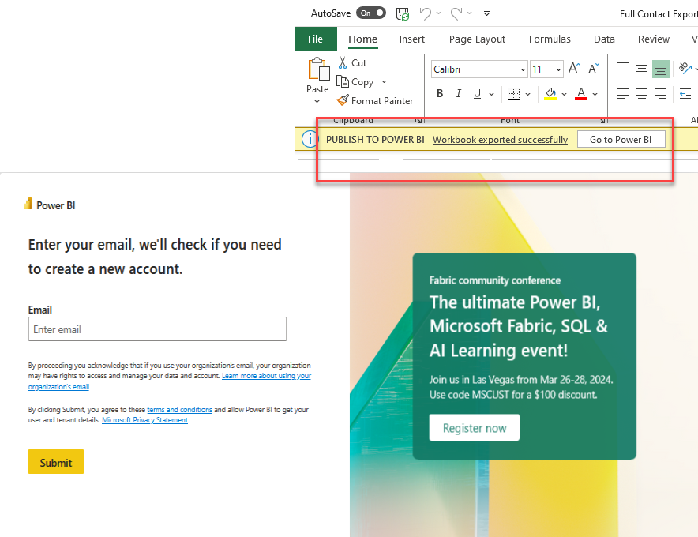
1. Power BI Services Online: MAC Users
MAC Users: Option #2
Option #2 – Publish Excel File Power BI Services Online
First: Go to Office.com, login. Find the apps, search for Power BI Services Online, and have it open.
Second: Open the Excel file you want to use. Make sure it is in table format.
Third: Go to File and scroll down to “Publish” Select Publish and a pop-up screen will show up. Choose the Export so you can create reports and dashboards
Fourth: You will see a note that the Workbook was exported successfully. Select Go to Power BI button and the following popup window will appear. Type in your Email account – use your college email account.

Slide 16

1. Explore Power BI Services Home, Create, Browse & OneLake
Home, Create, Browse, OneLake Data Hub
Home is what you would expect—It shows your files based on how recently accessed. It also has a “New report” button that you can use to start creating reports.
Create allows you to add data to start building a report. You have a few choices—(a) Excel (Preview), which means you link your Excel file from OneDrive; (b) link a CSV file from OneDrive; (c) paste or manually enter data (looks like a spreadsheet); or (d) select a published semantic model. If you recall,
Browse includes a list of files in order of the most recent use.
OneLake Data Hub is a centralized data hub for your entire organization. It allows members of the organization to use Fabric data items if they are given access.

Slide 17


1. Explore Power BI Services Online: Apps & Metrics
Apps
Create an App. “In Power BI, you can create ‘official’ packaged content, then distribute it to a broad audience as an app” (Microsoft, 2023, para 1). Apps are created in Workspaces and NOT ‘My Workspace’. This might sound odd but think of My Workspace as your personal space, whereas the intent of an app is to publish to large groups of people. And note, that free account users cannot create a Power BI app because they can’t create a Workspace!
Metrics. In Power BI Services (Online) you have an option to build metrics to hold your organization accountable by tracking them against key business objectives. The fundamental value of the scorecard is that others in your organization are interested in the targets set.

Slide 18


1. Explore Power BI Services Online: Deployment, Learn, Real-Time
Deployment pipelines, Learn, Real-Time
Deployment pipelines. A deployment pipeline provides “content creators with a production environment where they can collaborate to manage the lifecycle of the organizational content” (Microsoft Learn, 2023, para 1). By default, there are three typical stages: Development, Test, and Production. For example, software developers could use the process to write, build, test, and deploy code. You must have a premium license to use it.
Learn. Consider this a place to explore and learn basics to advanced topics. All free.
Real-Time (Hub) (This is new). In Power BI Services (Online) you have an option draw in real-time data. One of the sample experiences is Stock ticker data. You have to have Microsoft Fabric (and you may not see this icon, depending on your license).

Slide 19

Workspaces are containers for dashboards, reports, and semantic models. Workspaces can provide a team environment to collaborate with your co-workers. You can add co-workers to your workspace if they also have a Power BI Pro license and are part of your organization. If you only have a ‘free’ license, you will not be able to create a workspace. And you can only create an app in a workspace.
1. Explore Power BI Services Online: Workspaces, My Workspace
Workspaces, My workspace
Workspaces are containers for dashboards, reports, and semantic models. Workspaces can provide a team environment to collaborate with your co-workers. You can add co-workers to your workspace if they also have a Power BI Pro license and are part of your organization. If you only have a ‘free’ license, you will not be able to create a workspace. And you can only create an app in a workspace.
My workspace is your personal space for content. Only you have access to your ‘My workspace’ however, you can share individual dashboards and reports in the Pro version. If you have a Free license, plan to share from a Power BI Desktop to a One Drive shared folder. If you try sharing a file directly in Power BI Services Online, you will see a pop-up to upgrade your license.

Slide 20
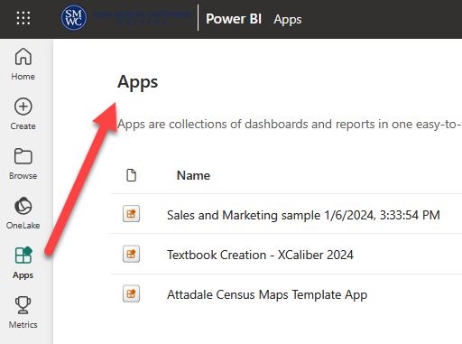
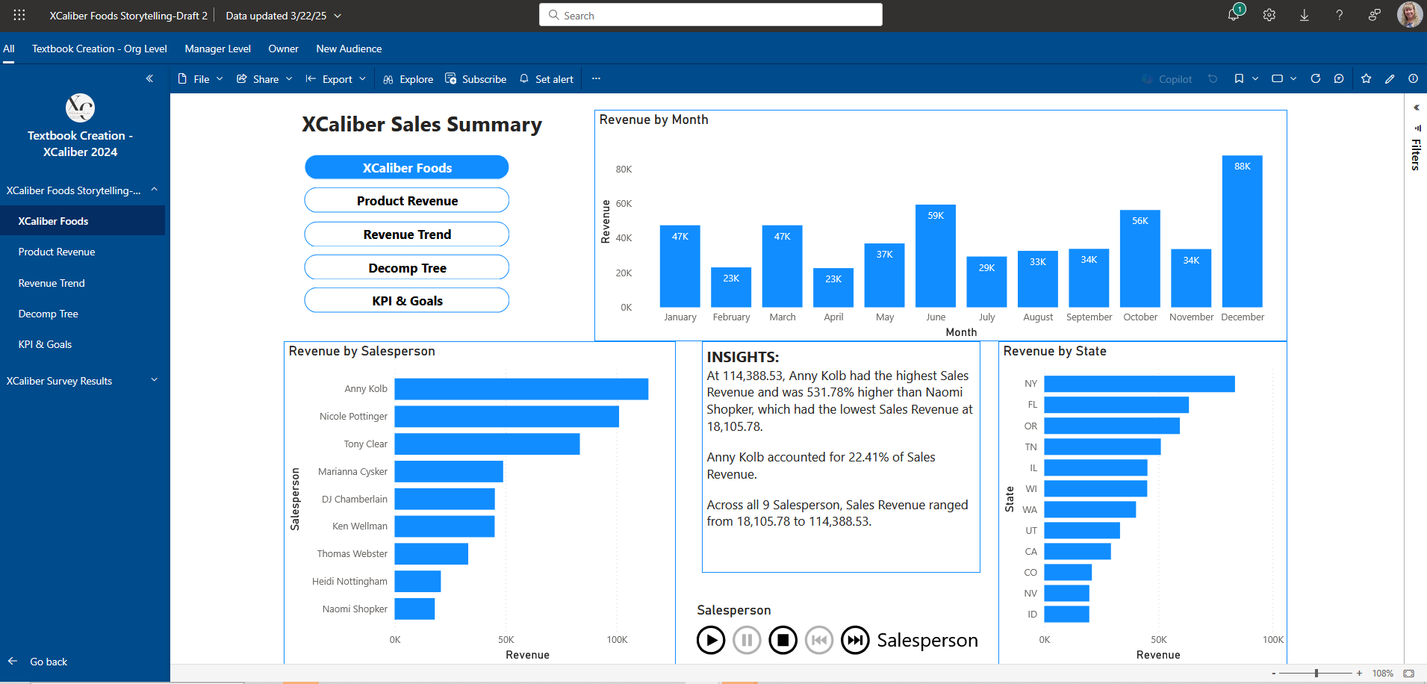
1. Apps in Action
Apps
XCaliber 2024 App
Pwer BI App showing in Power BI Services (Online).
This is an example of how an App in Workspaces would work.
Notes:
As an illustration, XCaliber Foods opened its business in 2024 intending to sell $50,000 each month. XCaliber planned to hire nine salespeople, which meant that each salesperson would sell approximately $5,500 per month. Instead of waiting until year-end to see if you are on target, you may want to set up the scorecard so that it looks at a monthly target ($600k total sales divided by 12 = $50k per month). Targets for salespeople also make sense to set up monthly. Then if you don’t make a target, you can investigate why. More likely, you may want to set targets for products, targets set for salespersons, and targets in cultivating new customers.

Slide 21
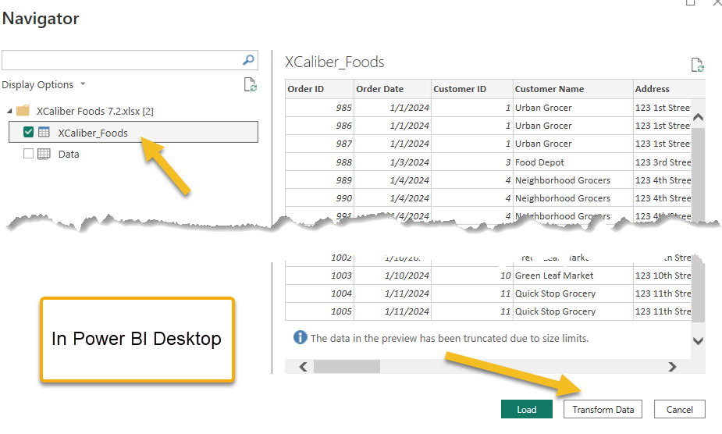
2. Clean Data in Power BI Desktop
Use XCaliber Food Distribution Data to Learn how to Clean Data
Step 1: Open Power BI Desktop and Get Data
Step 2: Check XCaliber Foods
Step 3: Select Transform Data
Step 4: The Power Query Editor will pop up on the screen.
What kind of issues can you clean/transform?
Attentive Processing – How many 5’s?
Make sure you are in Power BI Desktop!
Every line has USA for country.
Payment type has several blanks. It could be an error in entering the data, bad checks, or potential fraud. So keep the blanks to investigate.
Notice there is a need to calculate delivery time.

Slide 22
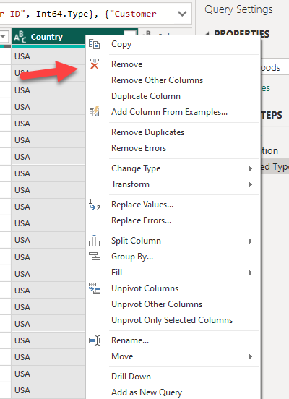
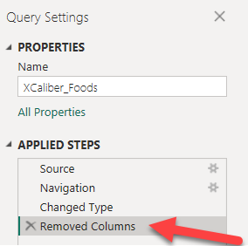
2. Query Editor – Remove Column
Remove the column called Country since every entry is USA
Attentive Processing – How many 5’s?
Notice the “x”? You can select this, and the column will be added back in. It is like the undo button!

Slide 23
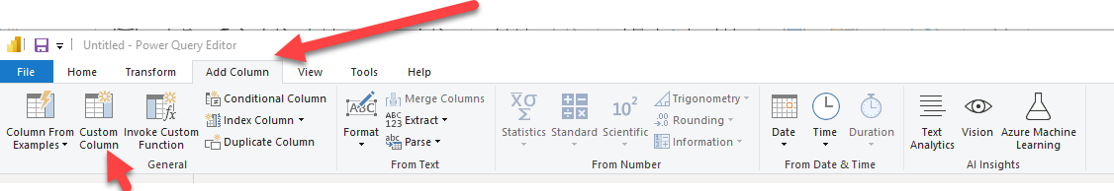
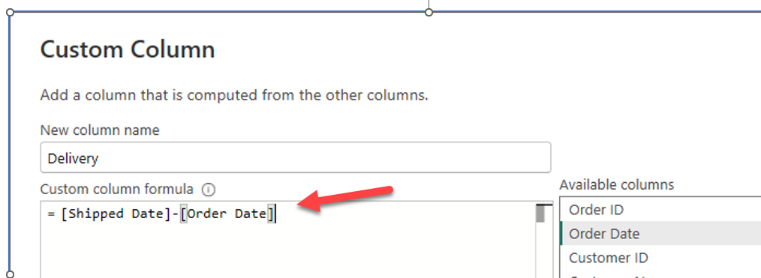
2. Query Editor – Add Column
Add a custom column to capture number of shipping days
Click on the main menu to Add Column in the main menu and choose Custom Column
Attentive Processing – How many 5’s?
The formula starts with an equal sign and double-click the available columns. Essentially the formula = Shipped Date minus the Order Date will tell you the length of time. That’s why the new column’s name is Delivery.

Slide 24
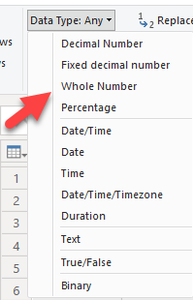
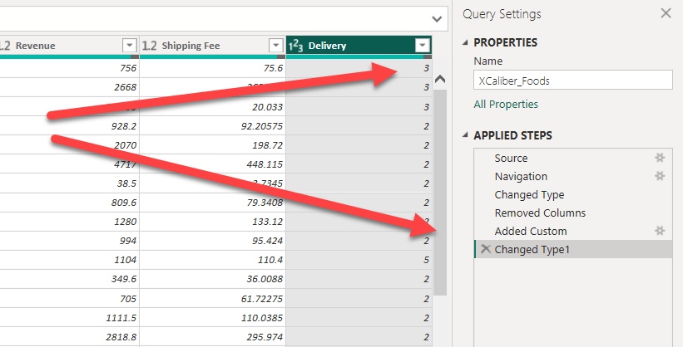
2. Query Editor – Format
Transform Delivery days to a Whole Number
On the main menu, choose Transform, then choose Data Type and then Whole Number.
Attentive Processing – How many 5’s?

Slide 25
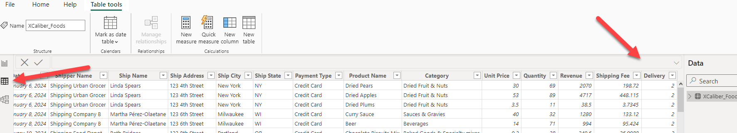
2. Table View- Delivery
Transform Delivery days to a Whole Number
Attentive Processing – How many 5’s?
Now on the main menu, choose File, then Close & Apply. Your changes are applied, and you have a trail of your steps. A popup should show that the file is applied. You should be back to the editing field in the Power BI Desktop.
Check to see if the Delivery column is there by choosing the table view on the left (arrow) and then scrolling over to see the new column. Congratulations! You have just cleaned the data!

Slide 26
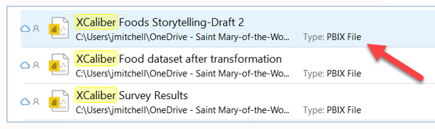
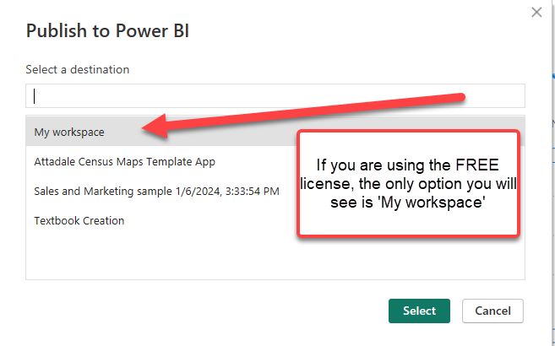
2. Save File as .PBIX and Publish
Save the file to OneDrive as XCaliber Foods Storytelling Draft 2.PBIX
Attentive Processing – How many 5’s?
Publish to Power BI
Choose Publish and the popup will show Publish to Power BI as seen in the illustration.
You will only have the ‘My workspace’ option if you have the Free license.
Notes:
Remember, both Power BI Desktop and Power BI Services Online will accept files with the .PBIX extension. This information is important for MAC users who can’t use Power BI Desktop but who can use Power BI Services Online.

Slide 27
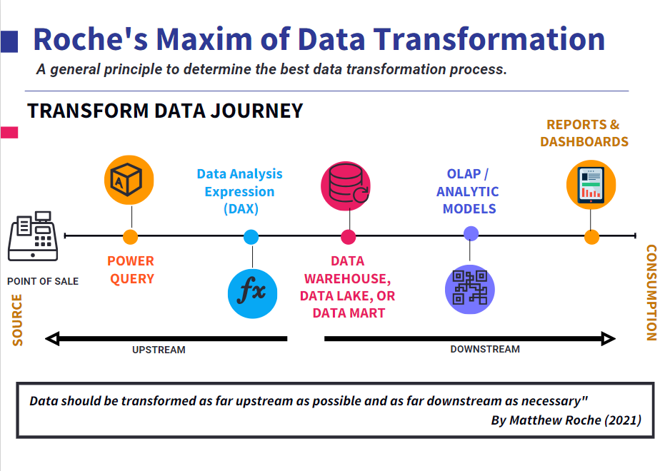
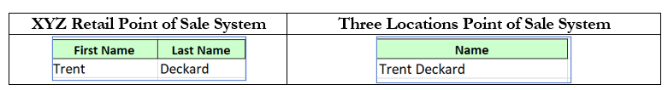
Scenario #1 – Small Company Expanding Local Locations
BACKGROUND: XYZ Rentals company purchased three retail locations with a different Point of Sale (POS) system.
NAMING CONVENTION:
XYZ’s point of sale collects data differently from the customer. XYZ’s data has a column for first name and a column for last name. The three retail locations use an older POS system that collects the entire name in one column.
2. Roche’s Maxim of Data Transformation
Report, Inform, Explain, Announce
NAMING CONVENTIONS: Do you see the problem?

Slide 28
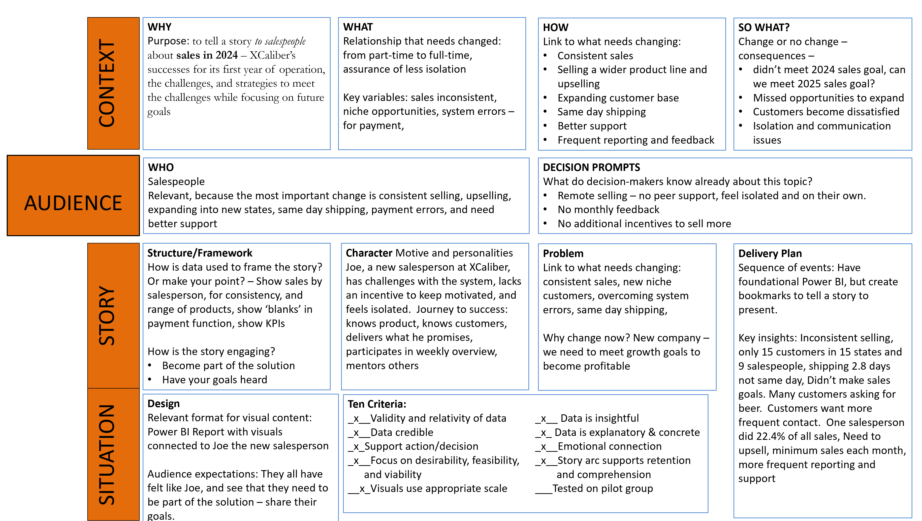




3. CASS Template – XCaliber Food Distribution Company
Report, Inform, Explain, Announce
Notes:
Zurich’s 2022 annual report is 392 pages long and full of images.

Slide 29

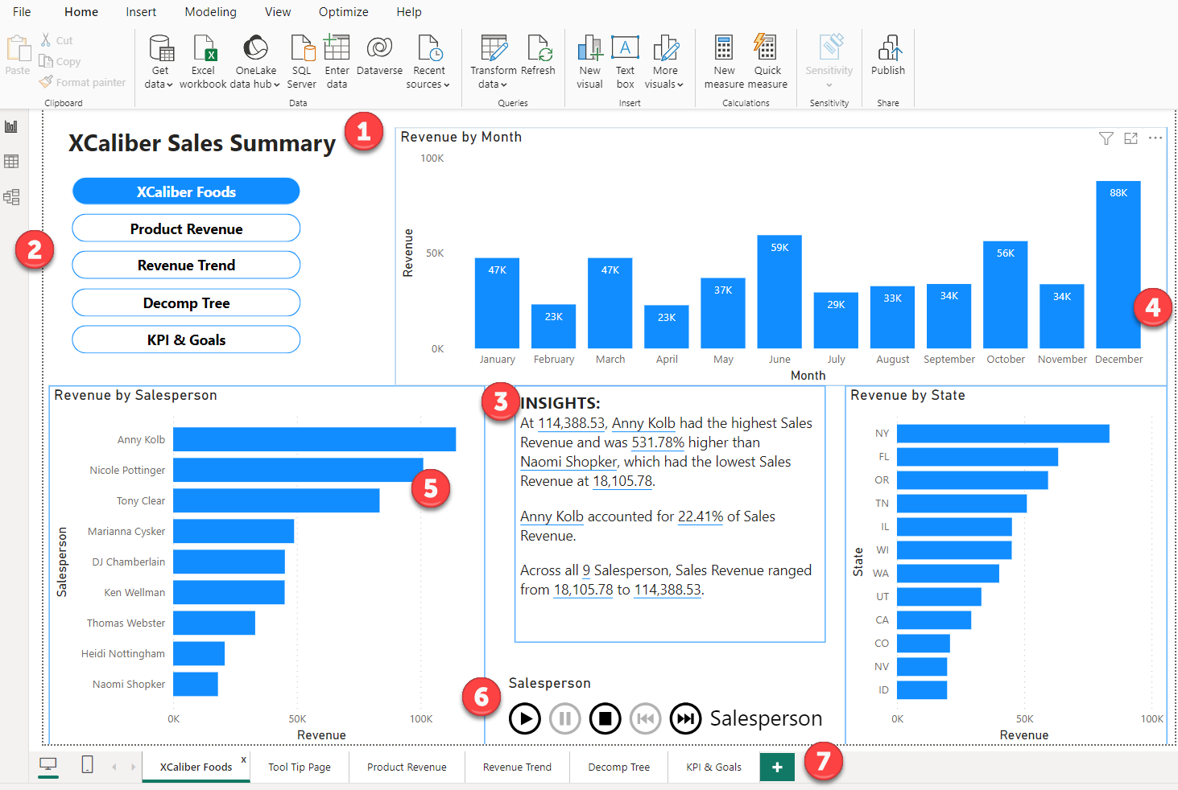






3. XCaliber Report Page #1
Page #1 Overview in Power BI Desktop
What’s in Page 1
A clear title
Navigation
High-level insights
Smart narrative that is customized
Updates as data changes
Drill throughs
Customized Tooltips
Play axis
Multipage Report
See textbook for steps to create this.

Slide 30
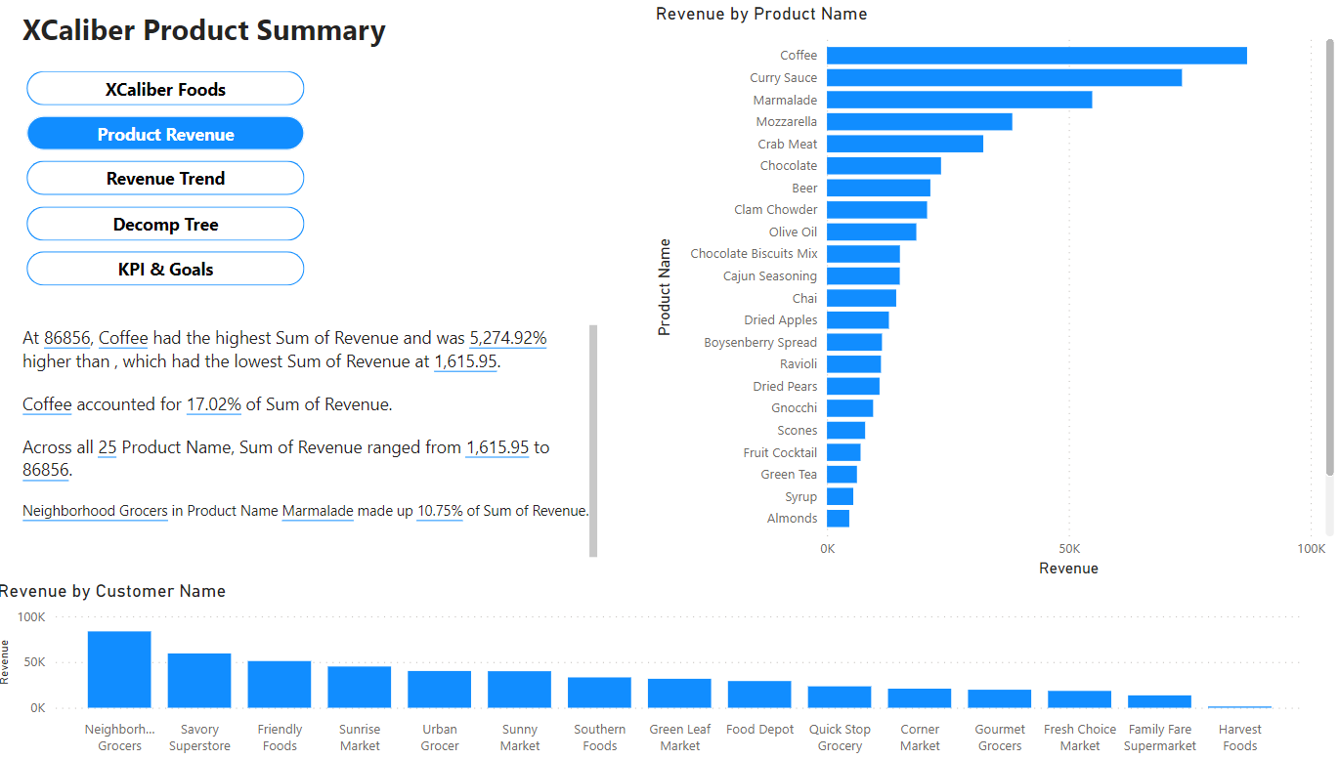
3. XCaliber Report Page #2
Page #2 Product Revenue in Power BI Desktop
What’s in Page 2
Navigation
Insights
Revenue by Product Name
Revenue by Customer
See textbook for steps to create this.

Slide 31
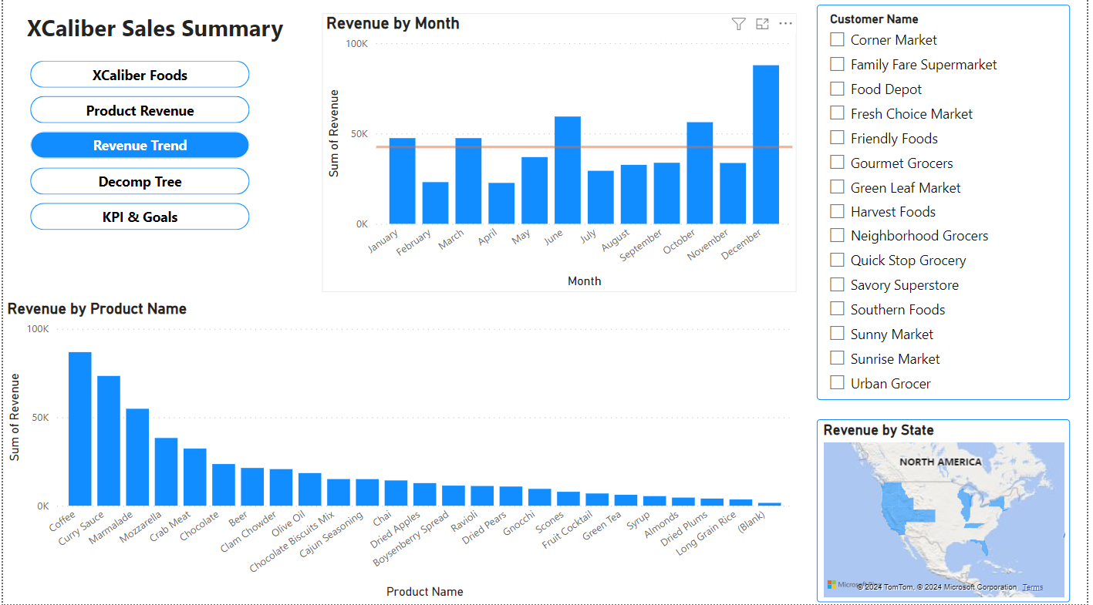
3. XCaliber Report Page #3
Page #3 Revenue Trends in Power BI Desktop
What’s in Page 3
Navigation
Revenue by Month
Customer Slicer
Revenue by Product Name
Map showing revenue by state
See textbook for steps to create this.

Slide 32
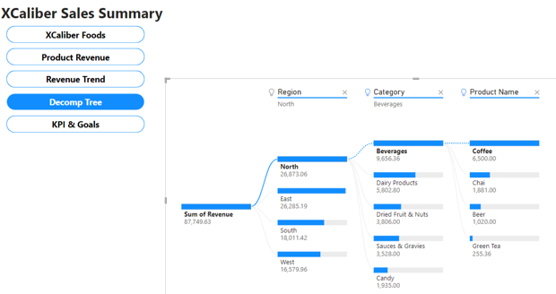
3. XCaliber Report Page #4
Page #4 Decomp Tree in Power BI Desktop
What’s in Page 4
Navigation
Sum of Revenue
Region
Category
Product Name
The presenter can use the decomposition tree to break this into metrics. When the presenter is demonstrating the key metrics of sales, they can show dimensions through the region, product categories, product name, and even add salespeople to the mix. If the presenter wants to demonstrate supply chain data, the dimensions could be shippers, shipping methods, and delivery time (the time from order to shipped).
.

Slide 33
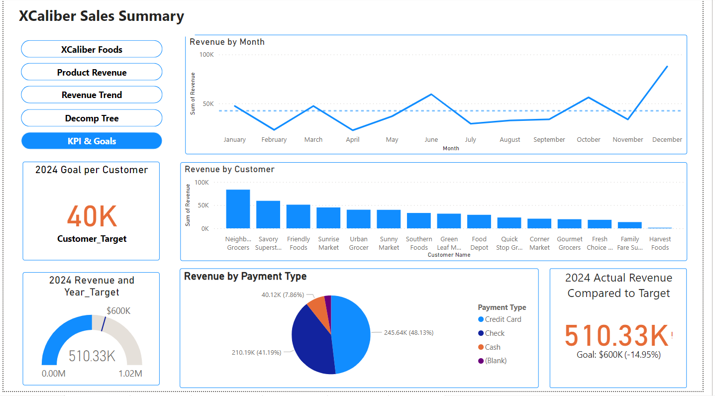
3. XCaliber Report Page #5
Page #5 KPI and Goals in Power BI Desktop
What’s in Page 5
Navigation
Sales by Month trend line with average
Sales Goal per Customer - KPI
Target 2024 Revenue
Revenue by Customer
Payment Type
2024 Actual Revenue Compared to Target
Review these pages to the CASS template for XCaliber. The step-by-step directions are in the textbook. Once the report is built in Power BI Desktop, it can be published to Power BI Services (Online). See directions for Mac Users.
T

Slide 34
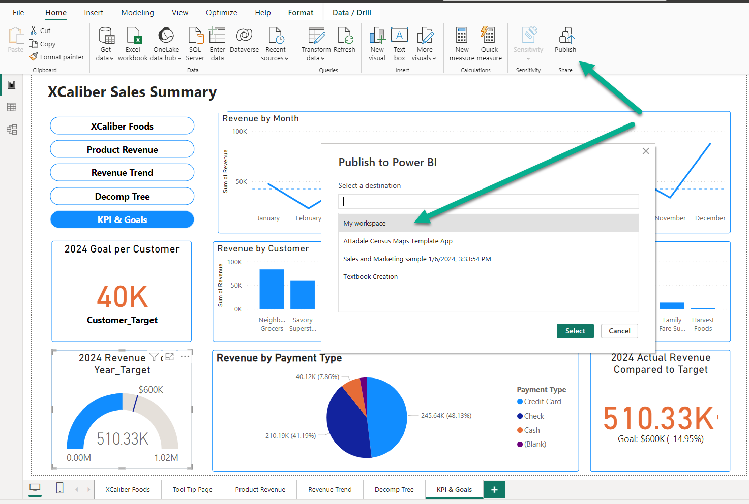
4. Publish your Desktop to Power BI Services (online)
Report, Inform, Explain, Announce
Notes:
Extra Information
Step 1 – Go to http://office.com and log in.
Step 2 – In the main Microsoft 365 page, choose Apps, and look for Power BI
Step 3 – Once logged in, click on your avatar (or picture) to determine your license. If you see FREE, that means that some of the extraordinary features will not be available. If you see PRO, you can create a Workspace and create an App.
Step 4 - Open your Power BI Desktop to the five-page report. To publish your Power BI Desktop five-page report to Power BI Services (Online), just choose Publish. A pop-up screen will show My workspace. The image shown in Figure 7.79 is different since I’ve been using this account and have set up Workspaces. If you don’t have a PRO account, you will not be able to set up additional workspaces; however, you can still publish to your personal ‘My workspace’.

Slide 35
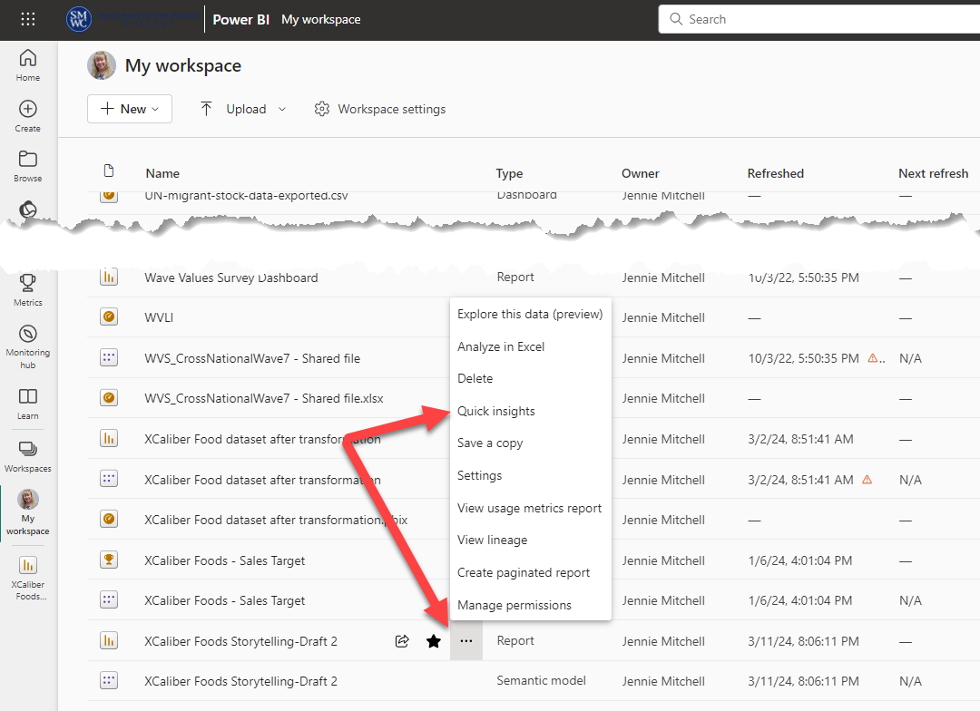
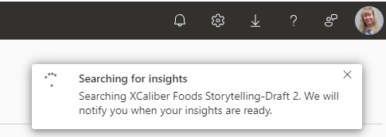
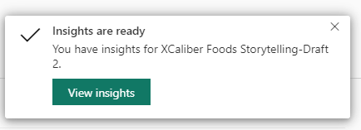
4. Get Quick Insights
In Power BI Services (online)
What are quick insights?
Use the three dots (ellipses) to find Quick Insights. Only Power BI Services online offers this feature. Quick insights will generate 30-40 graphs.
Quick Insights include 1) category outliers, 2) change points in a time series, 3) correlation, 4) low variance, 5) majority, and 6) outliers, and 7) time series.

Slide 36
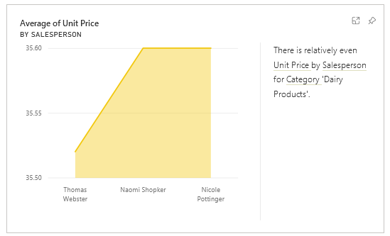
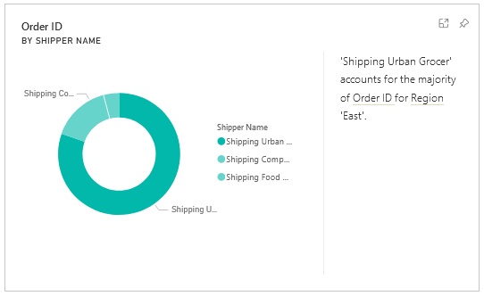
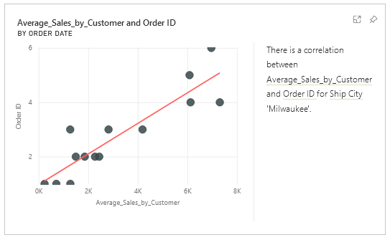
4. Quick Insights
Correlation
Low Variance
Majority
There is a correlation between average sales by customer for the product shipped to Milwaukee. In other words, the grocers tend to place the same order over and over with little to no fluctuation in unit price charged for the product.
These three salespeople are using a similar unit price for dairy products.
This chart tells us that the majority of shipping in the East region is done by shipper, Urban Grocer.

Slide 37

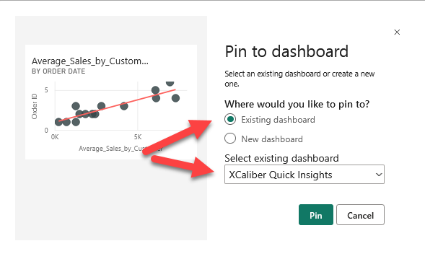
4. Pin chart to Dashboard
Report, Inform, Explain, Announce
When you open the dashboard, notice that the visuals are not organized well, with no context or title. You should also notice that by default, Power BI Services Online has added a Q&A component.
Notes:
Step-by-Step to Pin Quick Insights to a Dashboard
Step 1 – Open Power BI Services (Online)
(as a reminder, go to Office.com and log in, choose apps, find Power BI)
Step 2 – Get quick insights (go to your My workspace), find the report and semantic model that you published to Power BI Services Online, click on the three dots (ellipses), and choose Quick insights.
Step 3 – Find the category outlier shared earlier in Figure 7.86 and click the pushpin in the upper right-hand corner. In the pop-up, choose New dashboard, and name it XCaliber Quick Insights and then click Pin.

Slide 38
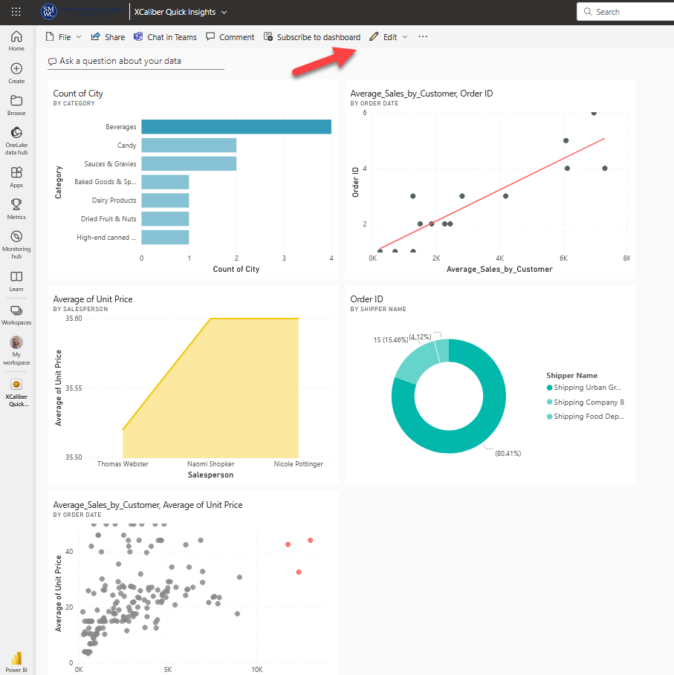
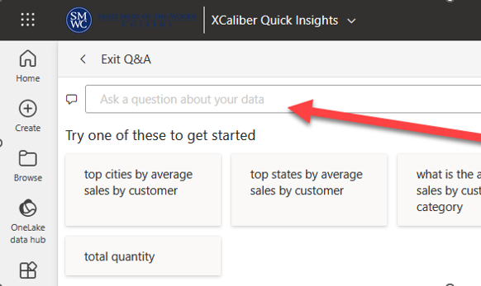
4. XCaliber Quick Insights Pinned
to Dashboard
Q&A, Write your questions….
This feature is even better with AI assistance!
Arrange it as a Story

Slide 39
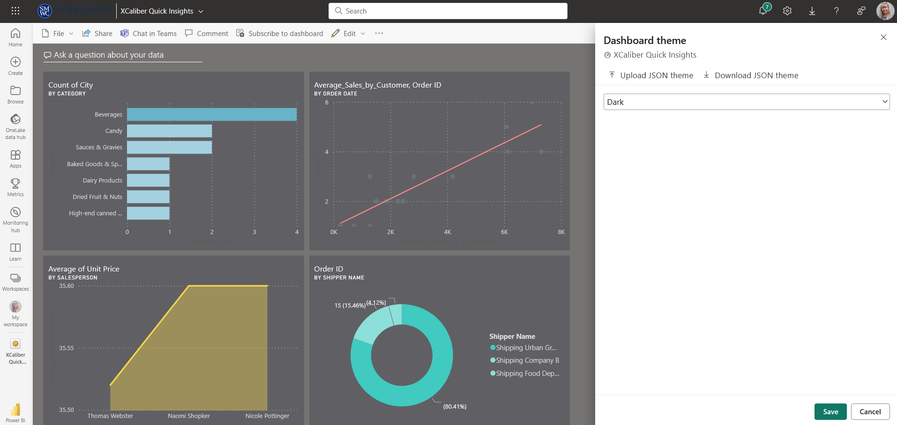
4. Change Dashboard Theme
Practice Q&A
Try Q&A in the Dashboard
Format Using Themes
Q&A, Write your questions….
This feature is even better with AI assistance!
Add title, text box, and image. Organize dashboard to tell a story.

Slide 40
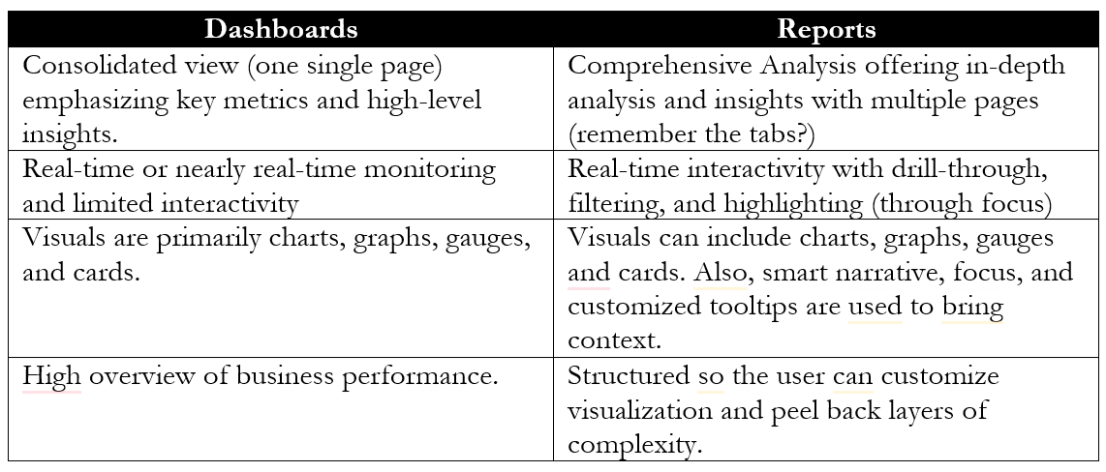
5. Power BI Dashboards Versus Reports
Seven Principles for better visual storytelling
  Is this the right data?
  Are these visuals the right ones?
  Are they visuals in the right configuration?
  Did you remove the noise or distraction?
  Does your design focus the audience’s attention?
  Does your design make it more approachable?
  Does your design instill trust? (Dykes, 2020)
“The bigger the insight is, the more disruptive it will be to the status quo” (Dykes, 2020, p. 3).

Slide 41
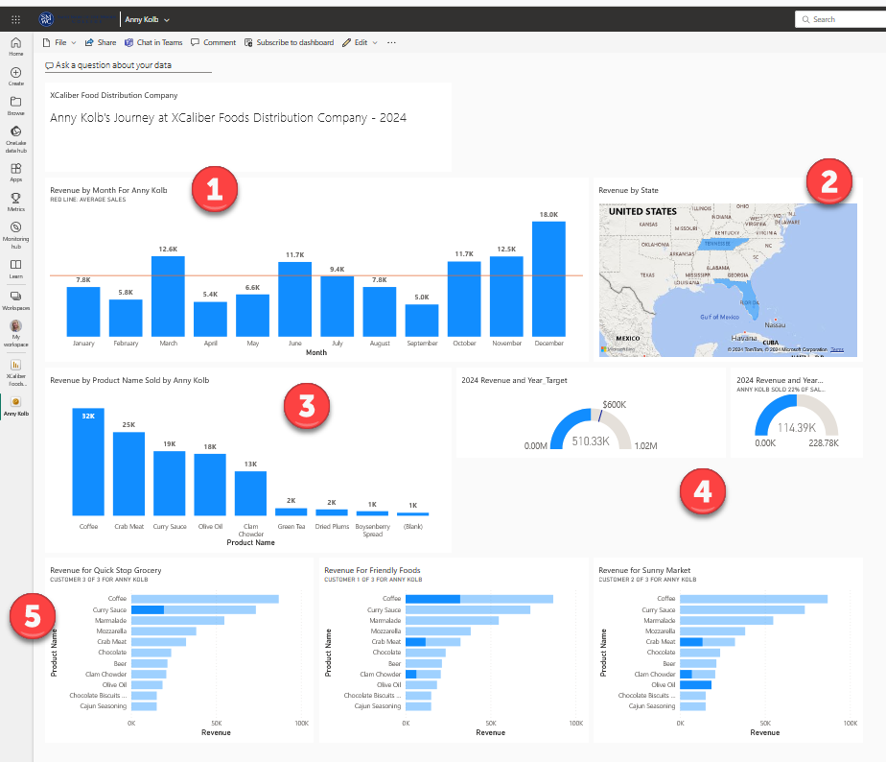
5. Power BI Individual Dashboard
Salesperson Anny Kolb’s Individual Dashboard
  Kolb’s Revenue by month
  Kolb sells in Tennesee and Florida
  Products sold by Anny: sells a lot of coffee
  Gauges showing Kolb’s goals and metrics
  Kolb’s customers

Slide 42
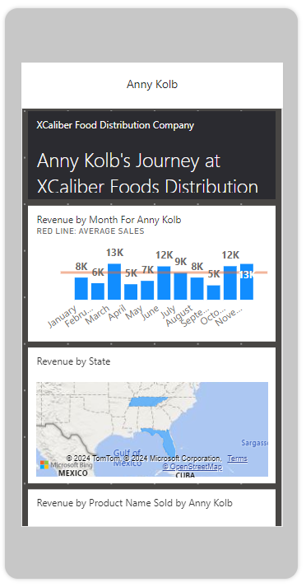
5. Power BI Mobile Layout
Salesperson Anny Kolb’s Individual Dashboard in Mobile Layout
  Kolb’s Revenue by month with average trend line.
  Map shows Kolb sells in Tennessee and Florida
  Products sold by Anny: sells a lot of coffee (not pictured)
  Gauges showing Kolb’s goals and metrics (not pictured)
  Kolb’s customers (not pictured)

Slide 43
6. Finding Public Datasets
Report, Inform, Explain, Announce
Partial List of public datasets:
Amazon Web Services Public Datasets: https://registry.opendata.aws/usage-examples/
Governmental Datasets (all incorporated in https://data.gov)
  Bureau of Justice Statistics: https://bjs.ojp.gov/data-collections/search?ty=dca
  Centers for Disease Control and Prevention: https://www.cdc.gov/brfss/annual_data/annual_data.htm
  U.S. Bureau of Labor Statistics: https://www.bls.gov/cex/
Healthdata.gov: https://www.healthdata.gov/
  US Census Data: https://www.census.gov/
  National Center for Education Statistics: https://nces.ed.gov/
Gapminder.org: https://www.gapminder.org/data/
World Health Organization: https://www.who.int/data/gho
Google provides a separate Dataset search: https://datasetsearch.research.google.com/
Microsoft Azure Data Markets: https://learn.microsoft.com/en-us/azure/azure-sql/public-data-sets?view=azuresql
World Bank -Open Data: https://data.worldbank.org/
World Values Survey: https://www.worldvaluessurvey.org/wvs.jsp

Slide 44


Ch 7 Case
Power BI Report & Dashboards

Slide 45







  Step 6
Screencast presentation
  Step 5
Create a second dashboard that highlights a salesperson
  Step 4
Comparison Report
Explore quick insights and create a dashboard that includes quick insights
Learning Outcomes:
1. Create a multi-paginated report in Power BI Desktop with storytelling techniques. (LO#3)
2. Publish a Power BI Desktop File (or a .pbix file) to Power BI Services Online. (LO#4)
3. LO 5: Generate quick insights in Power BI Services Online to analyze trends, outliers, and correlations. (Lo#5)
4. LO 7: Apply appropriate visualizations for specific KPIs. (LO#7)
  Step 3
Publish the report to Power BI Services Online
  Step 2
See case for what each page should include
Step 1
Set up navigation and foundation for five page report (essentially duplicating the step-by-step instructions.

Slide 46




Chapter 7
THANK YOU
Jennie Mitchell, Ph.D.
jmitchell@smwc.edu
Saint Mary-of-the-Woods College
Trent Deckard
Trent.deckard@smwc.edu
Saint Mary-of-the-Woods College

