Slide 1


LO#1 – Determine Insights
LO#2 – Use benchmarking, decision-making, and strategic analysis tools.
LO#3 – Interpret research industry trends and recognize bias.
LO#4- Create and use benchmarking frameworks to provide context for problems, support decisions, and measure performance.
LO#5 – Create and use decision-making tools to provide context for problems, support decisions, and assess risk.
LO#6 – Conduct preliminary statistical analysis, predictive statistics, and understand Six Sigma
CHAPTER 3
Visualizations Show Insights
Leveraging Data Visualization to Communicate Effectively
By Jennie Mitchell, Ph.D. Saint Mary-of-the-Woods College
and Trent Deckard, Indiana University

Slide 2
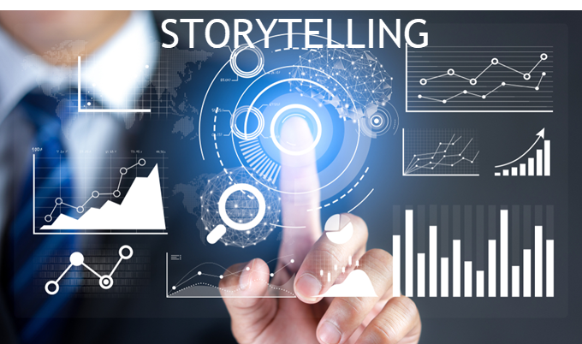
Content
01
Anscombe’s Four Datasets
02
The Simplest Graphics
03
Benchmark, Decisions, & Analysis
04
Visual Decision-Making Tools
05
Visualize & Persuade
06
Visual Animation Tools
07
Visualizations Used in Statistics

Slide 3


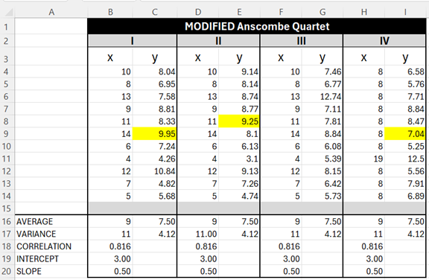
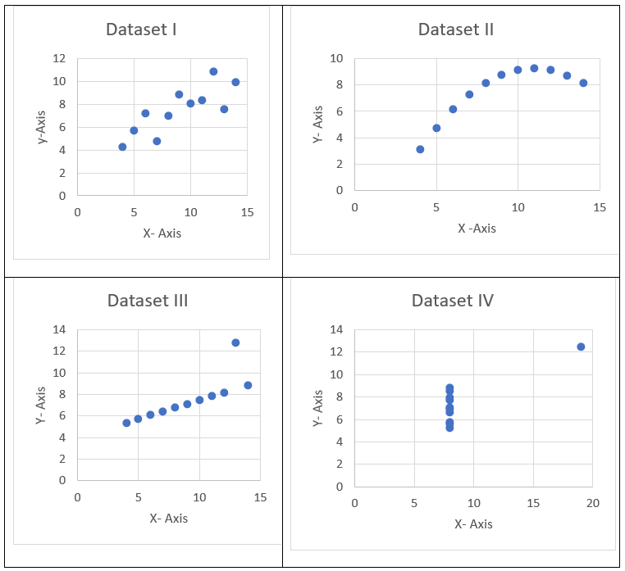


1. Anscombe’s Quartet
Same average, same variance, same correlation, same intercept, same slope
Is this data similar?
All interns worked approximately the same number of hours per week, but on different days with some overlap with other interns – 4-hour shifts.
Campus travel open every day of the week. Scheduling and working around classes is a scheduling nightmare.
The facilitator asked for the interns to create a report so they could assess ticket sales, destinations, sales people performance.
When you visualize it, you see that the visuals tell a different story – they are not similar.
Notes:
In 1973, Anscombe built four datasets of eleven points each. Statistically they are very similar: averages, variances, correlation, and even the linear regression formula are the same. Here are the four datasets slightly modified from the original.
When calculated, the following statistical information is true for each of the four datasets.
• The average X value is 9; the average Y value is 7.50
• The variance for X is 11 and the variance for Y is 4.12
• The correlation between X and Y is .816
• The linear regression is y = .50x + 3

Slide 4




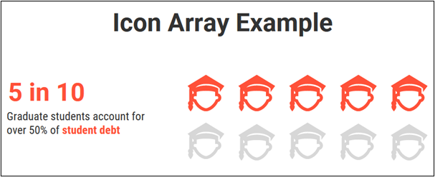
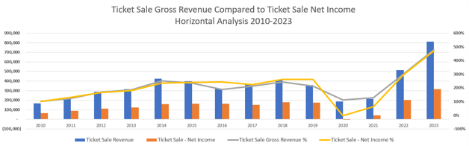
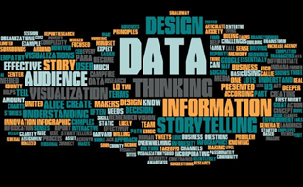
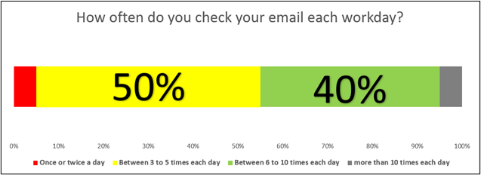
2. Data Storytelling
Sparklines, Word Clouds
Icon Array & Stacked Bar
Combo Charts
Quickly show trends
Support the story with a carefully crafted icon array or a meaningful stacked bar chart.
Carefully constructed combo charts should support the story but consider adding a handout if the trend exceeds five years.
Notes:
Sparklines are small, condensed visual representations of data that are great for a quick overview of trends and patterns. They are not detailed like full-fledged charts or graphs, but they offer several insights. They are so tiny that they fit within one cell of a spreadsheet!
Word clouds are just visual representation of text in graphic form where the size of each word is relevant to importance or frequency. Essentially, the more often the word is used, the larger the text.
An icon array uses small symbols to represent individual data points. They are useful for frequencies or proportions. There are specific uses of color, specific icons, and color coordination of the icons.
An example of starting with a horizontal stacked bar chart often used to represent the results of survey questions. In this example, instead of bars, you see icons representing the results. Notice that the colors also represent information to the viewer. Red represents concern and gray represents “a gray area” where employees check their email too often.
A combo graph is a combination of two column charts, two-line graphs or a column chart and a line graph(s). You can work from a single dataset or two datasets as long as the datasets share a common base. You want to use combo graphs to show some kind of relationship or trend.

Slide 5
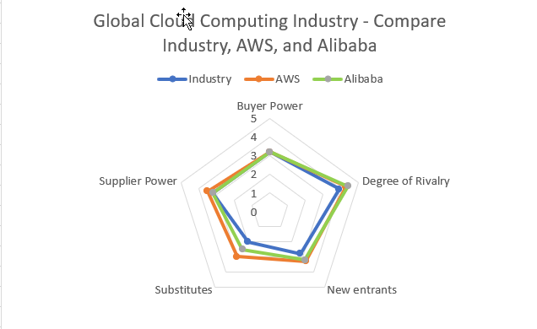
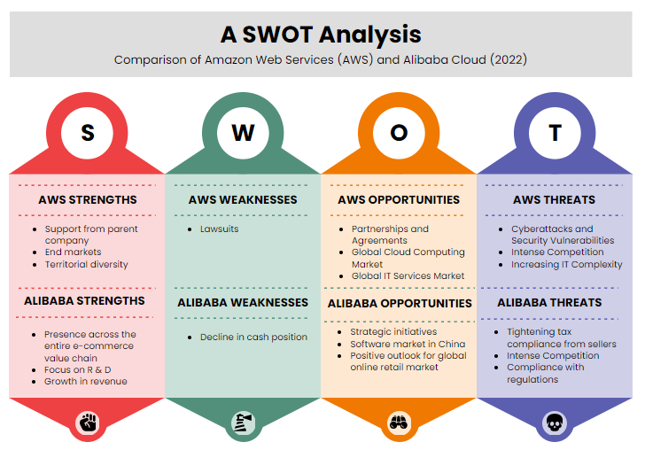
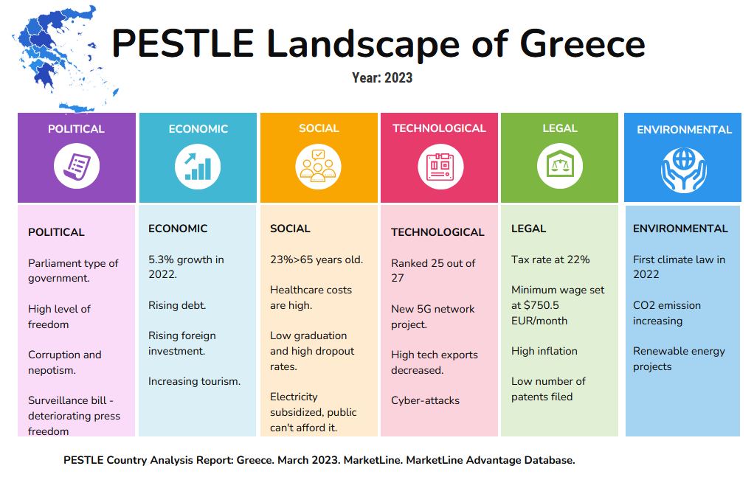
3. Benchmarks Tools
Porter’s Five Forces
SWOT
PESTLE
Buyer Power, Degree of Rivalry, New entrants, Substitutes, Supplier Power. Use MarketLine Industry Profile
SWOT = Strengths, Weaknesses, Opportunities, and Threats.
PESTLE = Political, Economic, Social, Technological, Legal, & Environmental. There are variations (like showing only PEST)
Notes:
For this chapter’s purpose, consider four types of benchmarking: 1) performance benchmarking; 2) practice benchmarking; 3) internal benchmarking, and 4) external benchmarking. Every industry should use benchmarking to help understand and transfer ‘best practices’ from other organizations and improve organizational performance.
Benchmarking Tool #1: Porter’s Five Forces
One of the best benchmarking tools to understand industry competitiveness is Porter’s Five Forces because industry leaders recognize the components. For example, MarketLine Advantage is a world leading provider of industry profiles that include Porter’s Five Forces. MarketLine Advantage showcases over 30,000 companies, over 3,500 industry profiles, and contains over 110 country profiles (MarketLine Advantage Brochure, 2023). MarketLine uses Porter’s Five Forces analysis framework “to evaluate the competitive pressures on ‘players’ rival companies in a particular market” (MarketLine Advantage Brochure, 2023). Industry profiles include five-year forecasts, practical application of Porter’s Five Forces analysis, and company financial metrics. Most college libraries have access to the MarketLine Advantage tool.
As you may recall, a SWOT will show Strengths, Weaknesses, Opportunities, and Threats. Strengths and weaknesses are considered internal, and opportunities and threats are considered external.
Once a company conducts a SWOT (either for their own organization or compared to a competitor), the next step is to develop strategies and action plans based on the insights gained from the analysis.
These include:
Capitalize on strengths: Leverage a company’s strength to gain a competitive advantage.
Address weaknesses: Work to improve identified weaknesses and develop plans to enhance capabilities, skills, processes, or resources pertaining to areas of weakness.
Exploit opportunities: Capitalize on external opportunities that align with the company’s strengths.
Mitigate threats: Develop strategies to minimize the impact of external threats on the business by creating contingency plans, diversifying offerings, or strengthening relationships.
Benchmarking Tool #3 PESTLE (Also a Strategic Analysis Tool)
A strategic analysis tool should be used anytime your company is considering expansion into a new geographic area. PESTLE Analysis incorporates: P = Political (or sometimes referred to as Politics), E = Economical, S = Social, T = Technological, L = Legal, and E = Environmental. MarketLine uses PESTLE and PEST as part of the country analysis framework. So, for companies considering expanding their market, this is a critical tool.

Slide 6
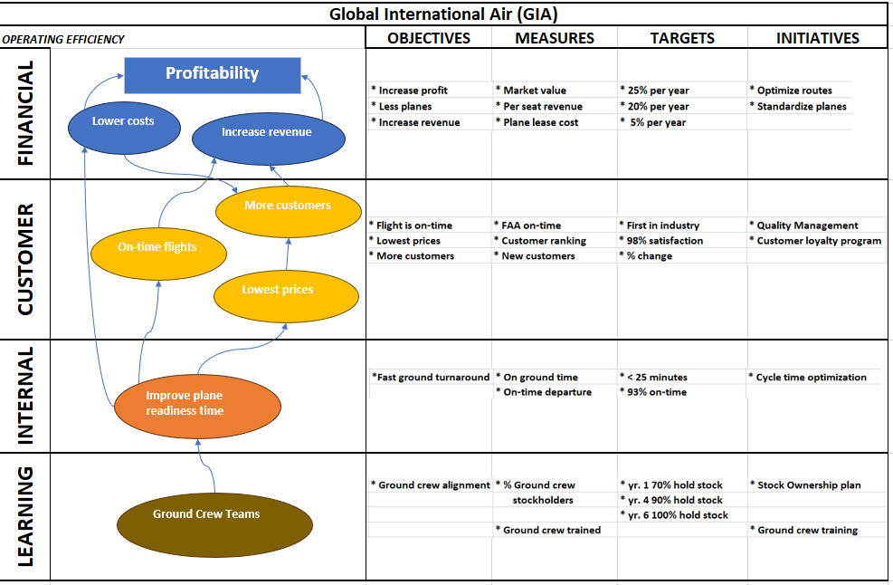
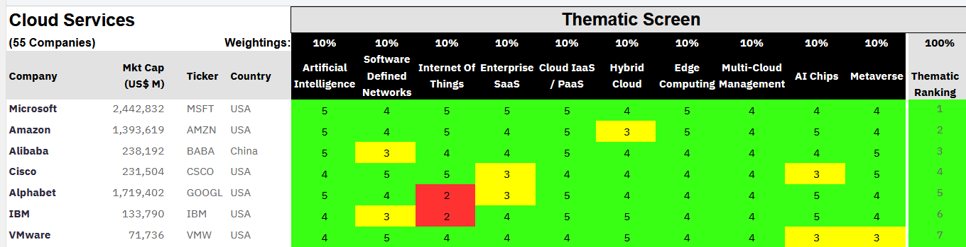
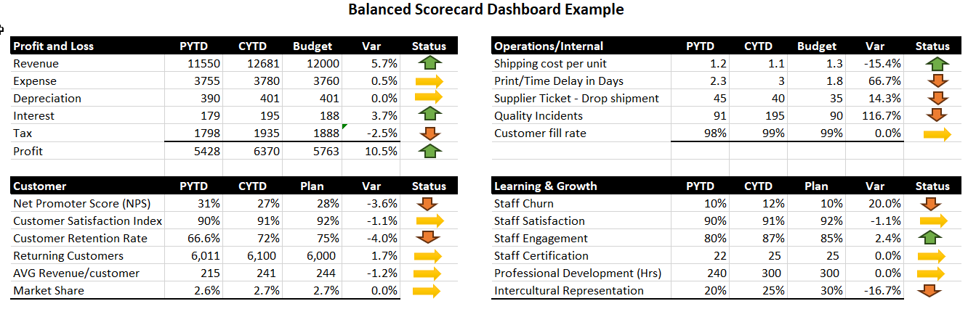
3. Continue: Benchmark-BSC
Balanced Scorecard (BSC)
BSC Thematic Scorecard and BSC Dashboard
Balanced Scorecard is a strategic management system from Kaplan & Norton. Shown is a sample strategy map using BSC.
Notes:
Benchmarking Tool #5 – Balanced Scorecard
There are several types of performance metrics that should be considered for your organization. Organizations need performance indicators to measure performance and the organization’s ability to reach their goals.
One of the first in this section is a Balanced Scorecard (BSC). This benchmarking tool was first introduced by David Norton and Robert Kaplan in the late 1990’s. BSC is considered to be one of the first performance metric tools to take into account nonfinancial information. The BSC measures four main aspects: learning and growth, business processes, customers, and finance (or for a nonprofit, instead of customers, it can be donors

Slide 7
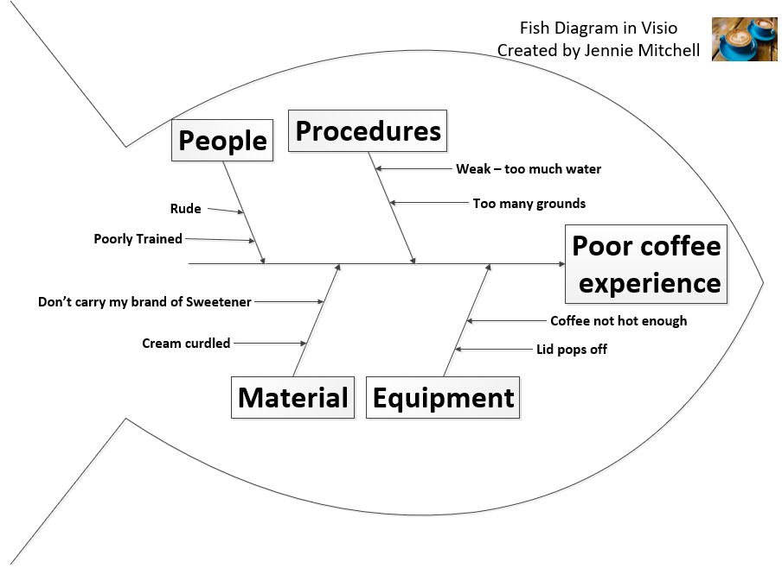
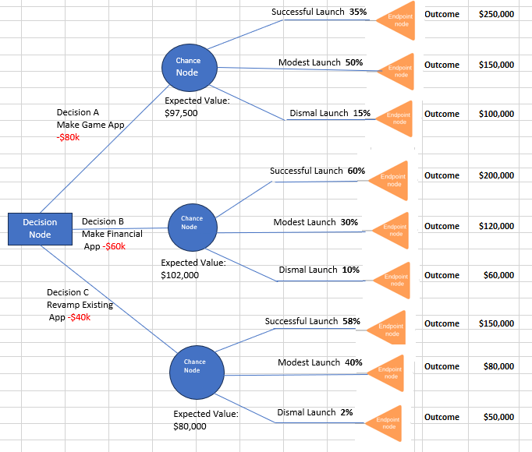
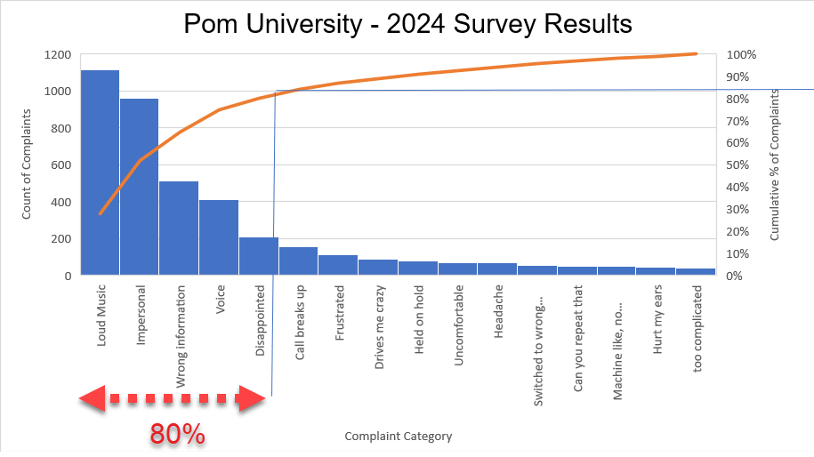
4. Decision-Making Tools
Ishikawa
Decision Tree
Pareto
The head of the fish represents the problem. The symptoms are organized in this case by People, Procedures, Material & Equipment.
A decision tree starts with a single node (the square symbol) and branches into possible outcomes. A chance node shows the probabilities of a certain event.
A Pareto diagram is a bar chart plotted by order of decreasing frequency relative to other data points. Have you heard of the 80/20 rule? Pareto represents this.
Notes:
Decision-Making Tool #1: What is an Ishikawa Diagram?
An Ishikawa diagram was invented several decades ago by Kaoru Ishikawa to help a team identify and arrange the causes of a problem. It is a brainstorming tool that can help a team organize, visualize, and communicate. Often teams use sticky notes to think of all the causes that contribute to a specific problem. You can still do that! Just start with five or six categories and build your fins. For example, assume that you have a coffeeholic in your family.
Decision-making Tool #2: What is a Decision Tree?
A decision tree offers a systematic approach to dissecting choices and their potential outcomes. It is a versatile decision-making tool that can be used in any industry to transform intricate decisions into a step-by-step journey. This section explores the foundational principles of the decision tree’s creation – from understanding decision nodes and chance nodes to assigning probabilities and calculating expected values. According to Investopedia (2019),
“a decision tree is a diagram or chart that people use to determine a course of action or show a statistical probability. ... Each branch of the decision tree represents a possible decision, outcome, or reaction. The farthest branches on the tree represent the end results” (para. 1).
Decision-Making Tool #3 – How can a Pareto Diagram help?
This tool enhances your ability to make informed decisions and has been adopted by many fields, especially in the context of quality management. The Pareto Diagram graph prioritizes keys factors through a visual representation of what industry experts call the ‘80/20 rule’. The typical data used to construct a Pareto Diagram is qualitative data.

Slide 8

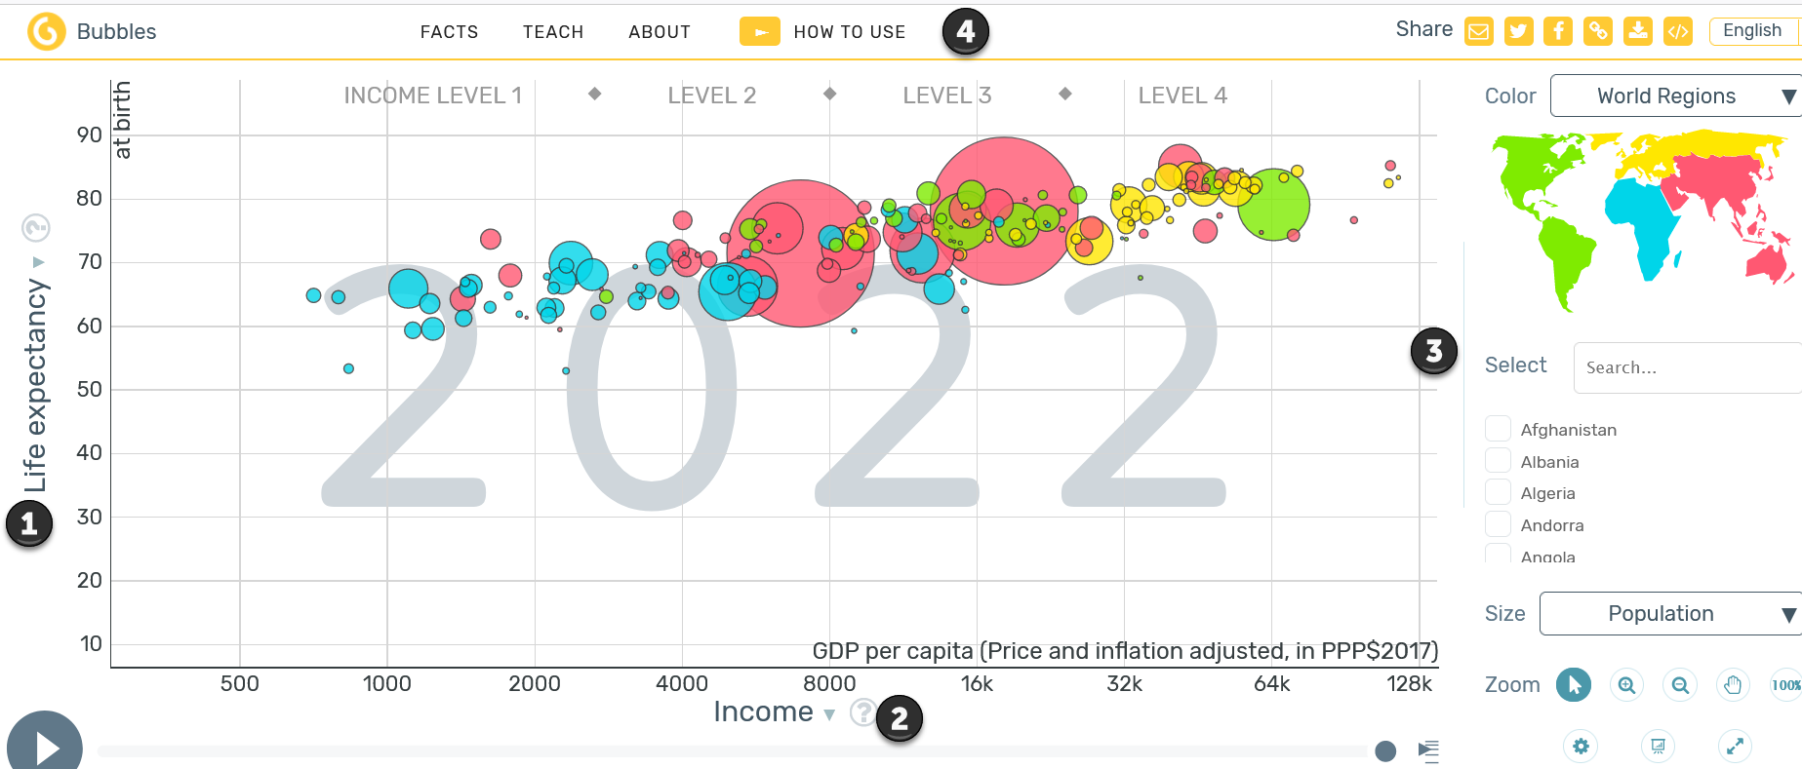
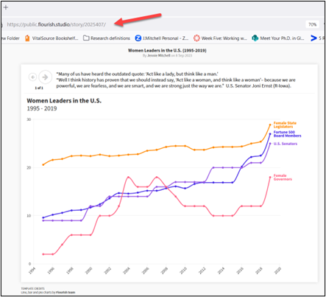
5 & 6. Visualize & Persuade
Poster Shows
GapMinder
Flourish
Always check the conference guidelines for a poster session Most have similar requirements.
GapMinder can be used for your own data. It is great for years of data, especially if you want to see trends and how variables interact. GapMinder is an interactive infographic (see the play button).
See this in action by visiting:
https://public.flourish.studio/story/2025407/
Notes:
What is a poster show?
A poster show is an event where posters are on exhibition and contain a researcher’s findings, projects, or ideas using a poster as a visual aid. Posters contain visually appealing representations of the subject matter. Posters are often created in PowerPoint and the sizes include 24” X 24” templates to 48” X 96” templates, and every size in between. (Warning: PowerPoint is limited to 56” X 56” in size.) The size depends on the guidelines of the event organizer and whether the presenter wants a vertical or horizontal poster. Attendees can browse through the posters and ask questions to the presenters and many of the remote poster sessions include ‘live’ sessions where the presenters put on a short presentation and take questions from the virtual audience.
GapMinder – a Visualization Tool Animated Through Time
If you have data that has years and you want to show the trend over time, this product will fill that need. But before you add your own data, explore Gapminder because the data already collected may offer further insight.
Flourish – a new data visualization tool for Canva
According to Christine Hall (2022), “Canva acquired Flourish in mission to tell better stories with data” (para 1). Canva has a free account available to students and educators. In addition, Canva has many apps that add to Canva’s already broad range of infographic and design features. One such app is Flourish. To use Flourish in Canva, you must add it as an app in Canva, set up a new account in Flourish, and connect to them. One of the key impacts of Flourish is how the animation can help inform, persuade, and inspire your audience.

Slide 9
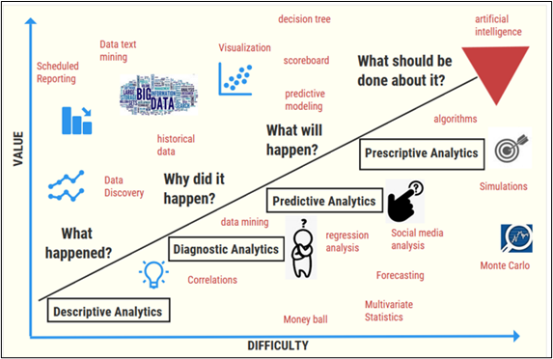
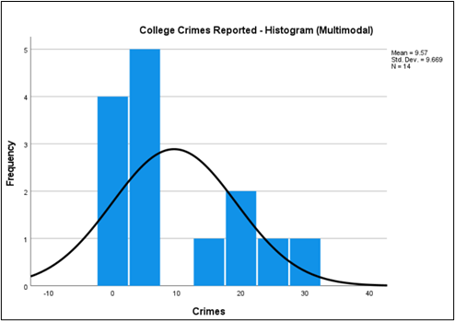
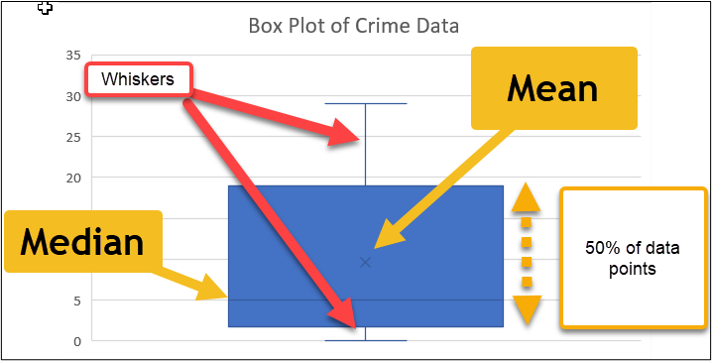
7. Visuals & Statistics
Statistics
Histograms
Box Plots
Notice that the axes are value and difficulty.
A histogram is a visual of the modes. This shows the data is skewed.
Box plots show central tendency, the data range, and outliers. This example has no outliers. If it did, you would see a point beyond the whiskers.
Notes:
Descriptive statistics – describe and summarize the data and display characteristics of the location, spread, and shape of data. Through visuals, you can describe a trend or specific features. Tools used to visualize descriptive statistics include bar charts, pie charts, histograms, scatter graphs, boxplots, and more. Descriptive statistics address the question, ‘What happened?’. Numerical descriptive tools allow you to summarize data for average, mean, mode, and minimum and maximum. There are two types of statistics used to describe data
The measure of central tendency (mean, median, or mode)
The measure of spread through range, quartiles, variation, and standard deviation
There are three types of skewness:
a positive skew (long right tail),
a symmetrical distribution (the bell curve or the normal distribution), and
a negative skew (long left tail).
In a normal distribution, the tails on either side of the curve are exact mirror images of each other. In the histogram of the College Crime dataset shows a positive skew, or long right tail.
How to Interpret a Box Plot
Central tendency: If the median is near the center of the box (the example is not), the data is roughly symmetric; if it’s closer to one end, the data may be skewed.
The length of the IQR illustrates the data’s range. A longer box indicates greater variability, while a shorter box suggests more consistency.
There are no outliers in this example, but if an outlier existed it would show as a data point beyond the whiskers.

Slide 10
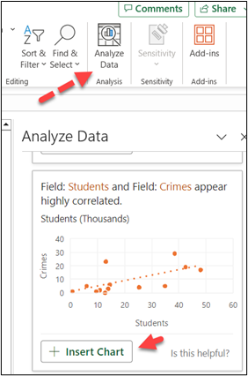
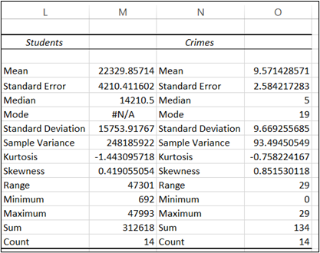
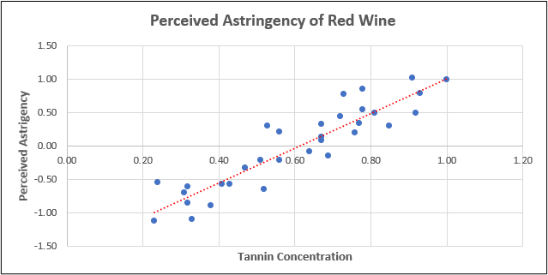
7. Continue Statistics
Analyze Data in Excel
Descriptive Statistics
Scatterplot
Excel now features a button called Analyze data and will automatically show examples – this is a scatterplot
The descriptive statistics is for the “fake” crime data. This statistic was completed in Excel. Review and explore, so you can interpret it.
Positive relationship between Perceived Astringency of red wine.
Notes:
Inferential statistics Vs Diagnostic Analytics
Inferential statistics takes the boundary a large step beyond descriptive statistics. It includes hypothesis testing, confidence intervals, regression analysis and more. It is different from diagnostic analytics. Diagnostic analytics’ goal is to understand ‘why’ something happened. It aims to identify the root causes of past events or trends. Why did sales decline? Why did enrollment drop? Diagnostic analytics works with historical data and focuses on analyzing events that have already occurred. Diagnostic analytic techniques include drill-down, data discovery, data mining, and correlations. As you might expect, the healthcare industry uses this analytical model every day. A sudden spike in the emergency room count could be pointing to an infectious agent that has broken out in your area (think of COVID-19!).
The questions often asked for inferential statistics might be ‘How likely…?’ or ‘What will happen…?’. Inferential statistics can be applied to both historical and future data to project estimates. Inferential statistical techniques provide insight to help the decision maker arrive at a deduction or conclusion. Inferential statistics is a technique that allows us to draw inferences or conclusions about the population from the sample. The tools used most often include hypothesis test statistics (e.g. t-tests, ANOVA) though some of the concepts are beyond this text. However, not all. So, look at the type of data visualizations used in inferential statistics.
You can still expect to see histograms, box plots, and scatter plots as some of the first steps because you should always conduct descriptive statistics to understand your data. Other types of tests could be probability plots, residual plots, time series plots, and many others.
Making a Scatter Plot that Tells a ‘Clear’ Story
One of the main visuals in the inferential statistics realm is a scatter plot which is valuable for visualizing the relationships between two continuous variables. Sometimes you expect a relationship, and the scatter plot will tell you if there is a correlation (or relationship). To understand the use of scatter plots, look at the relationship between perceived astringency and tannins in red wine

Slide 11
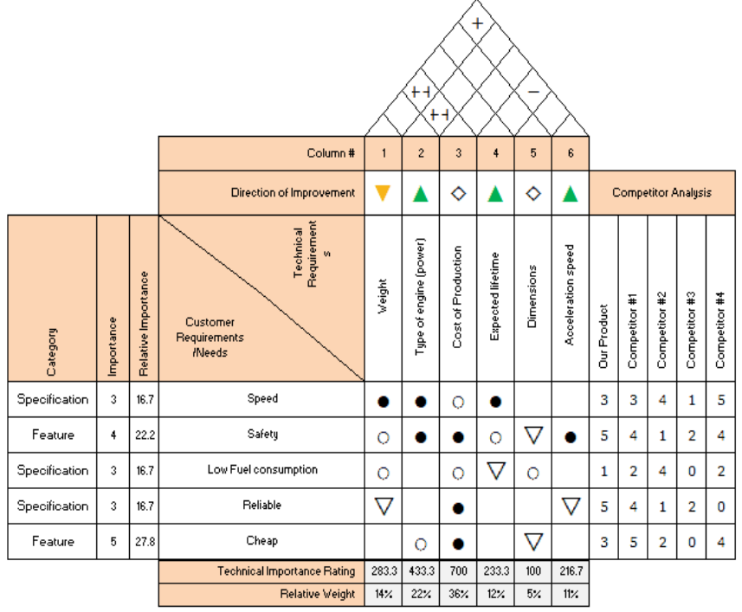
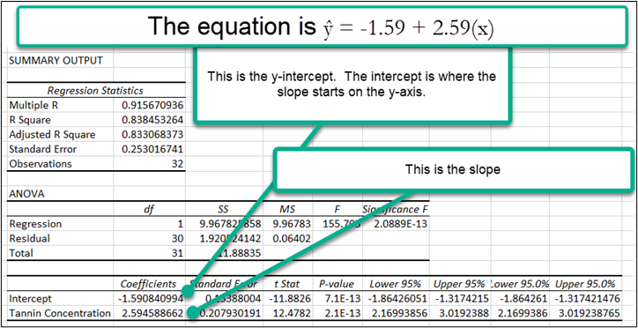

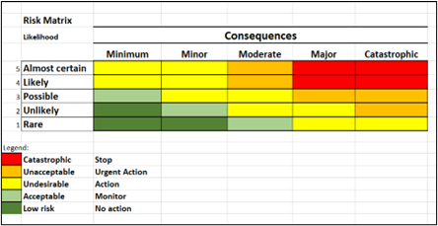
7. Continue Statistics
Heat Maps
Six Sigma
Regression
A heatmap is a visual presentation of data and often use the colors green, yellow, and red to show the magnitude of the data and/or identifies risk.
Source: Hessing, T. (2025) Quality Function Deployment (QFD and House of Quality (HOQ). https://sixsigmastudyguide.com/house-of-quality-hoq/
Regression is an inferential statistical tool. It answers the question, “How does change in one (or more) independent variable influence a dependent variable?”
Notes:
Heatmaps & Correlation Matrix
A good visual cue is a heat map. A heatmap is a graphical representation of data by color and it is a great tool for large datasets. For example, heatmaps are often used to show airplane delays, ranging from green for on-time landing, to bright red for delays as much as 40 minutes. Some organizations use a heat map to show website traffic by time of day.
Correlation is not causation, but it is clear that Board members and CEOs are NOT on the same page. A correlation at .90 to 100% is very highly correlated, .7 to .9 is highly correlated and .5 to .7 is moderately correlated.
Risk Matrix Heat Map
What is a risk matrix? Essentially, a risk matrix is a visual where the organization assesses its exposure to types of harm and plots this information on a risk matrix. The matrix is then used to develop management strategies and implement actions that manage the risk. The risk matrix should consider all the risks associated with an organization including financial risk, operation risk, workforce risk, client (customer) risk, and reputational risk, and in the case of an NFP, programmatic risks.
Regression Terms:
Multiple R This is the correlation coefficient. A value of 1 means a perfect positive relationship. A value of 0 means no relationship, and a value of -1 means a perfect negative relationship. Correlation tells you the degree (or strength) to which two variables move in relation to each other. Correlation measures association but not causation. In this scenario: .915670936 represents a highly positive correlation (which is what our scatter plot showed us).
R Square This is called the coefficient of determination. It tells you how many points fall on the regression line. In this example, 84% of the values fit the model.
Adjusted R Square This adjusts for the number of terms in a model. You would use this if you had more than one X variable.
Standard Error: First of all, this is not the same as the standard error in our descriptive statistics! This standard error is about precision. Essentially, this model predicts a variation around the regression line of 0.253016741.
ANOVA: If you are doing basic linear regression (and we are), this section can be skipped. But just so you know what these things are, here is the list:
The df is the degrees of freedom (the sample minus 1). The SS equals Sum of Squares. The MS = Residual SS/Regression degrees of freedom. F tests for the null hypothesis. Significance F is the significance associated with the p-value (if you look, you will see the same value in the third section under p-value. When you first see this, you may not know what the ‘-13’ means. Just know that it means that it is significant.

Slide 12

8. Data Visualization
Tools
Data Visualization Tool | Website Address | Free ?
Flourish: tons of templates, great animations, intuitive to use (also Canva & Venngage) | https://flourish.studio/ | Yes
Google Data Studio: integrated with Google sheets – several templates including a Gauge, some learning curves. | https://lookerstudio.google.com/visualization | Yes
Microsoft Power BI – best product for dashboards. Some learning curves, visualizations and practice datasets are available. Faculty & Students use Microsoft 365 account (adding AI tools and Copilot). | Students/Faculty access through apps for Microsoft 365 Nonstudent: https://powerbi.microsoft.com/en-us/ | Yes Trial
Tableau Public – Full version available free for download. However, everything created is available in Tableau’s visual gallery. (Non-free version expensive) | https://public.tableau.com/app/discover Make sure to visit Viz of the Day! | Yes
Datawrapper – The tool is built for journalists. Intuitive and easy to use. *Free plan includes 10,000 charts. | https://www.datawrapper.de/ | Yes*
Infogram- intuitive, drag-and-drop, some interactive visualizations. Plug-in for WordPress users. Basic account has plenty of templates. | https://infogram.com | Yes
Google Sheets or Microsoft Excel™ | https://workspace.google.com/products/sheets/ | Yes
Pririty Stakeholder
Stakeholder Name

Slide 13


Ch 3 Case
Empowering Women Leaders

Slide 14






  Step 4
Select preview and add labels, animation. Then create story.
  Step 3
OECD Employment Share of Female Managers
Select “Data”tab and replace the template data with the Female Manager Data
  Step 2
At Flourish, create a
Choose a projected line chart template. Templates come with data in them that you can replace.
Step 1
Please visit the step-by-step instructions to use Flourish.
Open Canva with Flourish or directly login (or create an account) at Flourish https://flourish.studio/

Slide 15
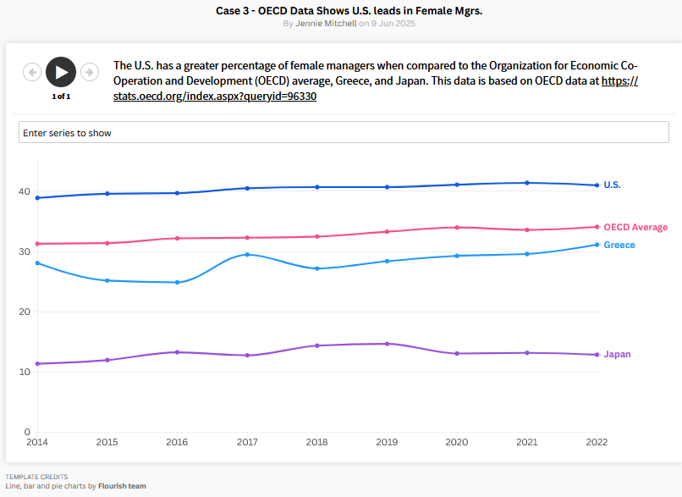
Click this link to see the animated chart
https://public.flourish.studio/story/3159473/

Slide 16




Chapter 3
THANK YOU
Jennie Mitchell, Ph.D.
jmitchell@smwc.edu
Saint Mary-of-the-Woods College
Trent Deckard
Trent.deckard@smwc.edu
Saint Mary-of-the-Woods College

