Slide 1


LO#1 – Review various dashboards and evaluate best practices
LO#2 – Understand how to clean data
LO#3 Apply the appropriate data visualization: report versus dashboard.
LO#4- Build visuals and dashboards to structure storytelling.
LO#5 – Use a dashboard for gap analysis to support decision-making.
CHAPTER 4
Interactive Dashboards
Leveraging Data Visualization to Communicate Effectively
By Jennie Mitchell, Ph.D. Saint Mary-of-the-Woods College
and Trent Deckard, Indiana University

Slide 2

Content
01
Report Versus Dashboard
02
Simplest Techniques to Visualize & Tell a Story
03
How Story Telling Connects to the Brain
04
Dashboard Cleaning & Presentation Advice
05
Advanced Excel Dashboard & Analyzing Insights
06
Example Dashboards and Reports

Slide 3


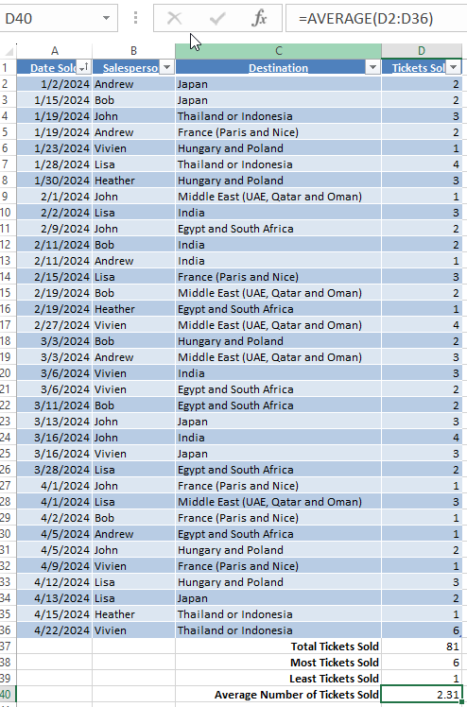
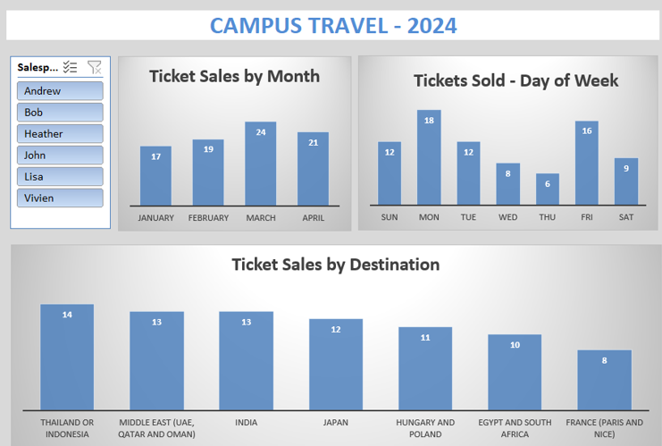


1. Report Versus Dashboard
Slicers drive the interaction of each chart.
Which do you need?
All interns worked approximately the same number of hours per week, but on different days with some overlap with other interns – 4-hour shifts.
Campus travel open every day of the week. Scheduling and working around classes is a scheduling nightmare.
The facilitator asked for the interns to create a report so they could assess ticket sales, destinations, sales people performance.
Reports can help you become familiar with the data. Dashboards can help users interact with the charts in the dashboard.
Notes:
There is a video that takes students through the entire dashboard process with a simple dataset.

Slide 4

1. Creating a Dashboard
YouTube Video
Which do you need?
All interns worked approximately the same number of hours per week, but on different days with some overlap with other interns – 4-hour shifts.
Campus travel open every day of the week. Scheduling and working around classes is a scheduling nightmare.
The facilitator asked for the interns to create a report so they could assess ticket sales, destinations, sales people performance.
Follow this example.

Slide 5


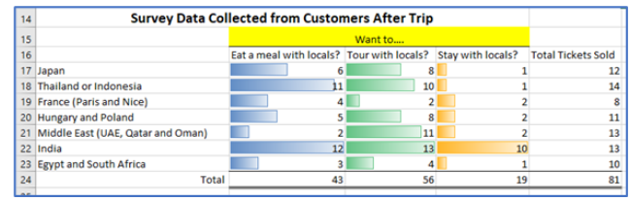
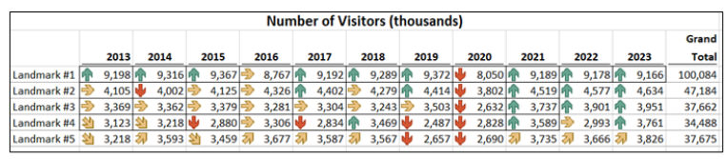
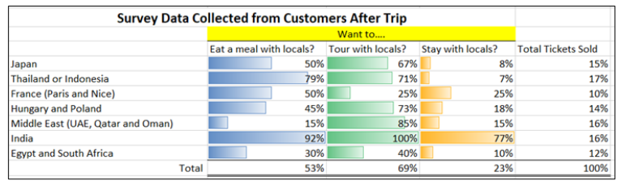
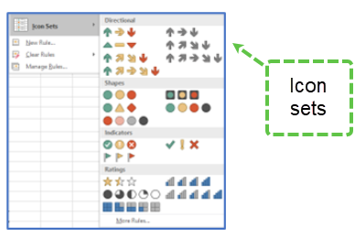
2. Simple Techniques
to Visualize and Tell a Story
Databars– Conditional Format
Icon Sets for Conditional Format
The use of conditional formatting in Excel has a large array of databars, color scales, and icon sets.
Icon sets can quickly tell the user the trend from a previous year.

Slide 6




Excuse me. I’m a speaker in this room at 1:00. Is there a way up to the platform for me?
77%
FEAR Public Speaking
Jaconbs-Pinson, E. (2025). 30+ Revealing Fear of Public Speaking Statistics for 2025. https://crowncounseling.com/statistics/fear-of-public-speaking-statistics/
Strategies:
Get organized
Be prepared
Careful with crutches
Practice, practice, practice!
Notes:
FEAR: Something that happens between the time you are planning for a presentation and the actual presentation. If you have a fear of public speaking (Glossophobia), it may be something that you have fought since childhood. Sweaty palms, faster heart rate, and memories of prior poor performances or presentations may get in the way of connecting with the audience. About the only thing that will help with pre-presentation fear is practice, practice, practice. Try out your storytelling with a pilot audience (family, friends, and coworkers are supportive and good critics). Get organized and make sure the technology works, that internet is available, and the space works. There is nothing worse than presenting when the display unit is too small for the room. If you know this ahead of time, you can request a second display, or encourage the audience to move forward, or even re-arrange the chairs.
Imagine you will be presenting in the room (pictured here) and need to keep your audience engaged even though there are potential distractions. Do you need a wireless microphone? Do you have a wireless presentation clicker to advance the slides? Oh wait! Where do the slides show? If someone asks a question, will you hear them? Or do you need to set up a way the audience can send questions through a phone app? Are you being asked to present both physically and virtually? If so, that brings another set of challenges.
Be prepared – know your presenting territory, and have water available, take deep breaths, and focus on the material.
CRUTCH: Most presenters use PowerPoint, but when you use it like a crutch it breaks the connection with your audience. Symptoms of a PowerPoint crutch: reading the slide, presenting with your back to the audience to see where you are in your slides, fumbling to remember what is next even with the slide up, excess ‘ums’ and other filler words. And please, if you notice a spelling error or typo, don’t point it out to the audience! Other things we use as a crutch – index cards. Most audience members cringe at the sight of index cards, especially when the presenter is flipping them and card-tricking them.

Slide 7






Report, Inform, Explain, Announce
2. Report, Inform, Explain, Announce
01
Determine most important information and determine best visuals to persuade 0 the right chart, infographic, or animation is important.
02
Start with a story that has a beginning, middle, and end. Can you summarize your presentation topic in 10-15 words? Do you get to the point quickly?
03
Avoid too much text and follow the 10-20-30 rule (10 slides, 20 minutes, font size 30.
04
Use the slide sorter to see if you have a simple structure: frame the issue, present the challenge, and explain how to solve the problem. Structure improves understanding, and users are more likely to retain the information.

Slide 8






Report, Inform, Explain, Announce
2. Collaborative Presentation
01 -Introduction
Speak with one voice.
02 - Handoff
Keeps the connection with smooth transitions.
03- Audience Engagement & Q&A
Use team dynamics to facilitate discussions – know which team member will field questions. Listen to the audience. Anticipate questions.
04- Keep to Schedule
05- Avoid annoying habits
Put your phone on “do not disturb” unless it is part of the presentation.
06- Gather feedback, debrief/reflect

Slide 9





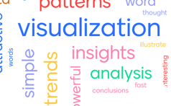

Report, Inform, Explain, Announce
2. Persuade, Inspire, Sell
01 –Know the arguments and your audience
Know the barriers – the audience needs to trust you. Use ethos, logos, or emotional appeal. Conduct audience research.
02 – Attention Grabbing opening
Anecdote, a surprising fact, a compelling question
03- Tell a compelling story with a call to action.
Craft a narrative that draws and resonates on a deeper level – connect.
04- Provide an ‘AH-HAH” moment
05- Get the audience involved
Polling app creates a word cloud. Audience uses their phone.
06- Be credible and maintain engaging delivery.
Practice, practice, practice

Slide 10
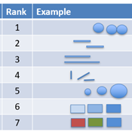
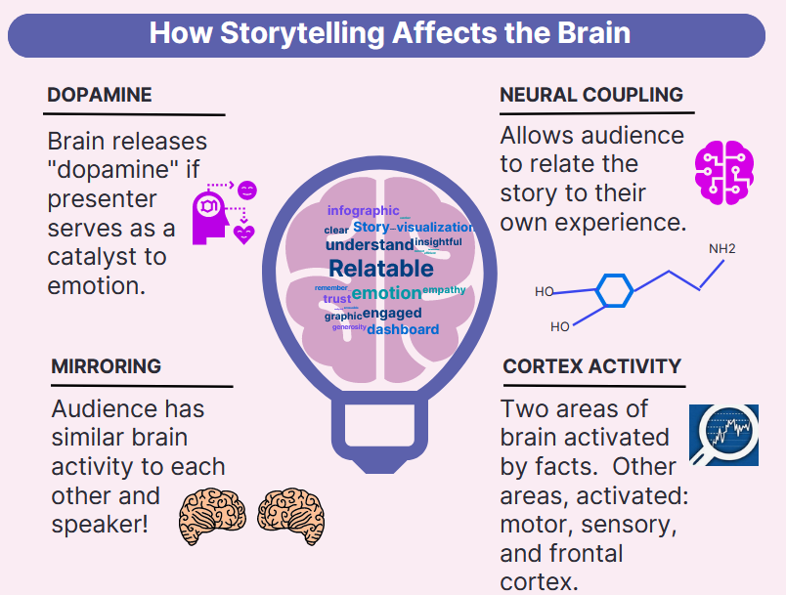
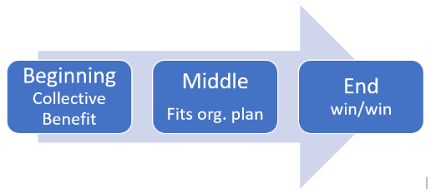

3. How Story Telling Connects to the Brain
How Your Brain Measures Visuals
Story Telling & the Brain
Story Basics
Ranked in order
Source: Cleveland & McGill. (1985).
Dopamine, Mirroring, Neural Coupling, Cortex Activity, and Narrative transport – all important concepts to help you connect to your audience.
New to story telling with data? Try PechaKucha. Twenty slides timed at 20 seconds each! Good practice.
Notes:
Our Brain when listening to a good story
If we add context to the mix, our stories affect the brain, and this is a good thing! In general, good storytelling can do the following (as seen in Figure 4.16 and listed here).
Dopamine: Enhances memory.
Mirroring: Experience similar brain experience as the speaker, we synchronize!
Neural Coupling: Listener turns the story into their own ideas.
Cortex Activity: Lights up more of the brain.
Narrative transport: engage emotionally. And if you engage emotionally, you increase trust, empathy, and generosity.

Slide 11
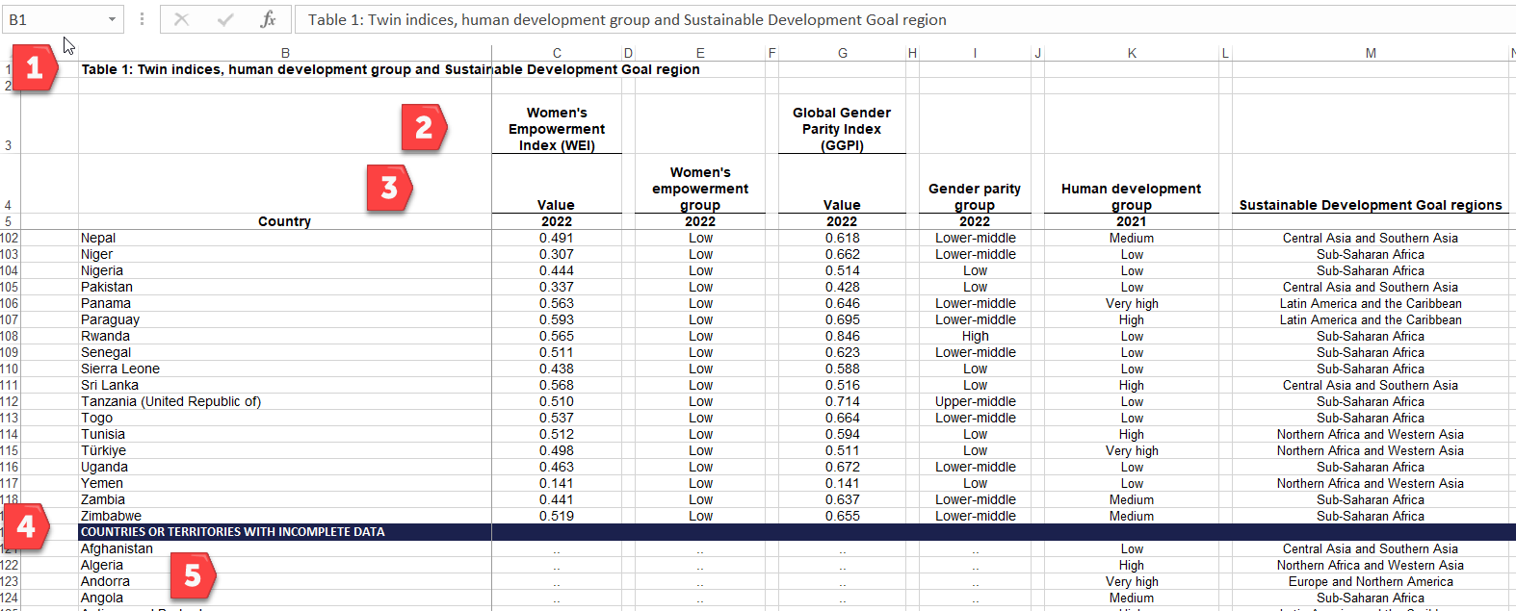
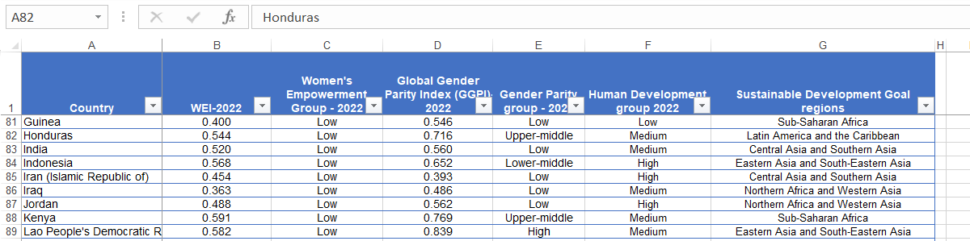
4. Cleaning Data
No Table & Noise
Cleaned & Converted to a Table
1.) To clean data, remove extra rows, 2) and 3), multiple headings columns with the arrow (filter) , 4) remove inserted titles over each section, and
5) Delete rows when data is missing. Next, format as a table
(then you can sort
Source: United Nations’ Human Development Report
Remove multiple rows. Reword as needed to have one heading and not multiple rows for titles. Format as a table. Then use the arrow to sort the data and get to know what the data contains.

Slide 12
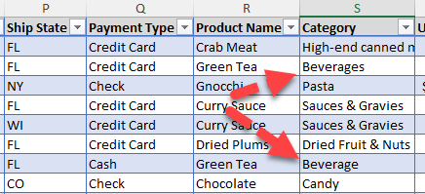
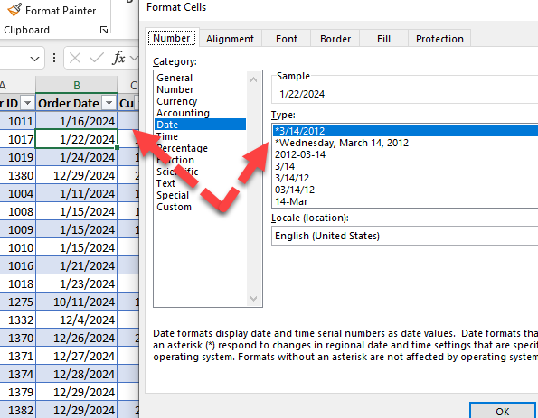
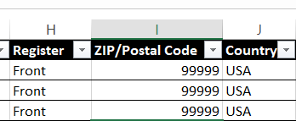
4. More Cleaning and Exploring Data
Remove columns that add no value
Fix Inconsistencies, Check Data Types
1.) To clean data, remove extra rows, 2) and 3), multiple headings columns with the arrow (filter) , 4) remove inserted titles over each section, and
5) Delete rows when data is missing. Next, format as a table
(then you can sort
Source: United Nations’ Human Development Report
Make sure that you check for inconsistencies in how data was entered. Excel will think it is a different category (i.e. Beverages Vs Beverage). Check data types – sometimes the person entering data might put in a date in a text type cell.

Slide 13
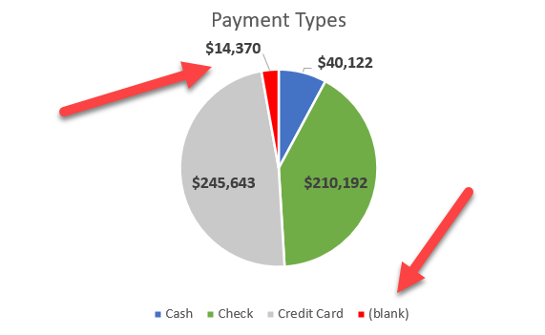
4. Data Exploring
Look for Anomalies
Why could sales show blank for payment type?
Perhaps the salesperson tried running the payment through credit and it was rejected. Solution – bill grocer.
Perhaps the salesperson collected the money but failed to deposit it. Solution – bill salesperson and add training.
Perhaps the customer complained (slow delivery, bad produce, wrong product) and the salesperson is trying to win the customer’s confidence by offering something free. Solution – discuss with salesperson and adjust sales.
Notice the legend – it shows sales that have a blank payment. No sale should be blank. This might mean that the salesperson did not collect the amount of the sales. Ask “Why?”

Slide 14
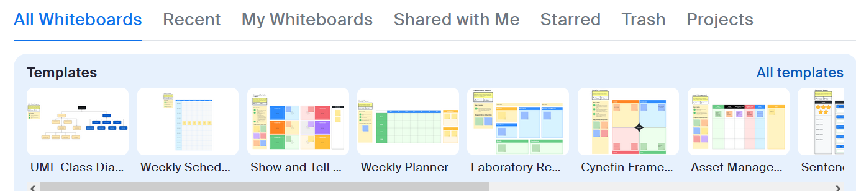
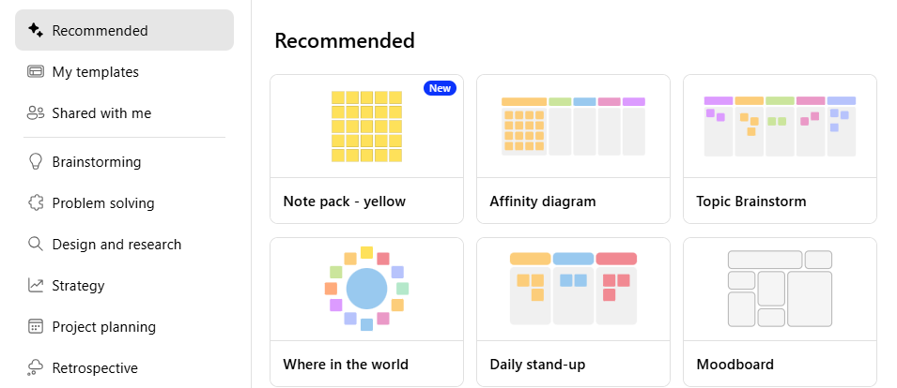
4. Dashboard Presentation Tactics
with a virtual team
Remote Teams
Zoom Templates
Create the right context for your team. Form your teams based on the strength of each person. Make sure your team is clear on the plan/goal.
Build a sense of community. Use tools so all your team members participate (like Zoom templates or Microsoft Team Templates).
Co-share leadership.
Microsoft Team Templates

Slide 15
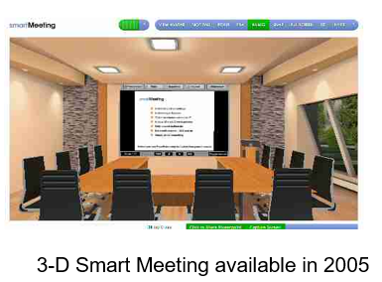

4. Continue - Avatar
Virtual Meeting Room in 2005 using Avatars
Virtual Event – United Nations
You use your gaming keys on your keyboard to move around, sit, wave your hand, etc. And this was in 2005!
MootUp. (2021). United Nations’ 75th Anniversary and Their First Virtual Event in MootUp. YouTube [Video]. https://youtu.be/0kkq98yF0q0?si=h2KRCTIbv7RdWfNL

Slide 16
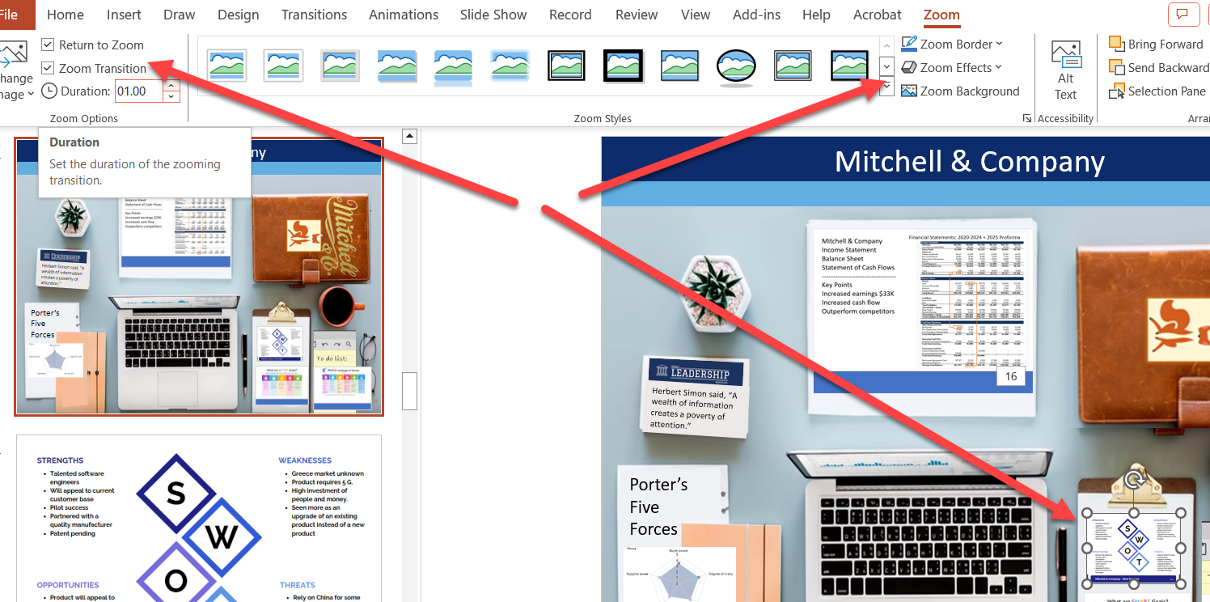
4. Continue - Large Audience
Parameters
Slide Zoom in PPT
Example of parameters:
The audience – adult professionals
Collaborative (team) presentation
Length of time – 20 to 30 minutes
A need to persuade the audience; may include a call to action
Structured with three goals: frame the issue with a story, present the challenge, and explain how to solve the problem
Three PPT Zoom Options: 1. Summary Zoom, 2. Section Zoom, and 3) Slide Zoom.

Slide 17
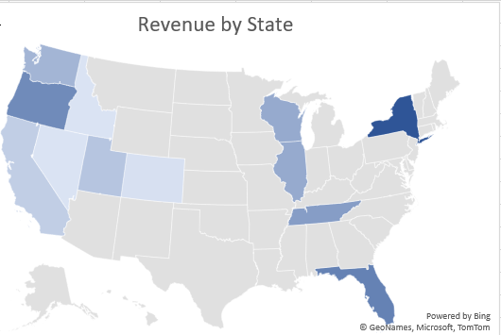

5. Advanced Dashboards
XCaliber Food Distribution
Get to know the data
How many customers?
How many salespeople?
To how many cities does XCaliber distribute food? How many states?
How many payment types and what are they?
What do you think of a blank payment type?
How many products?
Filter on the product called Blank. What product do you think it should be? And what do you base this on?
What range do you see in the unit price?
What is the range for the quantity?
What is the range for revenue?
What is the range for shipping fees?
How many countries?
How would you go about checking to see if orders are shipped the same day
Download the dataset.
See Step 2: Get to know your data. See if you can answer the questions just by using the drop-down arrow to filter.
Dataset Ch 4 – Original Dataset – XCaliber Foods with delivery time
Dataset Ch 4 – XCaliber Customer Satisfaction Survey Form

Slide 18
5. Continue - Advanced Dashboards
XCaliber Food Distribution
Owner’s Questions
1) I want to know how well my salespeople are doing. Which salespeople are selling the most, in what city, state, and region, and what are they selling? Are there two or three salespeople who could conduct the training (with pay)?
2) Are there products that should be dropped?
3) I want to know if using the summer intern in June & July was worth the cost (about $4,000)
4) Is every salesperson collecting from their customer by check, cash, or credit?
5) What is the range of invoices by customer and who are our best customers? Are there opportunities for upselling?
6) Are we shipping out within the same day on a consistent basis?
7) Do we have regional overlap? Are two salespeople selling to the same customer?
8) I want to increase revenue to $60,000/month in 2025. Can you do some sort of analysis to see the best way to reach this goal – perhaps using a GAP analysis or something like that?
9) I want to be able to ask a question and get the answer instantaneously. I think I heard it is called a dashboard. Can you set up a dashboard that allows me to analyze the data right along with you?
Download the dataset.
Follow steps in textbook to answer these questions using a dashboard.
Dataset Ch 4 – Original Dataset – XCaliber Foods with delivery time
Dataset Ch 4 – XCaliber Customer Satisfaction Survey Form

Slide 19
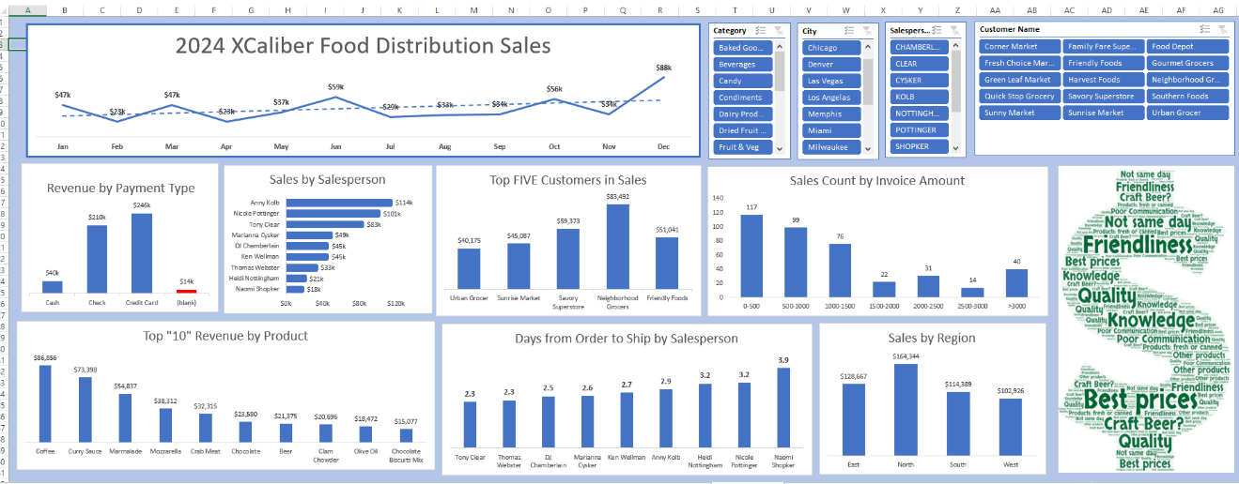
5. Continue Dashboard
Too Busy
Slicers: Category, City, Salesperson, Customer Name
XCaliber Food Distribution Company
Dataset Ch 4 – Original Dataset – XCaliber Foods with delivery time
Dataset Ch 4 – XCaliber Customer Satisfaction Survey Form

Slide 20

Continue 5. Gap Analysis
Gap Analysis
Basic Gap Strategies
Tools for Gap Analysis
Step 1: Identify the goals to be accomplished and the areas to be analyzed.
Step 2 – Analyze the current state.
Step 3 – Establish the goal and future goals.
Step 4 – Compare the current state to the goal (or ideal state).
Step 5 – Describe the gap and show the difference in percentages.
Step 6 – Organize the recommendations and create a plan to bridge the gaps. Use S.M.A.R.T. ( S = Specific, M = Measurable, A = goal Achievable, R= Relevant, T= Time bound.
Ishikawa, SWOT, PESTLE, McKinsey 7S Framework, Balanced Scorecard, and the Nadler-Tushman Model. Use the tool(s) that seems appropriate.
Expert Program Management (EPM). (2017, October 17). How to Do a Gap Analysis. [Video]. YouTube. https://youtu.be/AGQyaGtrTUc
XCaliber could:
Investigate geographic sales.
Investigate product base.
Investigate customer needs
Investigate customer satisfaction
Know the data first.
Organize GAP strategies using SMART.
Use the tools that support or help explain the reasons for the GAP.

Slide 21
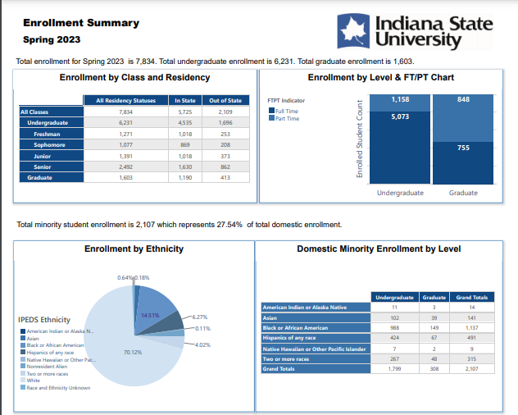
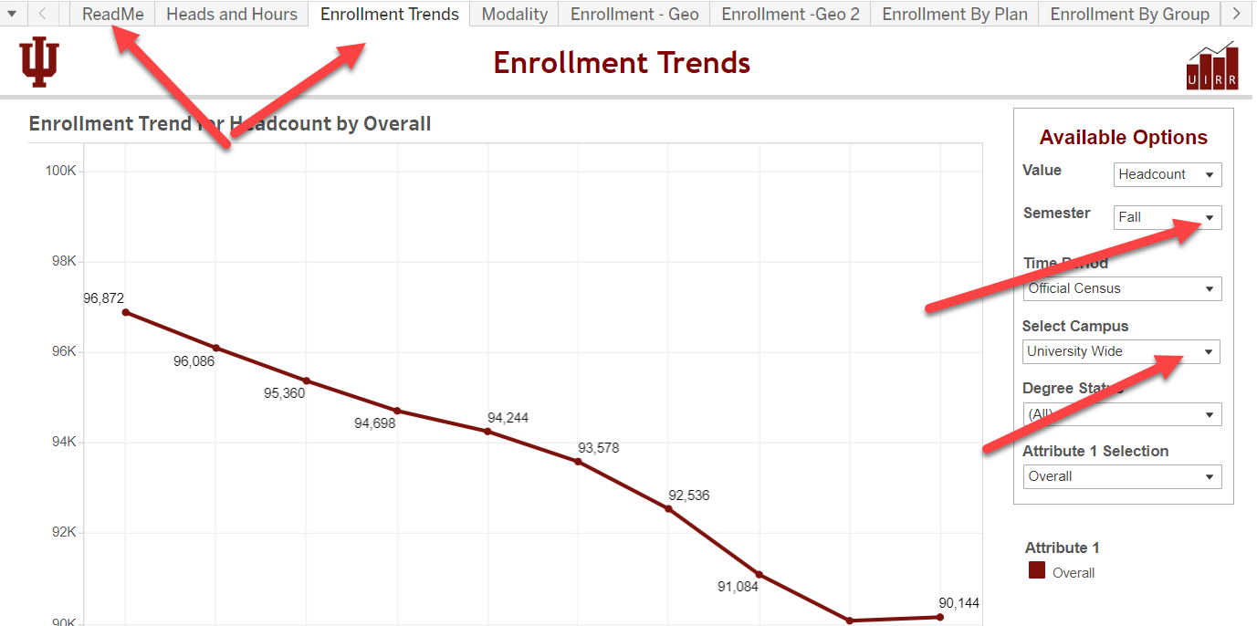
6. Example Dashboards
and Reports
Static Report
Interactive Dashboard
Informing
Allows user to answer questions and explore all options.

Slide 22


Ch 4 Case
XCaliber Food Distribution Company

Slide 23






  Step 5
Record presentation, tell the story, add the link to the recording.
  Step 4
Upload Excel Files and GAP Analysis Report.
  Step 3
Dashboard & Gap Analysis
Presentation
Develop a GAP Analysis Report and a Professional Presentation (with webcam) –
  Step 2
Incorporate a Word Cloud from the survey comments.
Step 1
Complete XCaliber Foods Distribution Company (Dashboard(s). You have a model to follow.
Please tell the story. See textbook for more details.

Slide 24




Chapter 4
THANK YOU
Jennie Mitchell, Ph.D.
jmitchell@smwc.edu
Saint Mary-of-the-Woods College
Trent Deckard
Trent.deckard@smwc.edu
Saint Mary-of-the-Woods College

