Slide 1


LO#1 – Apply Gestalt Principles to convey meaningful information.
LO#2 – Discern how the brain remembers information (iconic memory, strategies for short-term and long-term memory).
LO#3 Analyze and develop annual reports by leveraging tools like the CASS template, Gestalt Principles, and best practices.
CHAPTER 5
More than Charts!
Leveraging Data Visualization to Communicate Effectively
By Jennie Mitchell, Ph.D. Saint Mary-of-the-Woods College
and Trent Deckard, Indiana University

Slide 2

Content
01
Gestalt Principles
02
The Brain and How it Remembers Information
03
Infographics Used in Annual Reports
04
Technology Available for Annual Reports

Slide 3




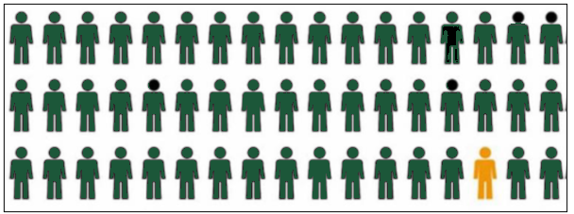


1. More than Charts!
Triangle or Pacman?
All interns worked approximately the same number of hours per week, but on different days with some overlap with other interns – 4-hour shifts.
Gestalt Principle of Closure
Gestalt Principle of Figure Ground
Gestalt Principle of Figure Ground
Gestalt Principles that will help you understand how our brains process data visualizations. The principles include proximity, similarity, enclosure, connection, continuation, closure, symmetry, and figure/ground
The giraffe is an example of closure. Even if more spots were removed you would recognize it.
Notes:
Gestalt Principles that will help you understand how our brains process data visualizations. The principles include proximity, similarity, enclosure, connection, continuation, closure, symmetry, and figure/ground

Slide 4

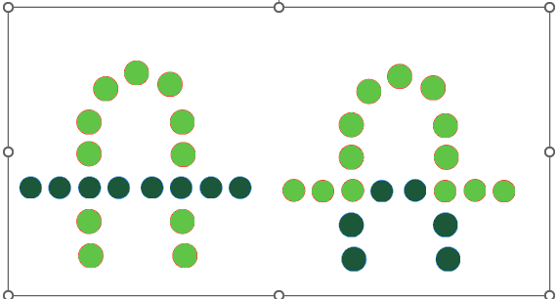
Gestalt Principles Continued
Gestalt Principle –
Proximity
Which principle supports your data?
Gestalt Principle –
Similarity and Dissimilarity
Gestalt Principle –
Continuation

Slide 5


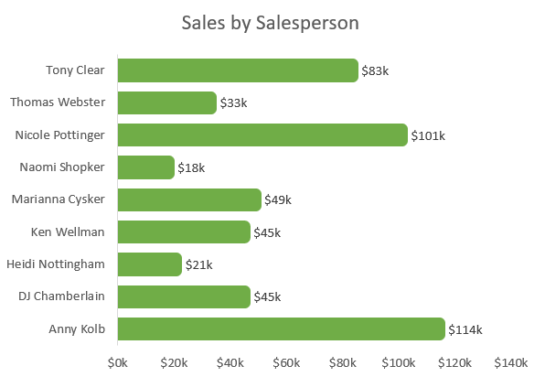
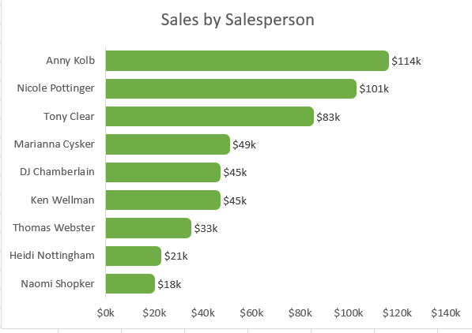
Gestalt Law of Prägnanz
to Visualize and Tell a Story
Not Sorted
Sorted Highest to Lowest
Your brain loves simplicity and will process simple patterns, so consider supporting the patterns by sorting the data.
Western Cultures read from the left to right
and from top to bottom.

Slide 6

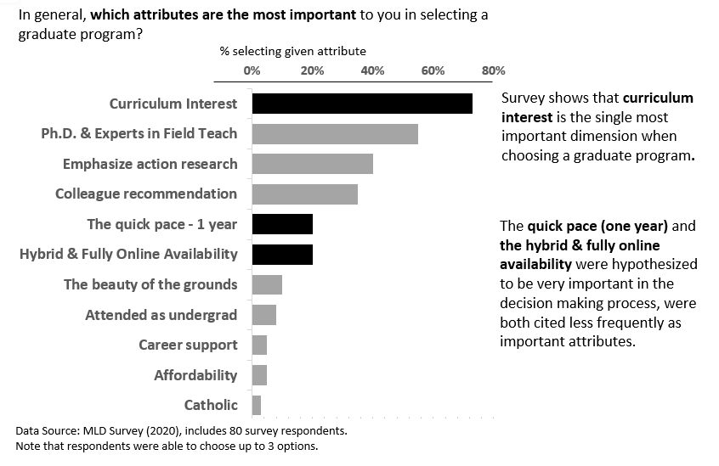
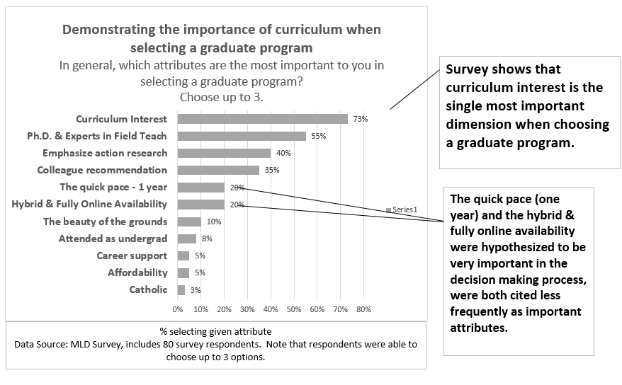
Report, Inform, Explain, Announce
What’s wrong with this design?
01
The title is too long – some of the information could be introduced when presenting the graph.
02
Several things repeated. If percentages at the end of the bar and the In the axis.
03
Series1 as a legend. Needs removed. It is not informative. No date on the graph and that is needed.
04
Clutter and key observations overwhelm the graph and the format with borders is somewhat distracting. Don’t need grid lines.

Slide 7
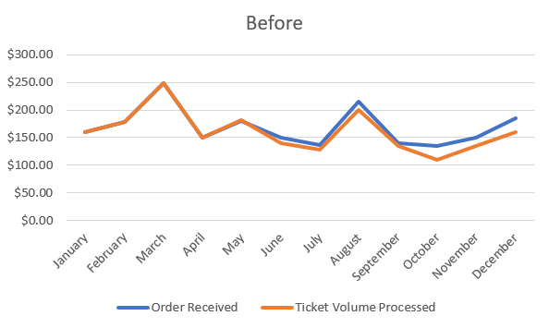
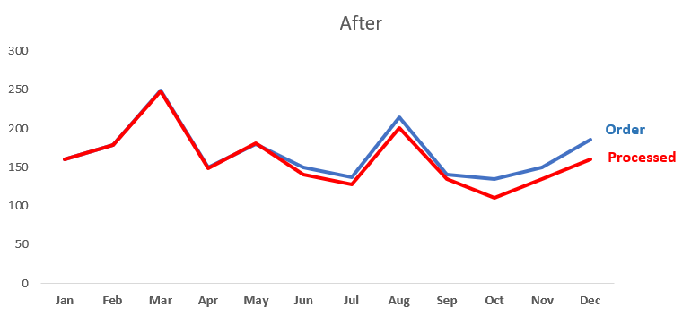
Gestalt: Before & After
Before Applying Gestalt Principles
After Applying Gestalt Principles
Look at this ‘before’ chart. What do you find distracting?
Notice the legend is no longer needed since the label is at the end of the line. It also has shortened abbreviation for the months since an angled title is distracting.

Slide 8
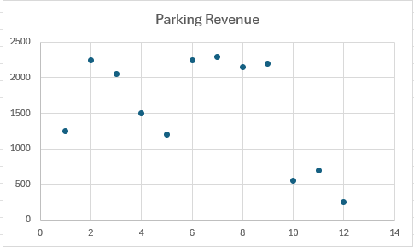
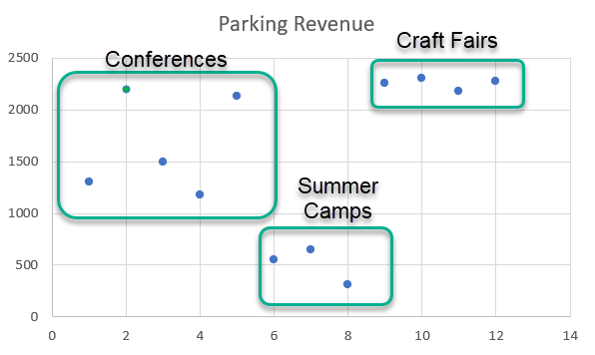
Gestalt: Before & After
Before Applying Gestalt Principles
Adding closure to a chart
Without closure we would not know which type of parking revenue.
This requires a few extra steps, but it clears up the revenue type.

Slide 9

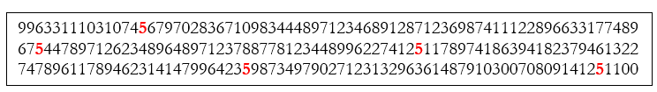
2. Iconic Memory
Attentive Processing – How many 5’s?
Preattentive Attribute Processing – How many 5’s?
Attentive Processing – How many 5’s?
Notice how your eye is drawn to the numbers in red!
Knaflic says it best, “If we use preattentive attributes strategically, they can help us enable our audience to see what we want them to see before they even know they’re seeing it” (Knaflic, 2015, p. 99).
.

Slide 10
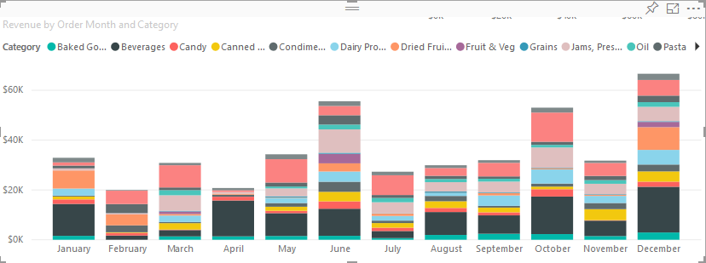
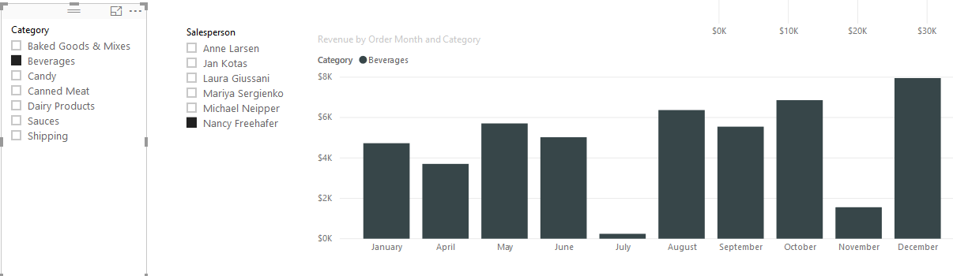
Short-term Memory
Two many Chunks for an Audience to Process
Use Slicers to reduce the number of
chunks of information
Attentive Processing – How many 5’s?
Audiences can normally retain four chunks of information. Squire et al. (2015) who posits, “short-term memory can become a long-term memory through repetition” (para 14).
The slicer is by category and salesperson. In this case the salesperson is Nancy, and the category is Beverages.
.

Slide 11
Example Trigger Phrase
Synergizing for Success
Report, Inform, Explain, Announce
Short-term Memory: Strategies
How can we seamlessly integrate and emphasize this trigger throughout a presentation?
Emphasizing for repetition: “Profitability isn’t just about the product; it’s about how we synergize as a team for success.”
Analogical Variation: “Think of it as a winning sports team. Each player contributes uniquely, but it’s the synergy, the “Synergizing for Success” that leads to victory.”
Illustration: “Consider our recent product launch. The numbers speak for themselves, highlighting the direct impact of Synergizing for Success on our profit margins.”
Audience Engagement: “Pause and reflect on your own experiences. When have you witnessed the power of teamwork contributing to success? That is the essence of ‘Synergizing for Success’”.
01 - Emphasizing
02- Analogical Variation
03- Illustration
04- Audience Engagement
Notes:
By weaving the trigger phrase into various aspects of the presentation, the CEO reinforces the importance of teamwork in product profitability and engages the audience in a way that enhances comprehension and retention. These repetitions would be paired with specific data visualizations for a cohesive and impactful delivery.

Slide 12






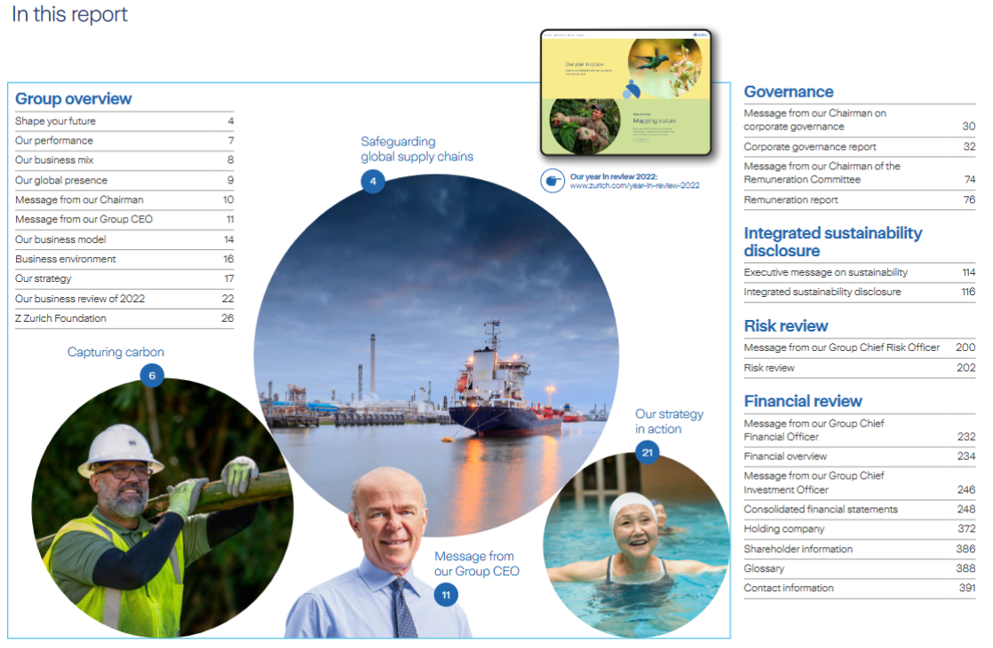
Report, Inform, Explain, Announce
3. Annual Reports Contain
01 –Letter from Chief Executive
02 – Investor Relations Section
03- Financial Information (10-K)
04- Performance Measures
05- Management Discussion and Analysis Reports (MD&A)
06- ESG Reports.
Zurich 2022 Annual Report
Source: Zurich Ins Website. https://www.zurich.com/investor-relations
Notes:
Zurich’s 2022 annual report is 392 pages long and full of images.

Slide 13
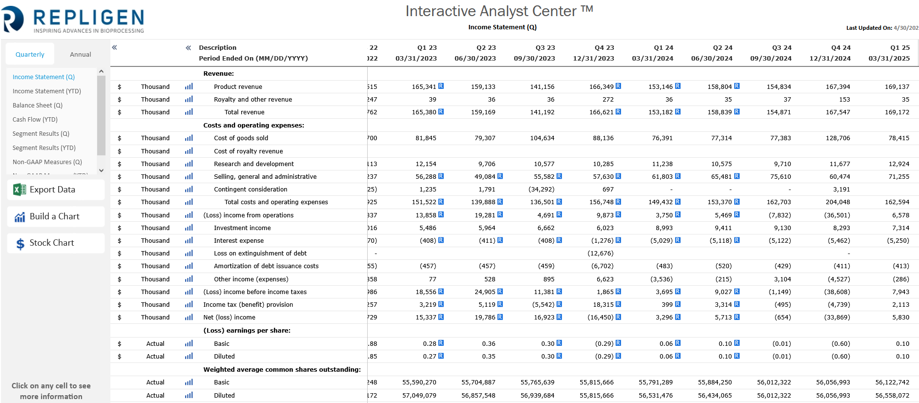
Repligen – Interactive Repligen https://vbench.virtuaresearch.com/IR/IAC/?Ticker=RGEN&Exchange=NASDAQGS
Report, Inform, Explain, Announce
3. Interactive Annual Reports

Slide 14




3. Non-profit Annual Report Contains
Report, Inform, Explain, Announce
  letter from executive/leader 1 page
  mission and metrics 2-4 pages
  program overview 4 + pages
  impact story 2 pages
  Financials 2 pages
  Testimonial 1+ pages
  Leadership 1-2 pages
  Recognition of donors 1-6 pages
  Looking forward to 1 page
https://www.philabundance.org/wp-content/uploads/2024/05/PhilabundanceAR2023_5_10_2024.pdf
Notes:
Take time to review the last few years of Philabundance’s annual impact reports. They have really changed!

Slide 15
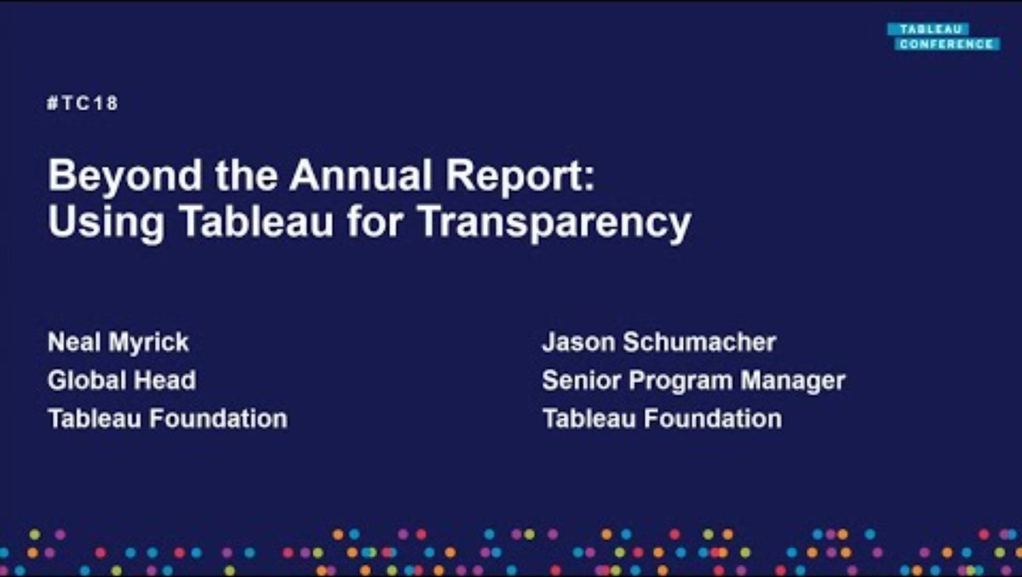
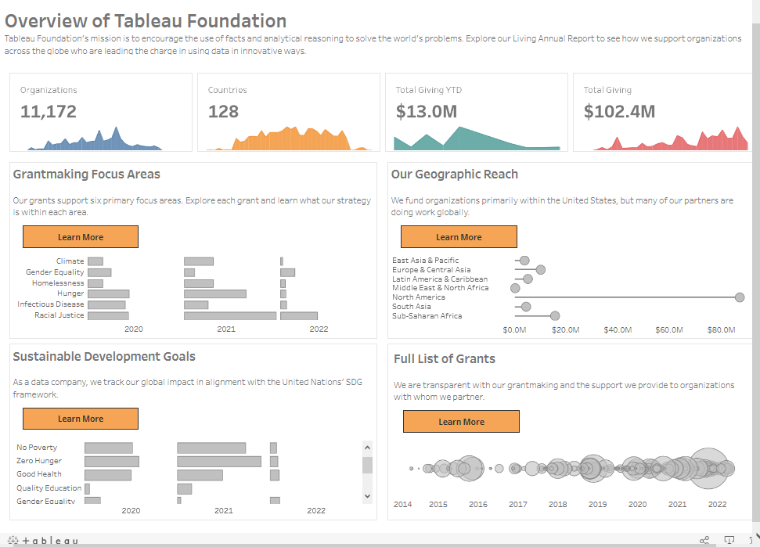
4. Technology Available for Annual Reports
Tableau Foundation
A ‘Living’ Annual Report
Tableau Foundation. (2019). Tableau Foundation: Moving beyond the annual report. [Video]. YouTube. https://youtu.be/JXU-6SE6Xbs?si=hCITT_gY6bSLDPUQ
Tableau Foundation Living Annual Report. Link: https://www.tableau.com/data-insights/dashboard-showcase/tableau-foundation-annual-report
Notes:
Tableau Foundation supports a living annual report and nonprofits can get Tableau free.

Slide 16
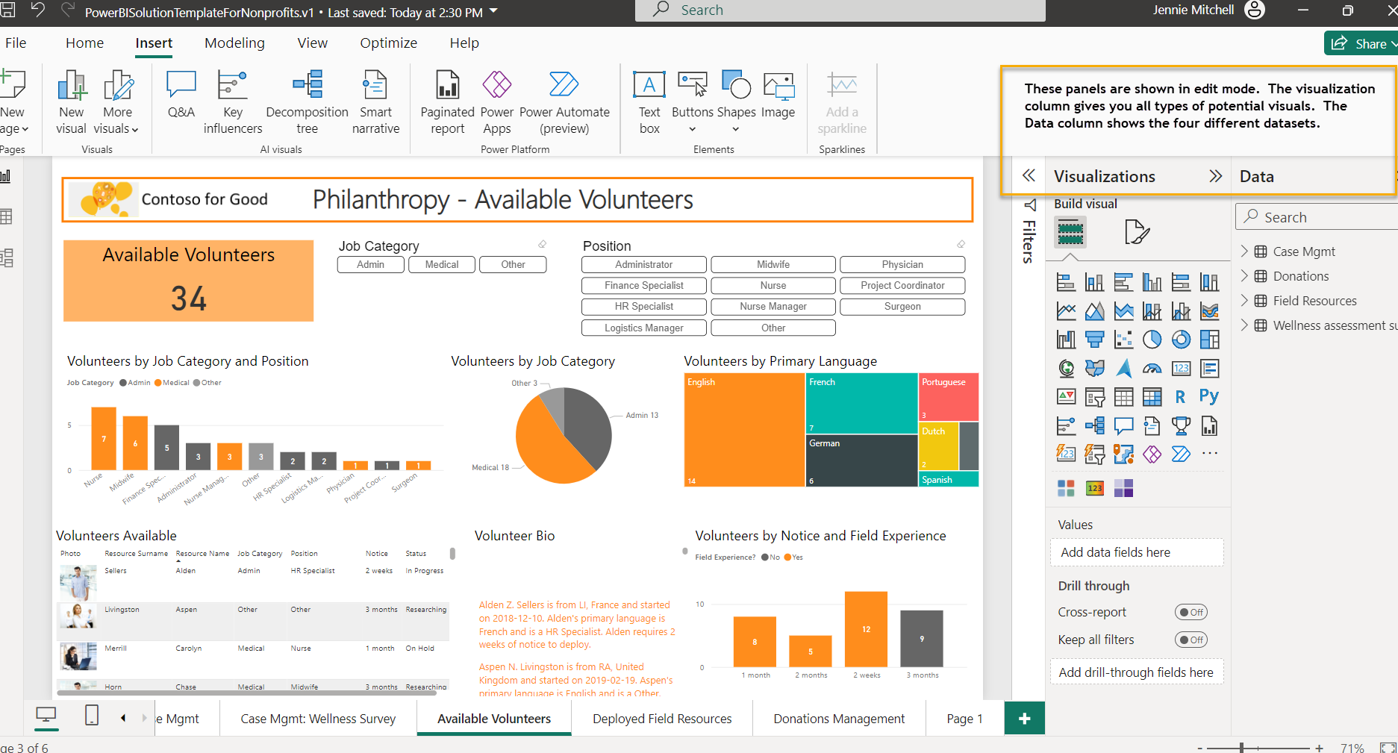
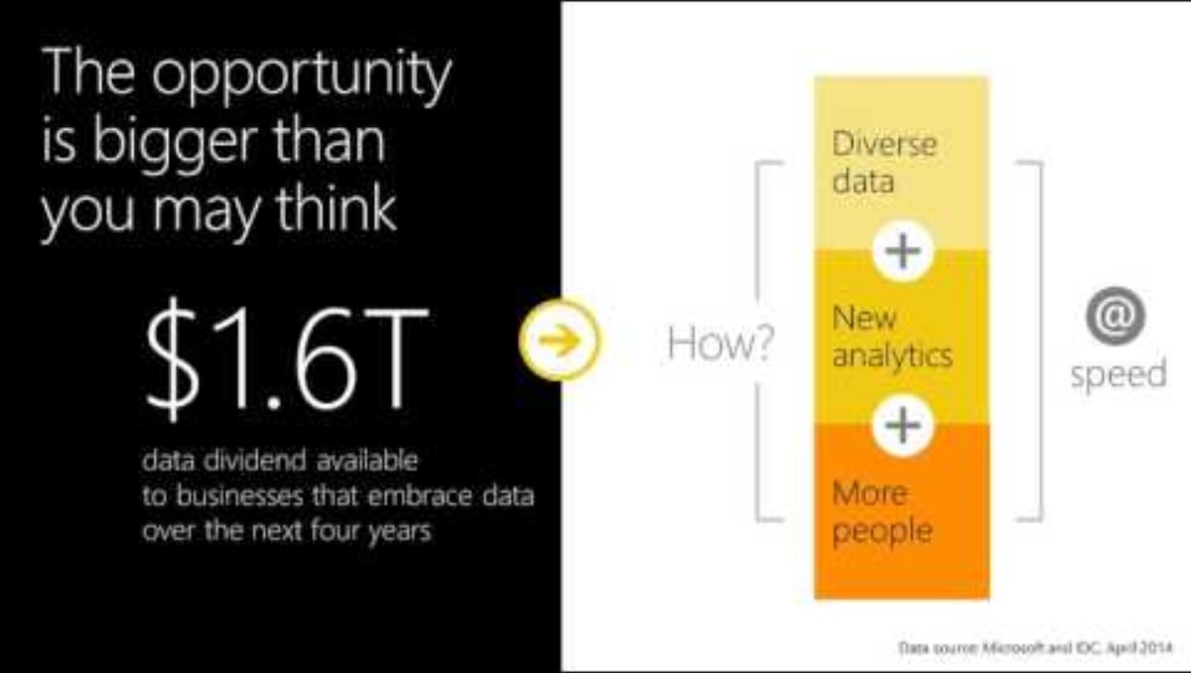
4. Living Annual Report
Power BI for Nonprofits
TechSoup Webinar (nonprofit)
Power BI provides data for a nonprofit, Contoso Cares, so you can get familiar with an example Power BI report.
TechSoup. (2016). Webinar – Bring Your Data to Life with Power BI. [Video]. YouTube. https://www.youtube.com/watch?v=VUJc6kfYu2I

Slide 17
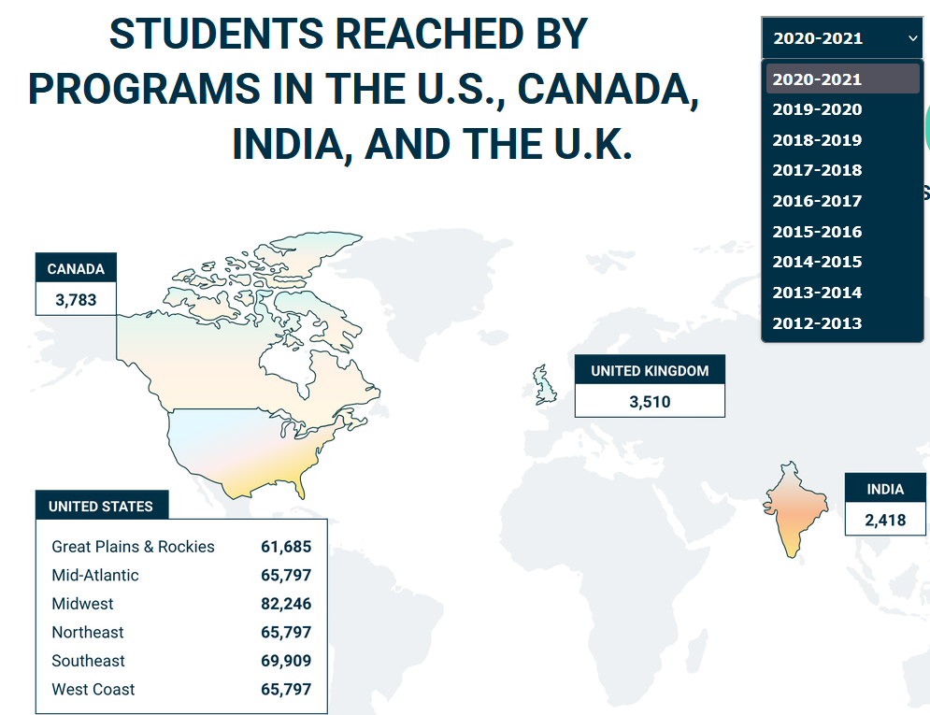
4. Animated Annual Report
Report, Inform, Explain, Announce
Some not-for-profit organizations are leveraging technology to create online reports that are interactive (as illustrated for Girls Who Code).
Is this the right approach for every organization?
https://girlswhocode.com/2020report/
Notes:
Zurich’s 2022 annual report is 392 pages long and full of images.

Slide 18
4. Flipbook Software
ISSUU
Flipping Book
Instant Flipbook
ISSUU—ISSUU is easy to use, full-featured, and the purchased version allows the ability to remove ads and customize embedment. It is a hosted web service from $0 to $299/month. ISSUU has Canva and InDesign integration.
Sample Use of ISSUU:
2022 UNICEF: https://www.unicef.org/reports/unicef-annual-report-2022
Flipping Book—Flipping Book creates HTML5 interactive documents that can be hosted on your own platform from $44 to $179/month.
Sample Uses Flipping Book:
Multiple examples: https://flippingbook.com/presentation-examples
Instant Flipbook—Instant Flipbook works for organizations who have technical support. It offers search, videos, and is priced by book: $77 for the first book with standard features, with discounts after one book. At 20 books, the cost is $47 per flipbook.
https://fliphtml5.com/
Somewhat expensive but integrated well with Canva and InDesign.
A good array of features and less expensive.
Flipbook software for nonprofits: https://sourceforge.net/software/flipbook/for-nonprofit
Notes:
Our Brain when listening to a good story
If we add context to the mix, our stories affect the brain, and this is a good thing! In general, good storytelling can do the following (as seen in Figure 4.16 and listed here).
Dopamine: Enhances memory.
Mirroring: Experience similar brain experience as the speaker, we synchronize!
Neural Coupling: Listener turns the story into their own ideas.
Cortex Activity: Lights up more of the brain.
Narrative transport: engage emotionally. And if you engage emotionally, you increase trust, empathy, and generosity.

Slide 19

4. A Video Annual Report
Repair the World – Video Annual Report
Repair the World. (2022). What a year it’s been! 2021-2022 Annual Report Snapshot. [Video]. YouTube. https://www.youtube.com/watch?v=7kqfY8XN4AE

Slide 20
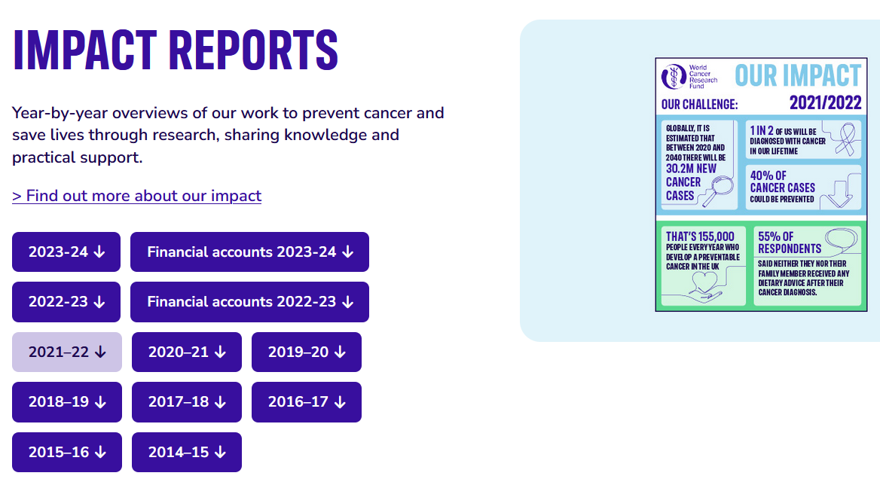
4. Impact Reports
World Cancer Research Fund – Impact Report with infographics
World Cancer Research Fund - https://www.wcrf.org/living-well/health-guides-cookbooks/impact-reports/

Slide 21


Ch 5 Case
The Power of
Annual Reports

Slide 22





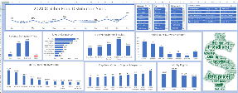
  Step 5
Post the comparison report.
  Step 4
Review annual reports. Use the CASS report.
  Step 3
Comparison Report
Review the 990’s making sure you are using the same years to compare.
  Step 2
Summarize the posted information from charity watchdogs (like Guidestar or Charity Navigator. Also, review website transparency.
Step 1
Learning Objective #3: Analyze and develop annual reports by leveraging the CASS template, Gestalt principles, and best practices.
Explore and compare Terre Haute Symphony Orchestra in Terre Haute, IN to Detroit Symphony Orchestra and one other orchestra of your choice.

Slide 23




Chapter 5
THANK YOU
Jennie Mitchell, Ph.D.
jmitchell@smwc.edu
Saint Mary-of-the-Woods College
Trent Deckard
Trent.deckard@smwc.edu
Saint Mary-of-the-Woods College

