Slide 1


LO#1 – Share strategies to address gender communication.
LO#2 – Identify competing ways to communicate.
LO#3 – Share strategies to address multigenerational issues.
LO#4 – Identify appropriate data visualization techniques.
LO#5 – Affect of poor visualizations on diversity, equity, and inclusion.
LO#6 – Leadership strategies to address burned out teams
LO#7 - Demonstration best communication practices as global leaders
CHAPTER 8
Visualization to Communicate across Gaps
Leveraging Data Visualization to Communicate Effectively
By Jennie Mitchell, Ph.D. Saint Mary-of-the-Woods College
and Trent Deckard, Indiana University

Slide 2

Content
01
Gender Communication Issues
02
Cultural Communication
03
Multi-Generation Communication
04
Design Strategies
05
Diversity, Equity, and Inclusion
06
Leading Remote Teams
07
Leadership in Visualization

Slide 3







1. Gender Communication Issues
Motivation & Conflict:
Male: Motivated by competition, winning, and performance; conflict seen as part of the game.
Female: Motivated by connection and cause; tends to internalize conflict and values harmony.
“I” vs. “We:”
Male: Uses “I” often – self promotion aligns with achievement and status.
Female: Prefers “we” – emphasizes collaboration, community, and courage through transparency.
Nonverbal Cues:
Male: Interrupts more frequently, typically to assert ideas—not personal.
Female: Less likely to interrupt; may feel dismissed when interrupted.
Interruptions:
Male: Interrupts more frequently, typically to assert ideas—not personal.
Female: Less likely to interrupt; may feel dismissed when interrupted.
Defining Problems:
Male: Seeks solutions; sees issues through an outcome lens.
Female: Seeks understanding; focuses on people and shared experiences.

Slide 4
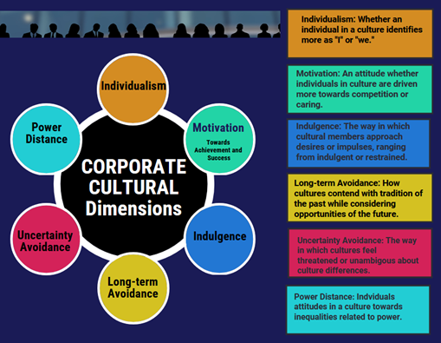
2. Cultural Communication Issues

Slide 5
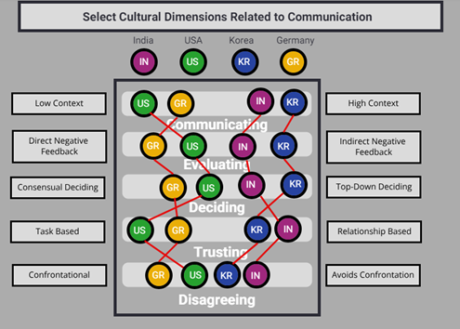
Cultural Differences
Cultural differences do not mean deficiencies; they just mean difference.

Slide 6
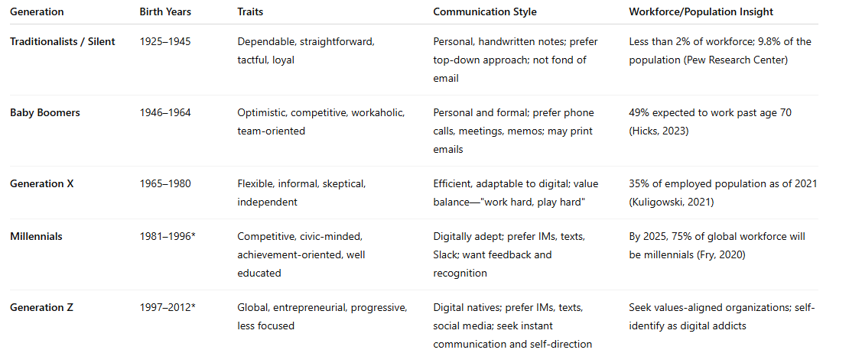
3. Multigeneration Cultural Issues

Slide 7
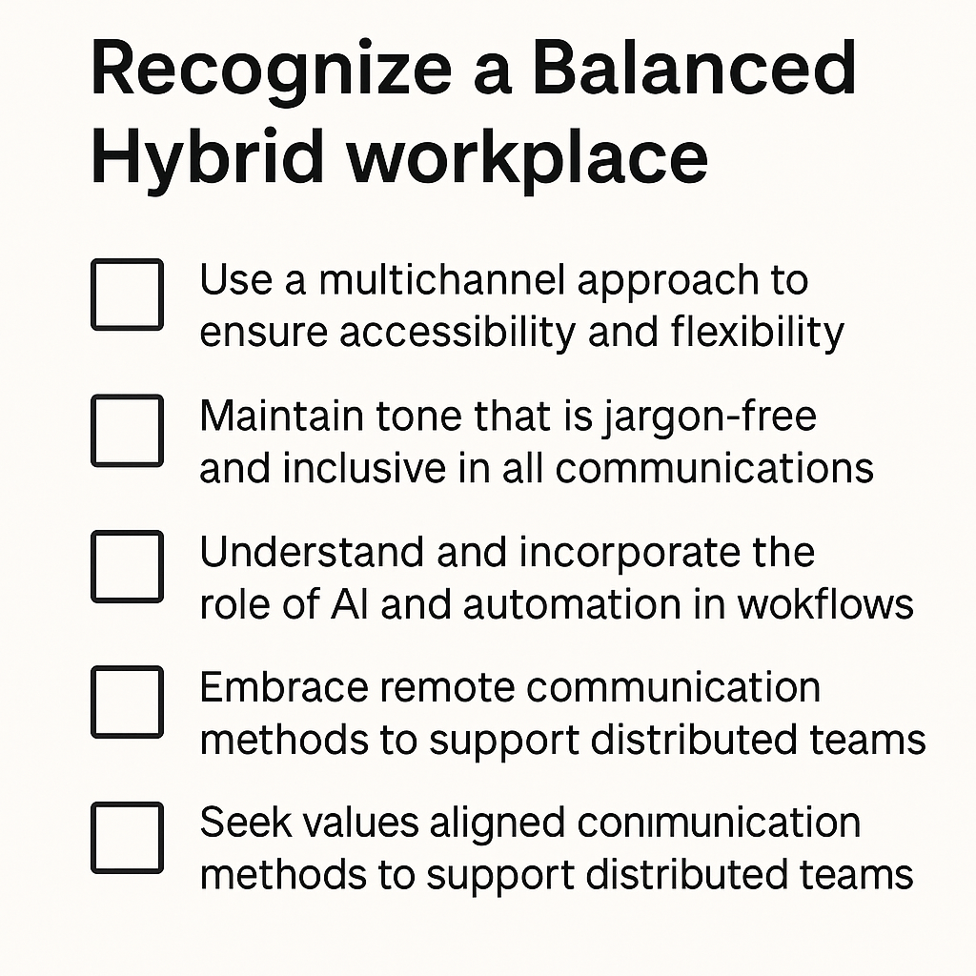
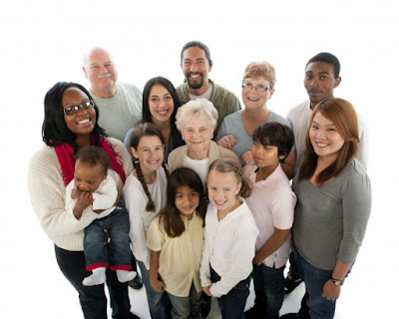
Strategies across the Generations

Slide 8



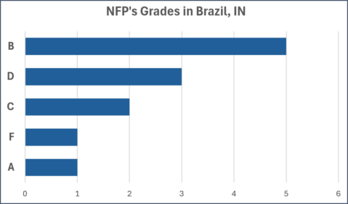

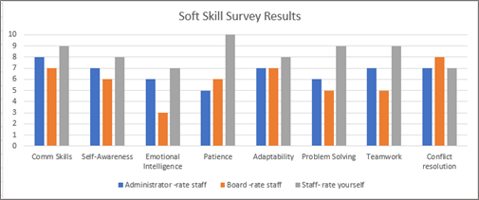
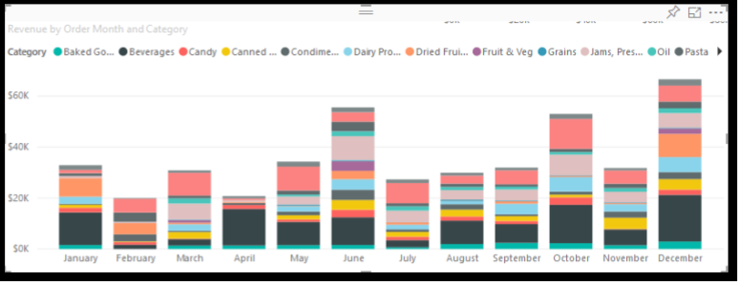
4. Design Strategies across Generations
These strategies are based on working with diverse teams and audiences:
PechaKucha: Plan a beginning, middle, and end in 7 minutes
2. Get to the point!
3. Use the appropriate data visualizations
.

Slide 9


5. Consider for DEI, Uncover Biases
Ageism: Making assumptions about another age or generation
2. Affinity Bias: Going with what you know (such as with hiring), based
on that being most like you.
3. Weight Bias: Discriminating based on an individual’s weight, instead of actual talents.
4. Ableism: Discrimination in favor of able-bodied people.
.

Slide 10

6. Ways to Address Remote Burnout
These strategies are based on working with remote teams:
Help your team find meaning, purpose, and connection
Build trust
Professional development: Skills for effective communication
Collaboration and accountability
Overcome Zoom fatigue
Utilize strong visualization techniques on Zoom
.

Slide 11
7. Leadership and Communication Guidelines
Leadership is responsible for setting the vision and goals for the data visualization project.
Leaders deal with resource allocation, including budget, time, and personnel.
Leadership coordinates the efforts of authors, data analysts, designers, and domain experts.
Leaders engage with audiences across the organization, like executives, managers, and end-users.
Leadership work with risks associated with data quality, technical challenges, or change.
Leaders make informed decisions based on data insights derived from visualizations.
Leadership facilitates change management efforts associated with adopting data-driven decisions.
Leaders ensure the quality and accuracy of visualizations with standards, reviews, and guidance.
Leadership fosters a culture of continuous improvement and flexibility.

Slide 12
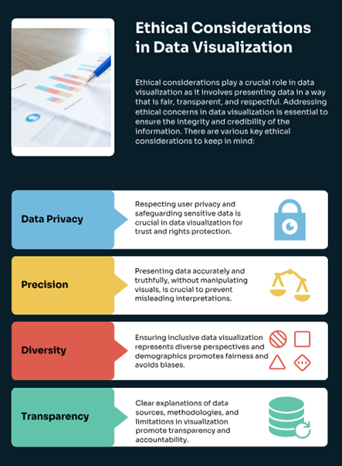

Ethical Considerations

Slide 13
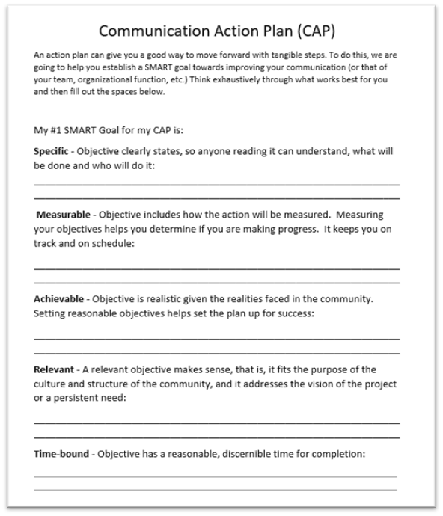
Communication Action Plans (CAPs)
Using SMART Goals, you can change the communication of you or your team on a wide-range of items important to your success, such as data visualization

Slide 14


Ch 8 Case
Cross-Cultural Leadership and Communication Case

Slide 15





  Step 4
Present your findings via strong data visualizations and a strong narrative.
  Step 3
Making a Communication Strategy
Suggest a formal policy/protocol in this specific case. Make it clear, evaluate for effectiveness, and plan a compelling case for the solution.
  Step 2
Perform research on profitability of organizations that embrace DEI principles. After analyzing, turn this research into strong data visualizations that make a compelling case.
Step 1
Please visit the step-by-step instructions in text for more detail.
Identify the problem in the case. Visit Our World in Data to research “trust” and the Hofstede Country Comparison Tool to determine cultural dimensions.

Slide 16




Chapter 8
THANK YOU
Jennie Mitchell, Ph.D.
jmitchell@smwc.edu
Saint Mary-of-the-Woods College
Trent Deckard
Trent.deckard@smwc.edu
Saint Mary-of-the-Woods College

